Slide 1
CSI & TSI Supports and Interventions
Alaska Department of Education & Early Development
Bob Williams & Brad Billings
April 26, 2018

Slide 2


Slide 3


Slide 4



Slide 5



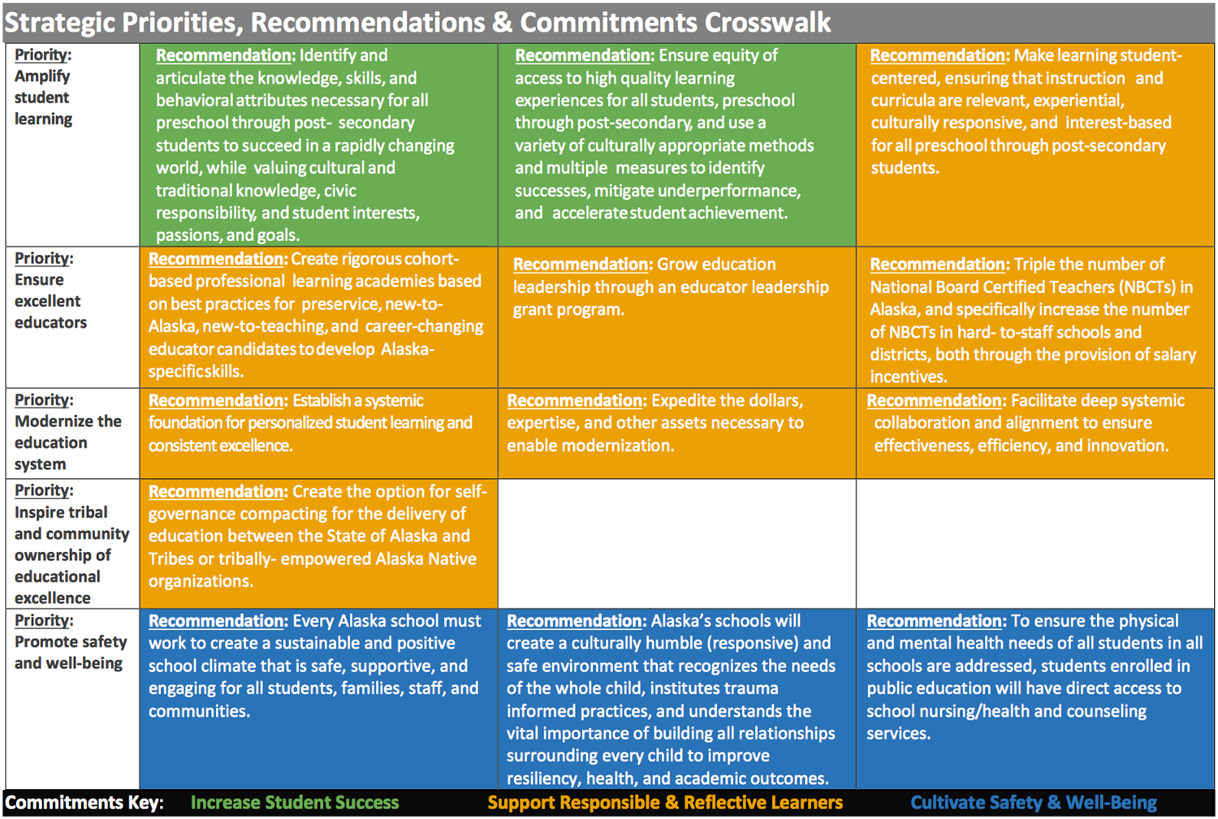
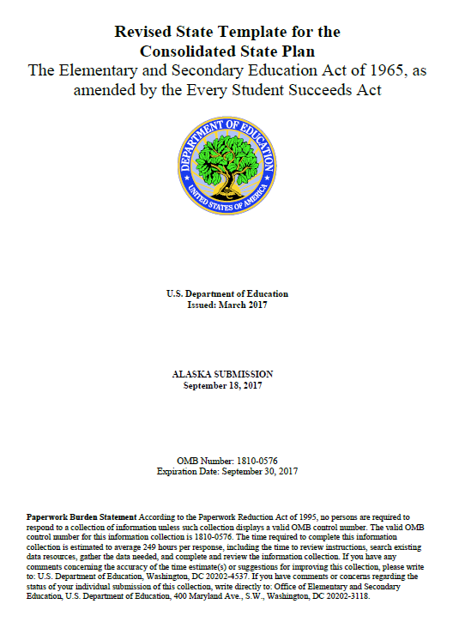
A Shared Vision

Slide 6
In the room?
District Administrators
Principals
Teachers
Paraprofessionals (ESPs)
NGO/Advocacy Stakeholders
Others?

Slide 7
Research tells us…
  the single most important factor in a student’s academic success is the quality of the teacher
  the second most important factor in a student’s academic success is the quality of the instructional leader (principal)

Slide 8
Key Questions
What does ESSA require?
How has Alaska responded?
Moving forward, how can Alaska leverage ESSA to meet our three commitments?
Notes:
Now that we know a little about the Alaska Education Challenge, who we are referring to when we say educator, and little about the research, let’s dive into our key questions…

Slide 9
What does ESSA require?

Slide 10

What does ESSA require?
Designation of CSI Schools
Designation of TSI Schools
All Schools Eligible for TSI or CSI Designation
CSI Designation Due to Low Graduation Rate
School Improvement Planning
Evidence-Based Interventions
Notes:
ESSA Current Authorization of ESEA
NCLB replaced - “Highly Qualified” eliminated

Slide 11

What do you know?
What do you wonder about?

Slide 12

Designation of CSI Schools
Designation of TSI Schools
All Schools Eligible for TSI or CSI Designation
CSI Designation Due to Low Graduation Rate
School Improvement Planning
Evidence-Based Interventions
Notes:
ESSA Current Authorization of ESEA
NCLB replaced - “Highly Qualified” eliminated

Slide 13
How have we responded?

Slide 14
Three Ways to be Designated a Comprehensive Support and Improvement School
Lowest 5% of Title I schools
Graduation rate < 66 2/3 %
3 Consecutive Years of a TSI Designation for the Same Subgroup

Slide 15
Nine Ways to be Designated a Targeted Support and Improvement School
At least one of the nine possible Subgroups in the School Performs within the Range of the Lowest 5% Designated CSI Schools

Slide 16
Subgroups
English Learners
Students with Disabilities
Economically Disadvantaged Students
African Americans
Alaska Natives or American Indians
Students of Two or More Races
Asians or Pacific Islanders
Hispanics
Whites

Slide 17
Small School Performance Review
Schools not eligible to receive score must be considered for CSI and TSI designation
Considerations:
Achievement of school’s students
Consideration of unique student population
Implementation of effective instructional strategies
Consultation with district leadership

Slide 18
Continuous School
Improvement Process
Local Needs Assessment
School improvement plan -> ACTION
Evidence-based interventions
Consideration of impact
Financial resource review

Slide 19
School Improvement Support
Evidence-based non-negotiables for struggling schools
…balanced with…
Flexibility to determine evidence-based interventions locally

Slide 20
Under Consideration
Serving schools with school improvement funds:
  School/District level team engagement in planning process
  Mentoring for new teachers
  Strengthening math instruction
  Support of local School Improvement Plan priorities
  Supporting National Board Certification for Teachers with 3 or more years of teaching experience
Transition timeline(s) for designation and use of resources…

Slide 21
Under Consideration
  Local planning process
  Mentoring for new teachers
  Strengthening math instruction
  Support of improvement plan priorities
  National Board Certification for teachers

Slide 22
Feedback Activity
What, Who, How to support districts in leading support of TSI schools?
What, Who, How to support schools as they intervene with low performing student groups?

Slide 23
Contact Information
Bob Williams, Division Director-Educator and School Excellence
465-2857
bob.williams@alaska.gov
Brad Billings, Administrator, School Improvement
465-8720
brad.billings@alaska.gov

