Slide 1
Supporting School Excellence through ESSA Reporting
Alaska Department of Education & Early Development
Margaret MacKinnon, Federal Program Coordinator
Sondra Meredith, Administrator Educator Education & Certification
April 26, 2018

Slide 2
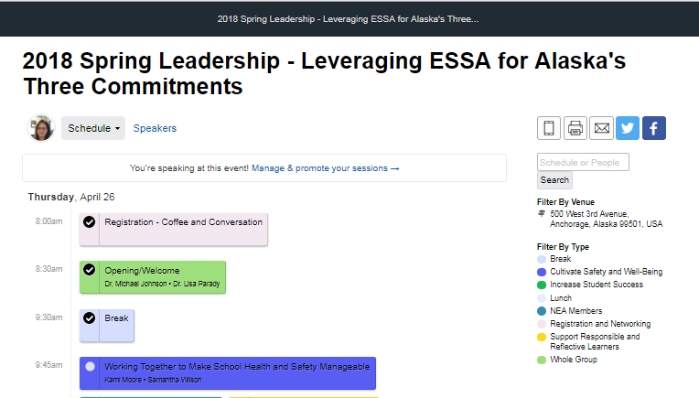
Presentation Materials
https://2018springlead.sched.com/

Slide 6
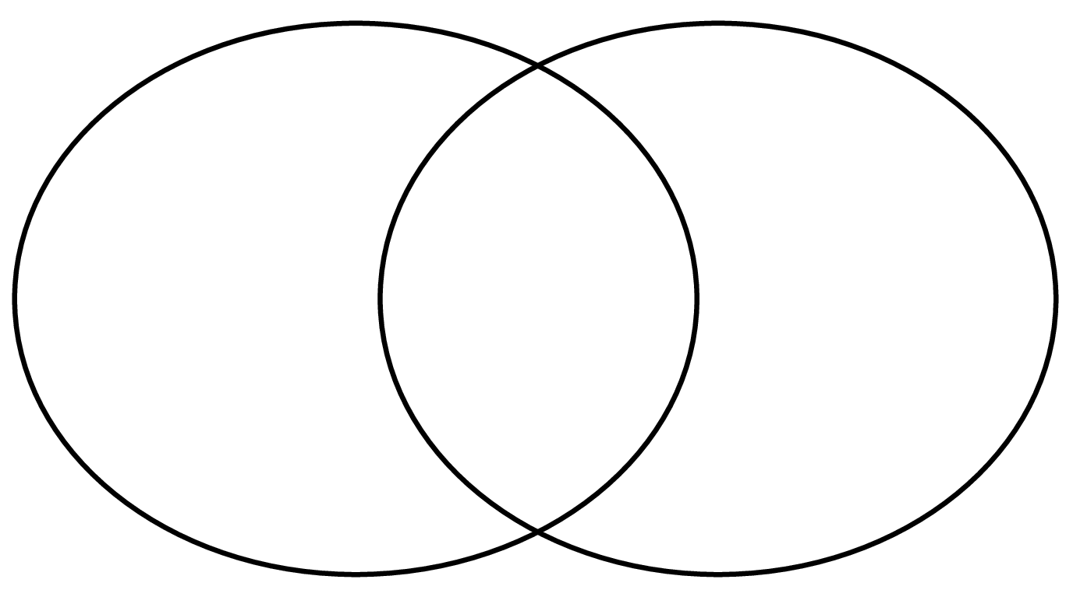
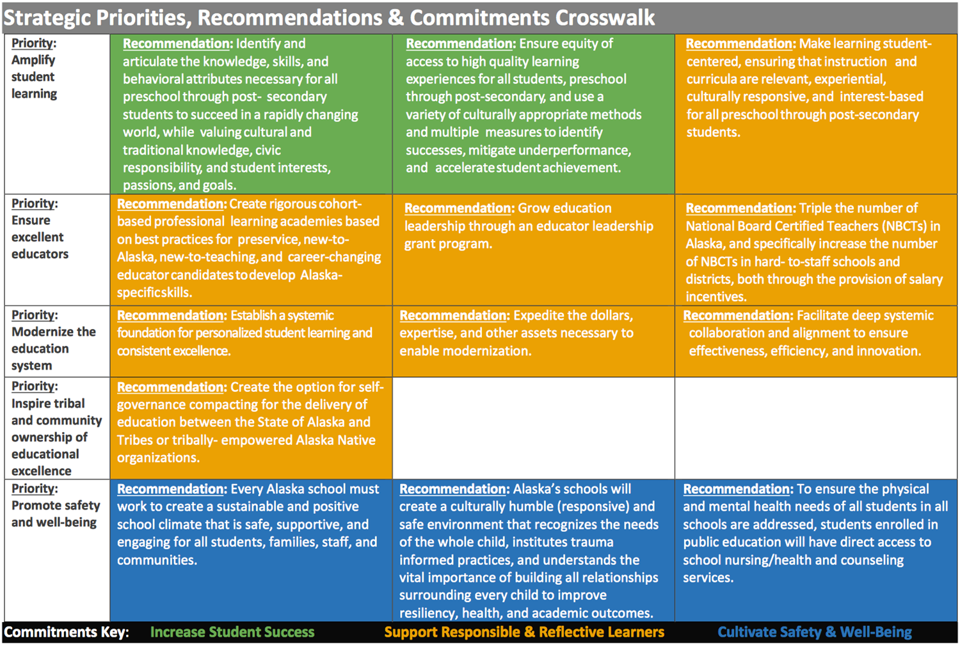
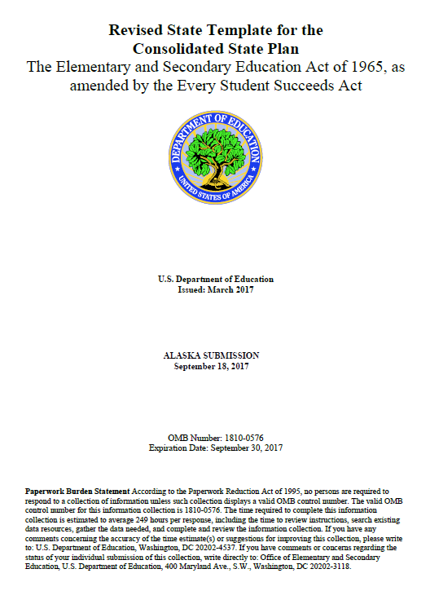
A Shared Vision

Slide 7
Purpose
Through ESSA reporting requirements and more, Alaska wants to…
Inspire communities to want great schools
Increase transparency
Identify areas for improvement

Slide 8
Reporting Questions
What is Alaska required to do?
ESSA Requirements
State law
What have we already done?
DEED’s Response
What more could we do?
Moving Beyond ESSA to the Three Commitments

Slide 9
What is Alaska required to do?
ESSA says…
Accountability
Overall score and designation for each school
Performance on all indicators
Progress toward long-term goals and measures of interim progress

Slide 10
What is Alaska required to do?
ESSA says…
All students and all subgroups
Economically disadvantaged, students with disabilities, English learners, state’s major racial and ethnic groups
Some information reported by gender, migrant status, students experiencing homelessness, students in foster care, with a parent on active duty in Armed Forces

Slide 11
What is Alaska required to do?
ESSA says…
Other information
Postsecondary enrollment of graduates
Teacher qualifications and equity
NAEP results
Per-pupil expenditures for each district and school
Civil Rights Data collection (school climate, safety, expulsions & suspensions, chronic absenteeism)
Enrollment in Pre-K
Enrollment in accelerated courses
Any other information state wishes to provide
May include CTE proficiencies

Slide 12
What is Alaska required to do?
State law requires…
School accreditation
Student, parent, business and community involvement:
# and % of responses to teacher surveys
Number of partnerships with businesses or other agencies
Average number of volunteer-hours a week
Narrative of parent, community, or business involvement
Any other information school wishes to provide

Slide 13
Leveraging ESSA reporting
How can each reporting element support the three commitments and the thirteen recommendations?
Notes:
Three commitment with thirteen recommendations—use the three commitments to categorize the Alaska’s current reported data.
Table groups.
For each participant
Need list of required data elements of report card
Thirteen recommendations and three commitments
For each table group:
Post-it notes
Graphic organizer

Slide 14
What have we already done?
DEED’s response…
Redesigned Data Center
Formed internal team and developed timeline
Adopted design principles for New Online Reporting System
Consulting with external experts
Stakeholder outreach

Slide 15
DEED’s Data Center

Slide 16
DEED’s Data Center

Slide 17
Design Principles for Online Reporting System
Community & Family Focused
Maintaining current look and feel
Accessibility
Provide deeper dive options
Allow for data download

Slide 18
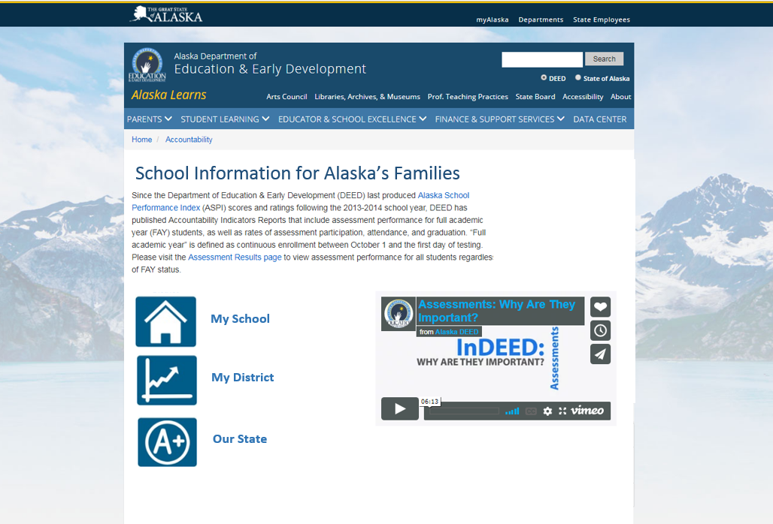
Opening page possibility (with purpose statement and video)

Slide 19
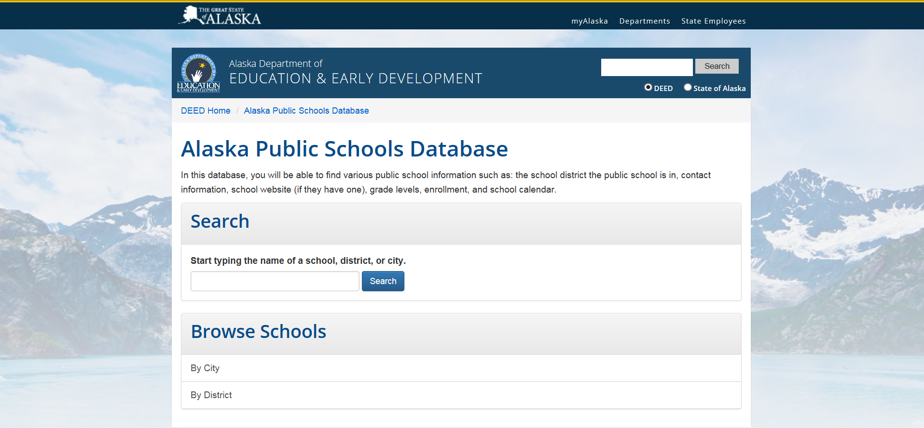
Easy Look-ups
https://education.alaska.gov/DOE_Rolodex/SchoolCalendar/
Find my School

Slide 20
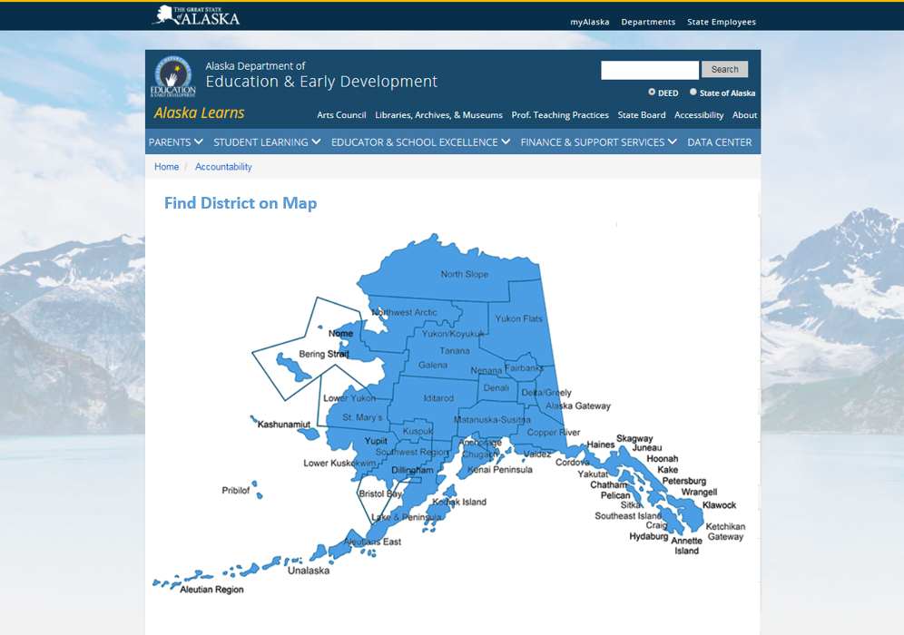
Easy Look-ups
https://education.alaska.gov/DOE_Rolodex/DistrictProfiles2000/DistrictProfilesSearch.cfm

Slide 21
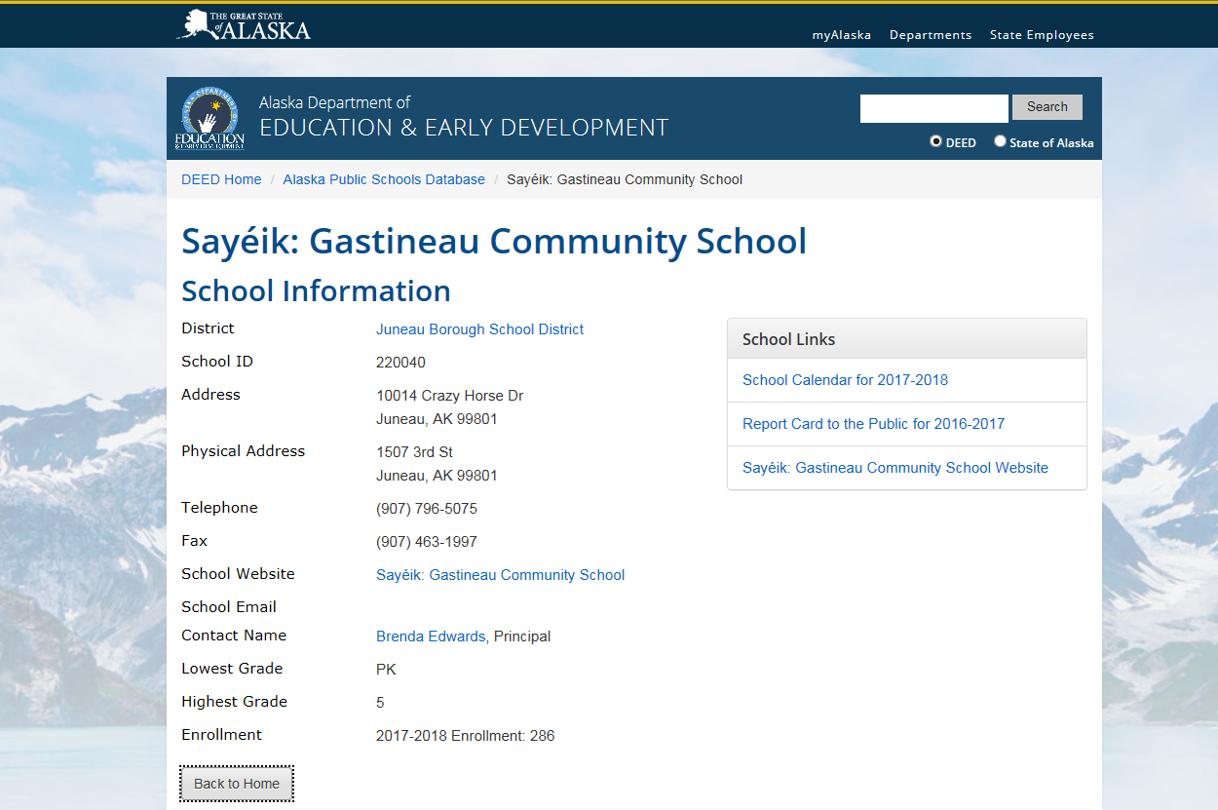
Current School Information Page
https://education.alaska.gov/DOE_Rolodex/SchoolCalendar/Home/SchoolDetails/220040

Slide 22
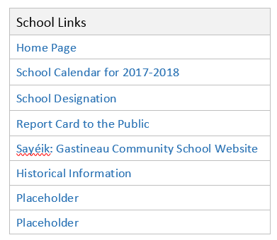
Possible Expanded School Information Page

Slide 23
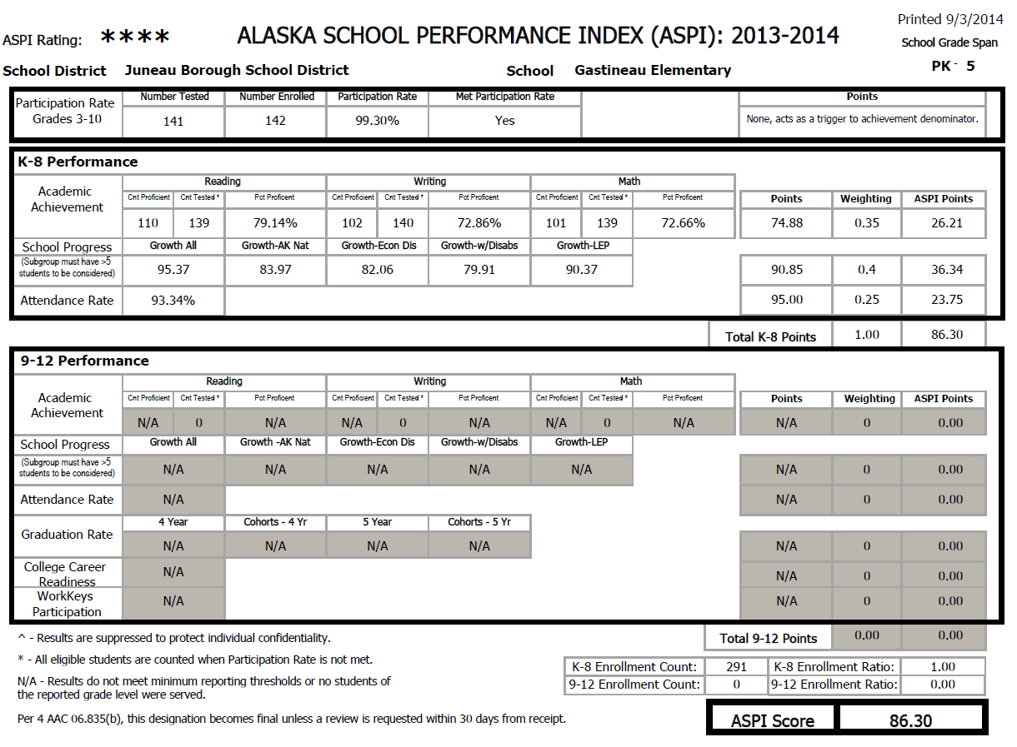
Previous (Not Very Accessible)
Accountability Report with ASPI
Notes:
Example of how the accountability information was most recently provided.

Slide 24
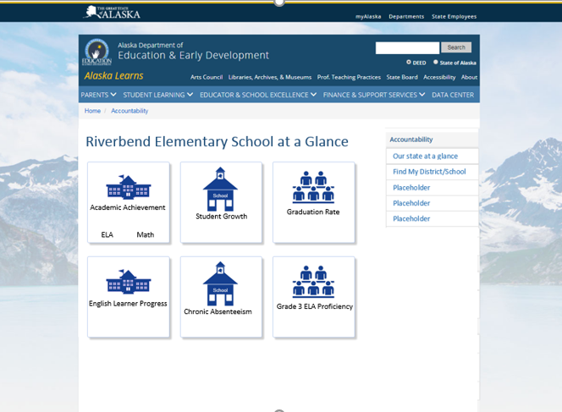
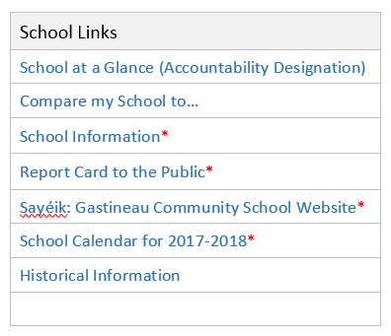
School at a Glance (Accountability Information and Designation)
School Designation
XXXXXXXXXXXXXX
Total Score
XX.XX
How is this calculated?
Notes:
Example of how the accountability information might be provided in the future.
As a parent digs into this information, do you think they would be most interested in seeing first, second, third? A single year of data, multiple years of data (showing trend information), data comparing the school to its district, or data comparing the school to the state?

Slide 25
School at a Glance (Accountability Information and Designation)
Notes:
Example of how the accountability information might be provided in the future.
As a parent digs into this information, do you think they would be most interested in seeing first, second, third? A single year of data, multiple years of data (showing trend information), data comparing the school to its district, or data comparing the school to the state?

Slide 26
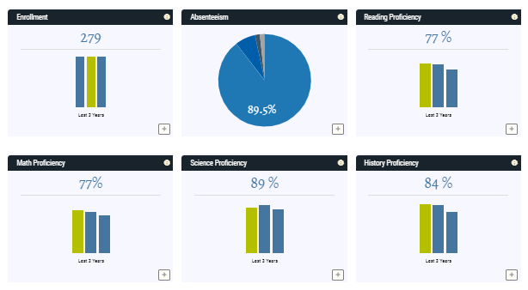
School at a Glance (Accountability Information and Designation)
School Designation
XXXXXXXXXXXXXX
Total Score
XX.XX
How is this calculated?
Notes:
Example of how the accountability information might be provided in the future.
As a parent digs into this information, do you think they would be most interested in seeing first, second, third? A single year of data, multiple years of data (showing trend information), data comparing the school to its district, or data comparing the school to the state?

Slide 27
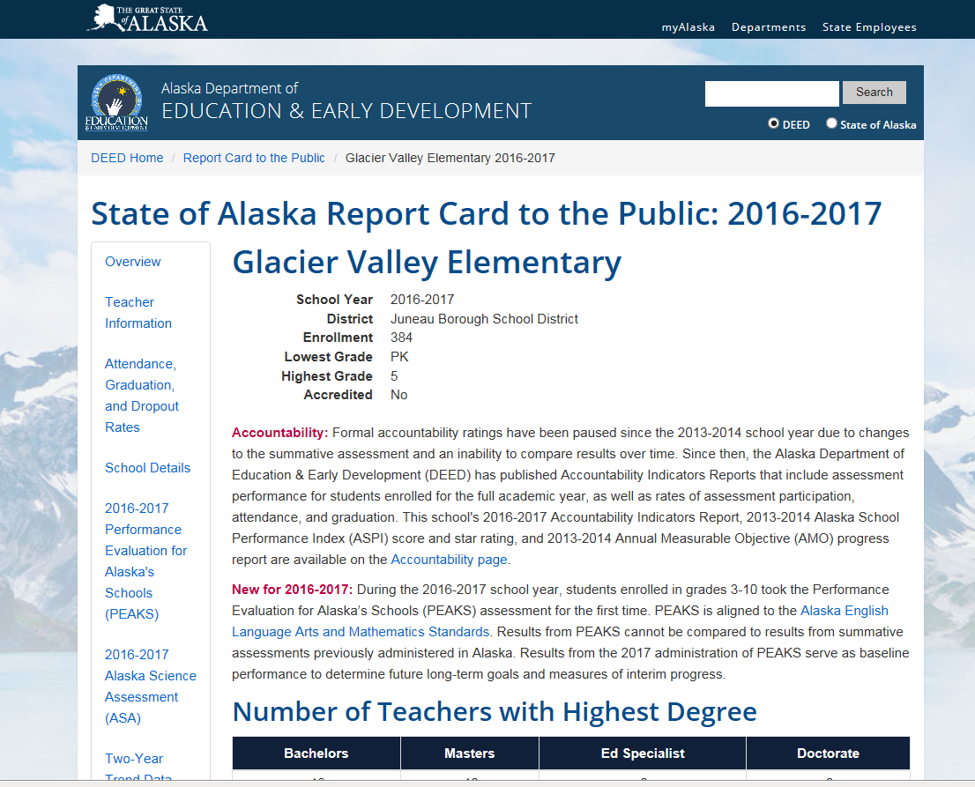
Current School Report Card https://education.alaska.gov/ReportCardToThePublic/

Slide 28
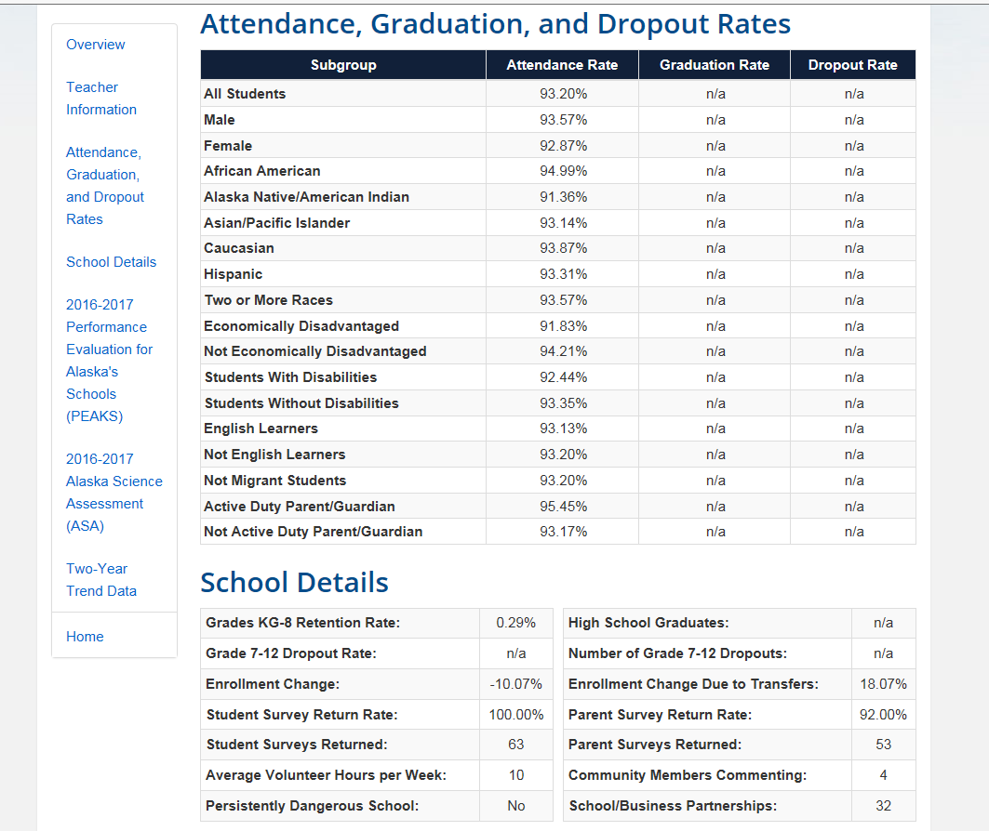
Current School Report Card

Slide 29
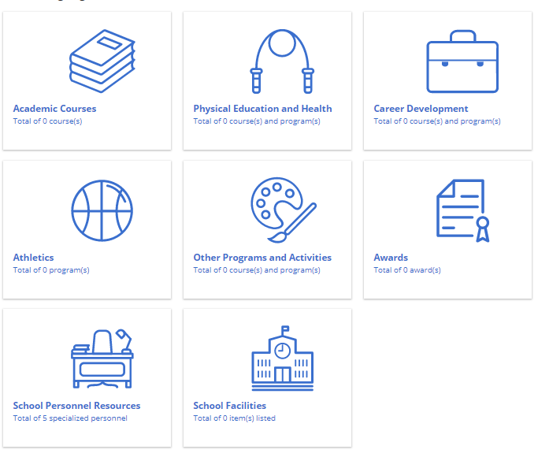
School Report Card
Riverbend Elementary School Report Card
Notes:
As a parent digs into this information, do you think they would be most interested in seeing first, second, third? A single year of data, multiple years of data (showing trend information), data comparing the school to its district, or data comparing the school to the state?

Slide 30
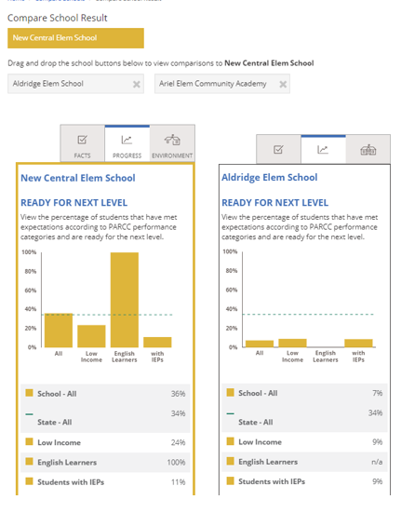
Compare my school…
Notes:
Show example from another state to provide audience visual of this feature.

Slide 31
Ways to display data
Year | Reading | Mathematics
2016 | 25% | 32%
2017 | 27% | 30%
2018 | 30% | 35%

Slide 32
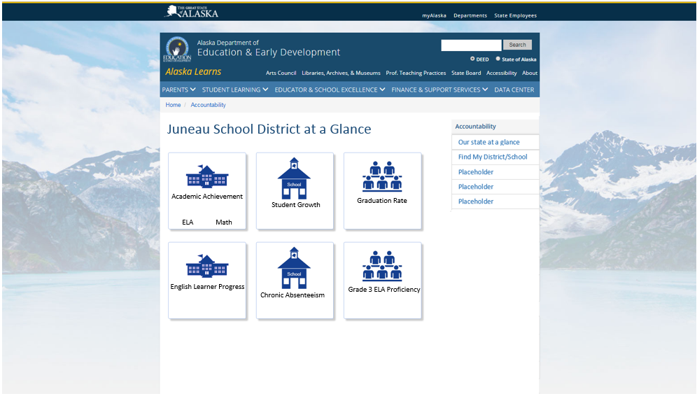
At a glance page: DISTRICT (more information just a click away)

Slide 33
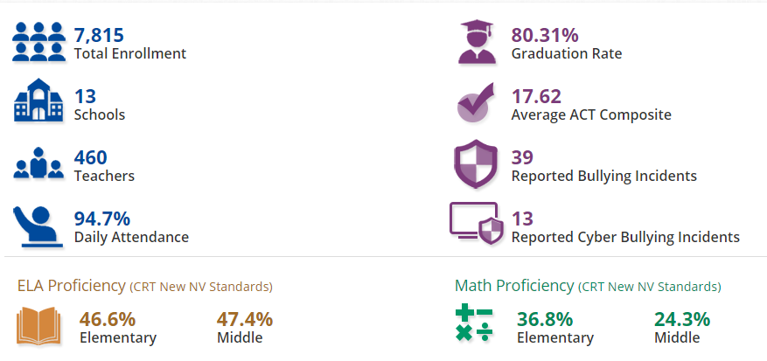
At a glance page: DISTRICT (more information just a click away)

Slide 34
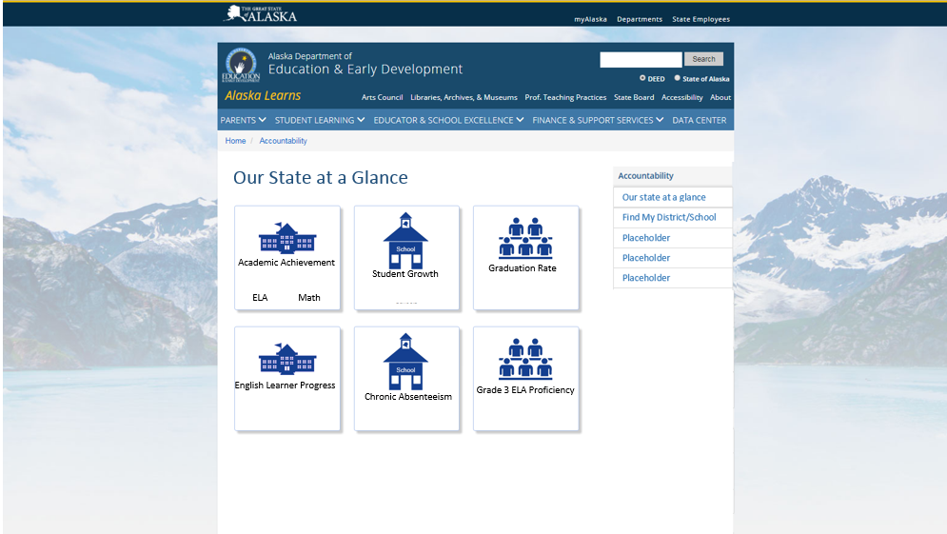
At a glance page: STATE (more information just a click away)

Slide 35
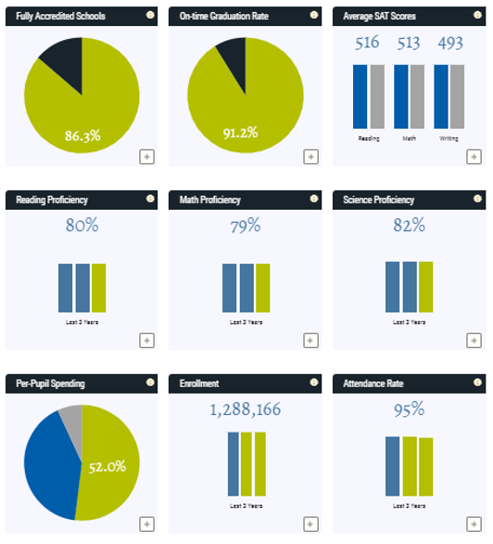
At a glance page: STATE (more information just a click away)

Slide 36
Timeline
Accountability
Full Reporting
Indicators
Long-term goals
School Designations
Participation Rate
By September 1st
All other reporting categories
No later than January 15th

Slide 37
What more should or could Alaska report?
Considering the three commitments and the thirteen recommendations, what other school level data or information should be reported?
Notes:
What additional information should Alaska provide to family and communities to begin the conversation locally about what it means to provide an excellent education to every child every day?
Three commitment—data sort of current reported data and adding data in the three commitment areas. (Reference to recommendations)
Will create survey monkey to gather this information…

Slide 38
Continuing the conversation!
https://www.surveymonkey.com/r/AlaskaSchoolReportCard
You are invited to participate in the Alaska Report Card Design Survey.
Notes:
Use SurveyMonkey to gather information concerning developing design of website, stakeholders who could be consulted, what as users they would like to see, etc.

Slide 39
Contact Information
Sondra Meredith
Administrator, Educator Education & Certification
sondra.meredith@alaska.gov
(907) 465-8663
Margaret MacKinnon
Federal Programs Coordinator
margaret.mackinnon@alaska.gov
(907) 465-2989
Notes:
The presenter’s contact information should be presented on this slide in this format. We encourage including a photo of the presenter to help personalize the presentation.

Slide 40
InDEED: Connect With Us
education.alaska.gov
Teacher Certification: (907) 465-2831
Main Line: (907) 465-2800
@AlaskaDEED on Twitter, Facebook, Instagram, Flickr, and Vimeo
Notes:
Every DEED presentation should end with this slide.

