Slide 1

ESSA School Accountability
2018 Spring Leadership Working Conference
Brian Laurent, Data Management Supervisor
Alaska Department of Education & Early Development
April 26, 2018

Slide 2
About today’s presentation
Goal: Provide a high-level overview of Alaska’s system of school differentiation to be implemented in Fall 2018
Inform, without overwhelming
Please ask clarifying questions
Index cards for detailed questions
  Creation of FAQ document
  Include contact information for questions specific to your school, district, etc.

Slide 3
Timeline
DEED submitted Alaska’s ESSA state plan in September; two resubmissions since then
  February 28, 2018
  April 12, 2018
U.S. Department of Education approval is (hopefully) imminent
Regulations available for public comment
DEED will release first ESSA-aligned accountability scores and designations in Fall 2018

Slide 4
Vocabulary
DLM = Dynamic Learning Maps, the assessment taken by students with the most significant cognitive disabilities
EL = English learner
ELA = English language arts
Full academic year (FAY) = Continuous enrollment at the same school between October 1 and the first day of the general assessment window
Minimum n = The minimum number of students needed for an indicator to count toward a school’s score

Slide 5
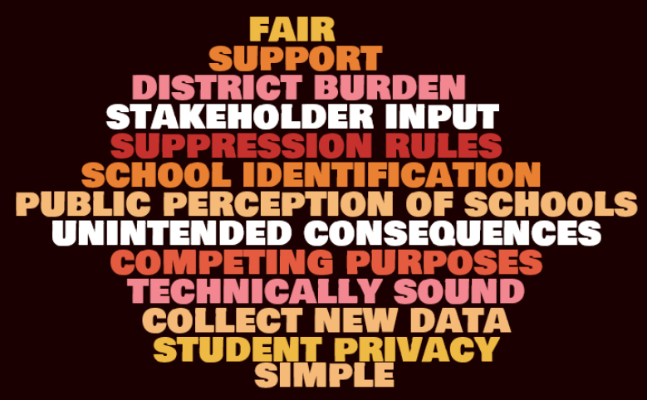

Slide 6
Two parts to school accountability
System of school differentiation
  Indicators
  Weights
  Scores
  Designations
Long-term goals and measures of interim progress
  Academic achievement
  Graduation rate
  English learner (EL) progress toward English language proficiency

Slide 7
System of school differentiation
ESSA-required indicators
Academic achievement
Student growth
Graduation rate
English learner progress toward English language proficiency
School quality/student success indicator(s)

Slide 8
System of school differentiation
Alaska’s ESSA state plan
Academic achievement
Student growth
Graduation rate
English learner progress toward English language proficiency
Chronic absenteeism
Grade 3 ELA proficiency

Slide 9
1. Academic achievement
Applicable to grades 3-9
ELA and Math separately
FAY students only
Percentage of students proficient on assessments
  PEAKS
  DLM
Impact of participation rate
  Denominator must include at least 95 percent of FAY students
  No provision for small schools

Slide 10
Participation example
A school with 100 FAY students enrolled in grades 3-9
ELA
  98 of the 100 FAY students took the assessment
  Academic Achievement = # of Proficient & Advanced FAY students / 98
Math
  90 of the 100 FAY students took the assessment
  Academic Achievement = # of Proficient & Advanced FAY students / 95

Slide 11
2. Student growth
Applicable to grades 4-9
ELA and Math
Improvements to growth indicator to increase clarity and make the data actionable
Percentage of students who met their growth target

Slide 12
New value table
Previous Year | Current Year
 | FBP Low | FBP High | BP Low | BP High | P Low | P High | A Low | A High
FBP Low |  | ✓ | ✓ | ✓ | ✓ | ✓ | ✓ | ✓
FBP High |  |  | ✓ | ✓ | ✓ | ✓ | ✓ | ✓
BP Low |  |  |  | ✓ | ✓ | ✓ | ✓ | ✓
BP High |  |  |  |  | ✓ | ✓ | ✓ | ✓
Note: FBP = Far Below Proficient; BP = Below Proficient; P = Proficient; A = Advanced

Slide 13
New value table
Previous Year | Current Year
 | FBP Low | FBP High | BP Low | BP High | P Low | P High | A Low | A High
P Low |  |  |  |  | ✓ | ✓ | ✓ | ✓
P High |  |  |  |  | ✓ | ✓ | ✓ | ✓
A Low |  |  |  |  |  |  | ✓ | ✓
A High |  |  |  |  |  |  | ✓ | ✓
Note: FBP = Far Below Proficient; BP = Below Proficient; P = Proficient; A = Advanced

Slide 14
New value table
Previous Year | Current Year
 | FBP Low | FBP High | BP Low | BP High | P Low | P High | A Low | A High
FBP Low |  | ✓ | ✓ | ✓ | ✓ | ✓ | ✓ | ✓
FBP High |  |  | ✓ | ✓ | ✓ | ✓ | ✓ | ✓
BP Low |  |  |  | ✓ | ✓ | ✓ | ✓ | ✓
BP High |  |  |  |  | ✓ | ✓ | ✓ | ✓
P Low |  |  |  |  | ✓ | ✓ | ✓ | ✓
P High |  |  |  |  | ✓ | ✓ | ✓ | ✓
A Low |  |  |  |  |  |  | ✓ | ✓
A High |  |  |  |  |  |  | ✓ | ✓
Note: FBP = Far Below Proficient; BP = Below Proficient; P = Proficient; A = Advanced

Slide 15
Student growth eligibility
Student will be eligible to be counted when:
  The student received valid scores in the previous and current years
  The student had natural grade progression
    e.g. 4th grade in previous year, 5th grade in current year
  The student was enrolled for the full academic year in the current year

Slide 16
3. Graduation rate
Applicable to schools that serve grade 12
Two separate calculations
  Percentage of students in four-year cohort who graduated within four years
  Percentage of students in five-year cohort who graduated within five years
Reminder: Cohort assignment based on first-time entry into grade 9

Slide 17
What is ACCESS for ELLs 2.0?
Assessment administered to English learners
Four domains: listening, reading, speaking, and writing
Overall composite proficiency level (CPL)
Proficiency levels between 1.0 and 6.0
New exit criteria
  4.5 overall CPL
  4.0 on listening, reading, and speaking
  3.8 on writing

Slide 18
4. English learner progress
Applicable to grades 1-12
FAY students only
Must have natural grade progression
Percentage of all FAY students who met their growth target on ACCESS for ELLs 2.0
Initial growth target depends on level of proficiency at identification
  Between four and seven years to become proficient

Slide 19
Number of years to exit
Year 0: Initial Overall CPL | Maximum Years to Meet Exit Criteria
1.0 – 1.9 | Year 7
2.0 – 2.9 | Year 6
3.0 – 3.9 | Year 5
4.0 and above | Year 4
Note: DEED will “reset” the number or years to meet the exit criteria. The baseline will be 2016.

Slide 20
Example
Year 0 overall CPL = 1.0
Using table, student has seven additional years to reach overall CPL of 4.5
(4.5 – 1.0) / 7 years = 3.5 / 7 = 0.5
Year 1 target = 1.0 + 0.5 = 1.5 overall CPL

Slide 21
5. Chronic absenteeism
Definition: A student who missed at least 10 percent of the days in which they were enrolled in the school
Applicable to grades K-12
Includes all students enrolled at least half of year
Points based on percentage of students who were not chronically absent

Slide 22
6. Grade 3 ELA proficiency
Applicable to grade 3 only
FAY students only
Percentage of Grade 3 students proficient on ELA
  PEAKS
  DLM
Denominator must include at least 95 percent of FAY students (like Academic Achievement)

Slide 23
Postponed indicators
Participation on district-administered interim assessments
  Question about differentiation of schools
  No data yet
Eligibility for Alaska Performance Scholarship (APS)
  Question about applying to all students
  Effect of no college/career-ready assessment
Grade 9 on track for on-time graduation
  No data yet

Slide 24
Calculating a score
Minimum n = 10
  Indicators with at least 10 students count toward a school’s score
  Indicators with fewer than 10 students do not count toward a school’s score
Indicators with fewer than 10 students do not count against a school
Schools that meet the minimum n in at least two indicators, one of which must be an academic indicator, will receive a score between 0 and 100
Scores cannot be compared to ASPI!

Slide 25
Data aggregation
Aggregating (i.e. combining) multiple years of data when the minimum n is not reached
Stakeholder feedback was positive on this topic
Will aggregate up to three years of available data (including current year)
Limited data initially for aggregation
  Academic achievement
  Student growth
  EL progress
  Chronic absenteeism

Slide 26
Indicator weights: K-6

Slide 27
Indicator weights: 7-12

Slide 28
Enrollment ratio example
Grade Span | Index Points Earned | Enrollment on October 1 | % of Overall Enrollment on October 1 | Weighted Points
K-6 | 75.00 | 500 | 66.67% | 50.00
7-12 | 60.00 | 250 | 33.33% | 20.00
Total for School | -- | 750 | -- | 70.00

Slide 29
Shift to K-6/7-12 grade spans
Outsized weighting of grade 9 assessment results
Better alignment with instruction
Mitigate minimum n issues

Slide 30
School designations
Based on index score
Feeder schools
Small schools

Slide 31
Designations based on index score
Comprehensive Support and Improvement (CSI)
  Criteria 1: Lowest five percent of Title I schools
  Criteria 2: Graduation rate ≤ 66 2/3 percent (all schools)
  Criteria 3: TSI low-performing subgroup (not applicable in Year 1)
Targeted Support and Improvement (TSI)
  Six race/ethnicity subgroups
  Students with disabilities
  English learners
  Economically disadvantaged
Universal Support

Slide 32
Designations for feeder schools
Schools that serve students through grade 2
The students “feed” into another school
Will receive index score and designation of the school in which students enroll
  Same as ASPI

Slide 33
Designations for small schools
Schools that do not meet the minimum n in at least two indicators, one of which must be an academic indicator
Subject to a “small school performance review”
  Review of available data: goals and indicators
  Desk audit
  Consultation with superintendent
More details to come

Slide 34
Concluding thoughts and next steps
Period of public comment for the proposed accountability regulations – We want your comments!
DEED will increase communication about accountability and other aspects of state plan
Develop indicators for alternative schools
Address need for additional data
  Annual credits earned in high school – pilot study

Slide 35
Questions?
Brian Laurent
Data Management Supervisor
brian.laurent@alaska.gov
(907) 465-8418

