Slide 1
Reaffirming Our Commitment to School Safety
Alaska Department of Education & Early Development
Todd Brocious, Education Administrator II
April 26th, 2018
Notes:
Every DEED presentation should start with this title slide. Adjust presenter(s) names as appropriate.

Slide 2
Schools are very safe places, but
11.5% high school students reported missing 1 or more days in last 30 (felt unsafe at school) and 10% carried a weapon in last 30 days (2017 YRBS)
In the 2016-2017 school year there were 1,916 suspensions/expulsions for bullying statewide
In the 2016-2017 school year there were 18,092 suspensions and expulsions statewide
By elementary school 50% experience an ACE
59% of high school students felt teachers cared about them 2017 YRBS

Slide 3
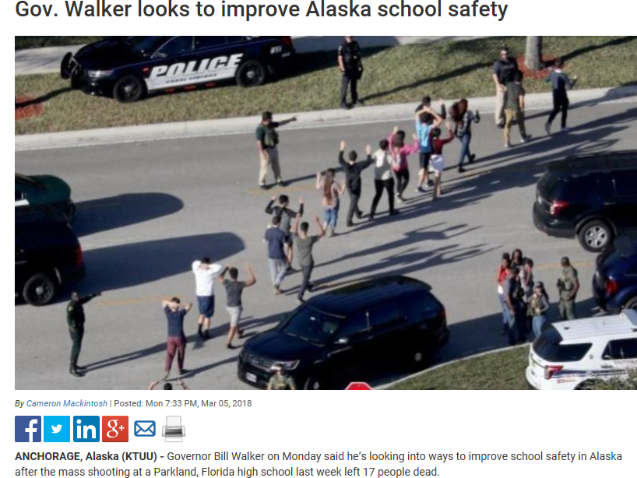

Slide 4
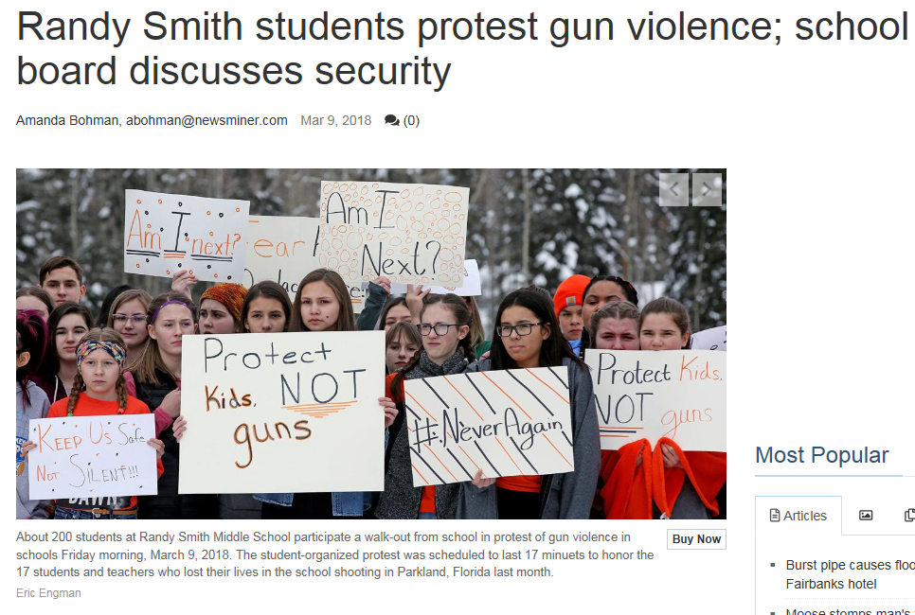

Slide 5
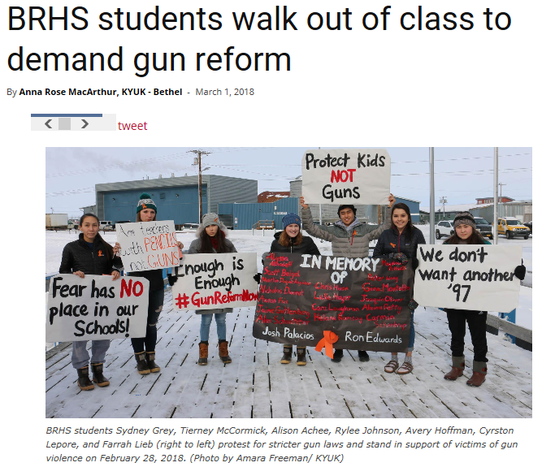

Slide 6
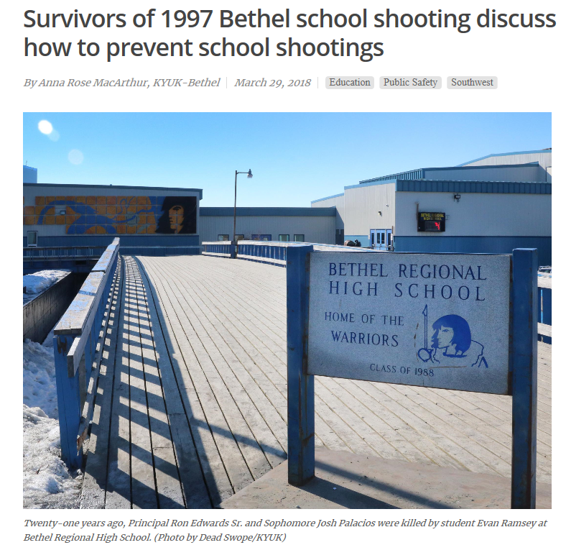
Bethel Survivor Discussion

Slide 7
2013 Alaska School Safety Superintendent Gap Analysis
Sandy Hook Elementary (Dec 14, 2012 28 fatalities)
Phone interviews with majority (46) of superintendents
Asked 5 central questions on school safety
Aggregated answers in a summary report
Data indicated significant need for resources
Results were shared broadly with education stakeholders including legislators and were a catalyst for additional school safety funding

Slide 8
Alaska Superintendent School Safety Gap Analysis Questions
Controlled School Access
School Safety Hardware
Training on School Crisis Response Preparedness
Training on programs/practices/policies that promote positive school climate and training for staff on identifying students with mental health issues that may pose a danger
Anything else related to school safety

Slide 9
Activity
10 minutes total
Review 2013 Gap Analysis (3-4 minutes)
Share what about the gap analysis results most resonates with you and your school/district needs (3-4 minutes)
Please be prepared to share your observations with larger group (volunteers only)

Slide 10
DEED’s Response to Safety Needs

Slide 12
Education Challenge Safety & Well-Being Goals
1) Transforming School Climate
Every Alaska school must work to create a sustainable and positive school climate that is safe, supportive, and engaging for all students, families, staff, and communities.
2) Building Trauma Engaged Schools
Alaska’s schools will create a culturally humble (responsive) and safe environment that recognizes the needs of the whole child, institutes trauma informed practices, and understands the vital importance of building all relationships surrounding every child to improve resiliency, health, and academic outcomes.
3) Student Health
To ensure the physical and mental health needs of all students in all schools are addressed, students enrolled in public education will have direct access to school nursing/health and counseling services.

Slide 13
Every Student Succeeds Act
Like NCLB, ESSA’s fundamental mission is to promote educational equity.
Disciplinary Reforms
Non-Academic Accountability Indicators
Title II Professional Development on Safety
Creation of new Title IV Part A with Safety and Health Priority

Slide 14
Governor Walker Meets with Students

Slide 15
Contact Information
Todd Brocious, Education Administrator II
Todd.brocious@alaska.gov
(907) 465-2887
Notes:
The presenter’s contact information should be presented on this slide in this format. We encourage including a photo of the presenter to help personalize the presentation.

