Slide 1
Making School Health & Safety Manageable
Alaska Department of Education & Early Development
Kami Moore, Program Coordinator
Samantha Wilson, Program Coordinator
April 26, 2018

Slide 3
https://youtu.be/CwO45La_NVo

Slide 4
Alaska State Statutes
The Alaska Safe Children’s Act
AS 14.30.355 (Erin’s Law)
AS 14.30.356 (Bree’s Law)
School Crisis Response Planning
AS 14.33.100

Slide 5
The Alaska Safe Children’s Act
Effective June 30, 2107 the governing body of each school district shall:
Relating to Erin’s Law and Bree’s Law

Slide 6
Opt-Out Provision
The policy, training, and notices under Erin's Law and Bree's Law must include a procedure for allowing students to be excused from participating in training or from receiving notices relating to Erin's Law and Bree's Law, at the written request of a parent or guardian of the student, or of the student if the student is emancipated or 18 years of age or older.

Slide 7
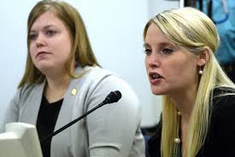
AS 14.30.355 (Erin’s Law)
Sexual abuse & sexual assault awareness & prevention
Grades K-12
Erin’s Law training must include:
Age-appropriate information
Warning signs of sexual abuse of a child
Referral and resources information
Methods for increasing teacher, student and parent awareness of issues regarding sexual abuse of children
Actions that a child may take to prevent and report sexual assault

Slide 8
AS 14.30.356 (Bree’s Law)
Dating violence and abuse
Grades 7-12
Bree’s Law training must include:
Age-appropriate information
Warning signs of dating violence and abusive behavior
Characteristics of healthy relationships
Measures to prevent and stop dating violence and abuse
Community resources available to victims of dating violence and abuse

Slide 9
Required School Crisis Response Planning
AS 14.33.100
Outlines what must be included in crisis response plan.
States that districts must annually review their plans and update as needed.
Outlines the training requirements for staff

Slide 10
AS 14.33.100 (a)
Each district shall develop a model school crisis response plan for use by each school in the district…
Each school shall form a crisis response team consisting of the:
principal
one certified member of the school staff
one classified member of the school staff
one parent whose child attends the school.
The district and each school within the district shall consult with local social services agencies and local law enforcement authorities when developing the school crisis response plan.

Slide 11
AS 14.33.100 (b)
A school specific crisis response plan must include…

Slide 12
AS 14.33.100 (c)
Each district shall annually review and update as appropriate each school's crisis response plan…

Slide 13
AS 14.33.100 (d)
Each district shall provide to each district employee training in crisis response, including evacuation and lockdown drills.

Slide 14
Four Pillars of School Safety
Crisis Response Planning
Positive School Climate
Mental Health and Well-Being
Physical
Safety

Slide 17
How do eLearning courses come to life?
New statute or regulation
DEED & a team of subject matter experts develop course content
Contractor builds the course with professional touches (audio and graphics)
The team reconvenes for a thorough review and the final touches are added
The course is released for district use

Slide 18
Partners

Slide 19
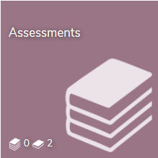
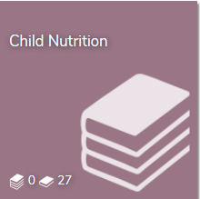
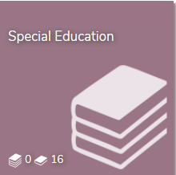
eLearning Course Topics
Domestic Violence & Sexual Assault Training for Educators
Gender and Race Equity
Mandated Reporters of Child Abuse and Neglect
Medication Administration: Training for Unlicensed School Staff
Narcan Administration for an Opioid Overdose
Opioids and the Opioid Epidemic 101
Overcoming ACEs in Alaskan Schools
Positive Behavioral Interventions and Supports (PBIS)
Precautions Against Blood-borne Pathogens
Prenatal Alcohol and Drug Related Disabilities
School Crisis Response Planning
Suicide Awareness, Prevention, Intervention, Responding to Suicide- Postvention Guidelines
Trauma-Sensitive Schools
Health
&
Safety

Slide 20
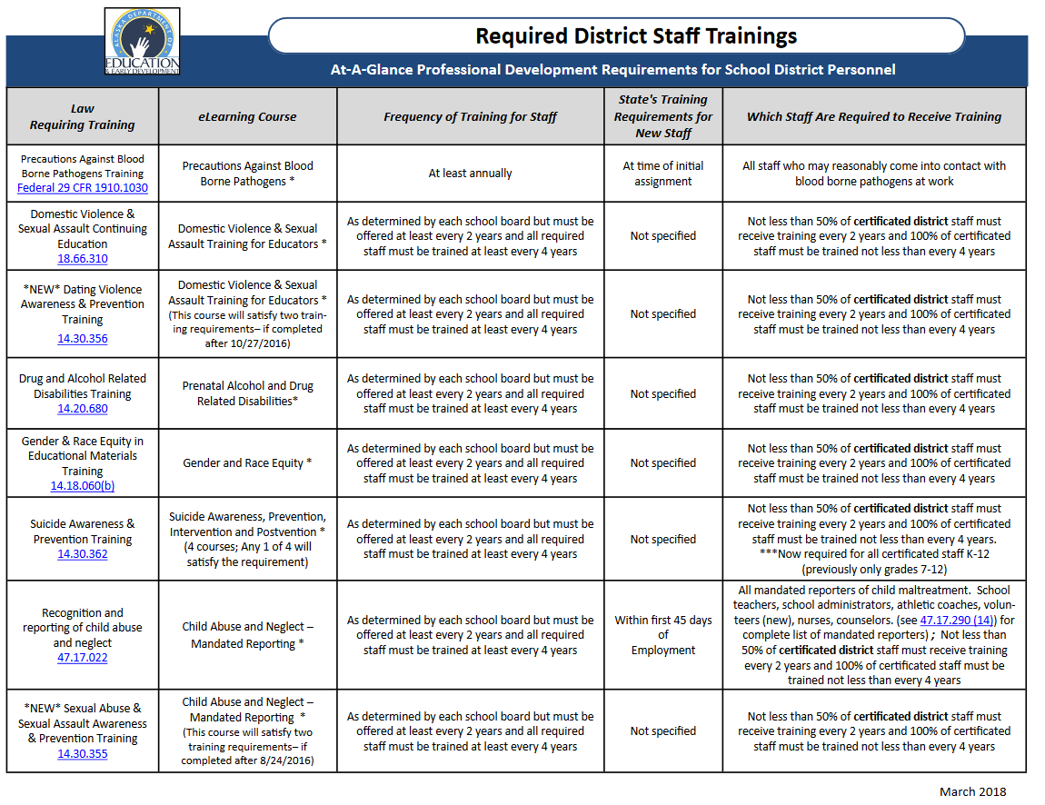
Go to education.Alaska.gov/elearning for a printable list of professional development requirements. Located under Resources.

Slide 21
New Requirements for Teacher Certification
4 Courses
Certificates of completion
Course history remains in your eLearning profile
Includes teacher training requirements under Erin’s and Bree’s Laws
Effective June 30, 2017

Slide 22
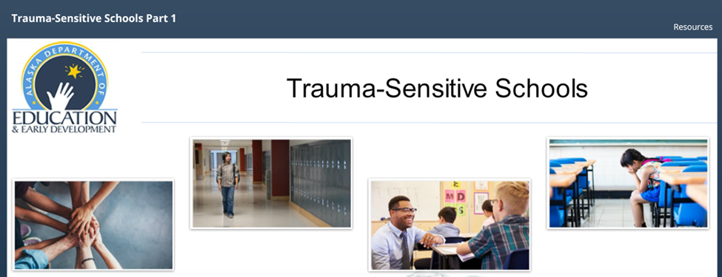
Non-mandatory eLearning Courses
Courses can be completed independently or in group settings

Slide 23
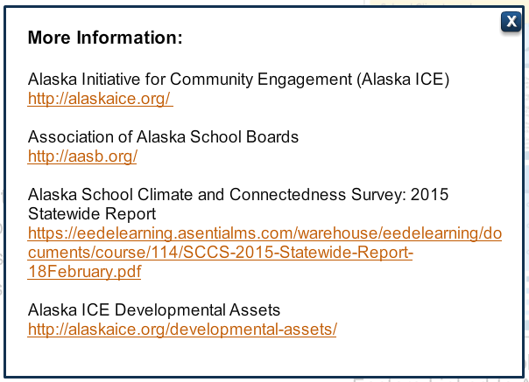
Additional Resources
Helpful links, documents and other resources can be found inside and outside the courses

Slide 24
Thank you for your help!
Your participation in surveys such as the YRBS and School Climate & Connectedness Survey by AASB provide us with opportunities to garner funding for eLearning courses and other meaningful projects to protect the health and safety of students and educators.

Slide 25
What topics would you like to see in our eLearning program?

Slide 26
YOU

Slide 27
Leveraging Title IV Part A Funds for School Safety
$700 million increase at the federal level
Priority II: Safe & Healthy Students
Safe and Supportive Schools
Student Physical and Mental Health
Cross-Cutting Activities

Slide 28
Allowable Activities
Safe & Supportive Schools
Preventing bullying & harassment
Relationship building skills
Reducing the use of exclusionary discipline practices & promoting supportive school discipline
Suicide prevention
Student Physical & Mental Health
School-based health & mental health services
Trauma-informed classroom management
Drug and violence prevention
Cross-Cutting Activities
Mentoring and School Counseling
Schoolwide Positive Behavioral Interventions and Supports

Slide 29
State and National School Safety & Emergency Management Resources
State Agencies
Department of Education and Early Development
Department of Health and Social Services, Division of Public Health
The Department of Military and Veteran Affairs, Division of Homeland Security and Emergency Management
National Agencies
Readiness & Emergency Management for Schools Technical Assistance Center (REMS)
FEMA Emergency Management Institute

Slide 30
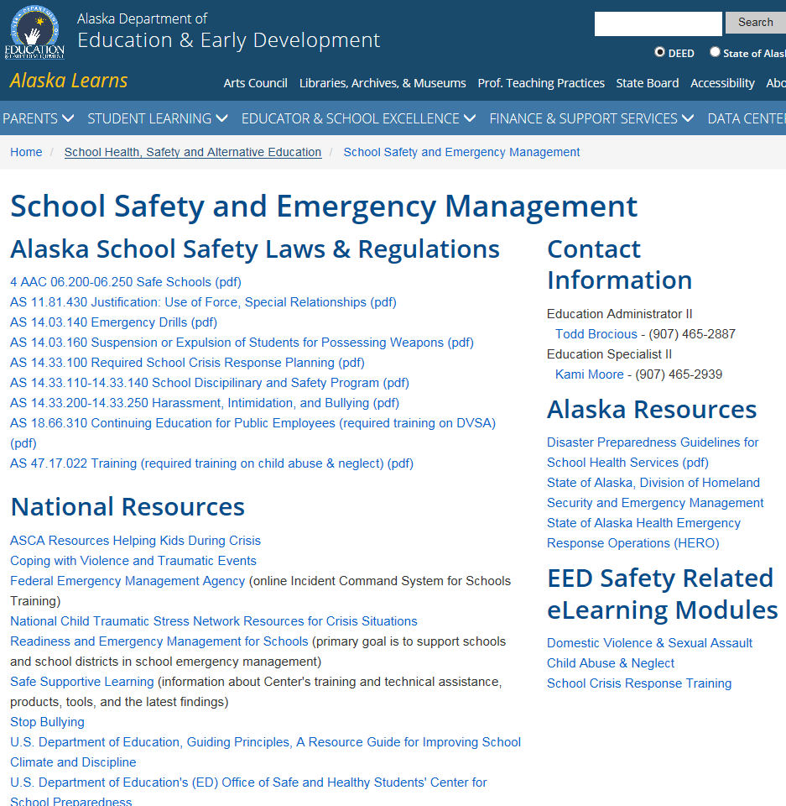

Slide 31
Alaska Safe Children’s Act Resources
LiveBinder
Resource Guide
Resource Mail out
http://www.livebinders.com/play/play?id=2144135#anchor

Slide 32
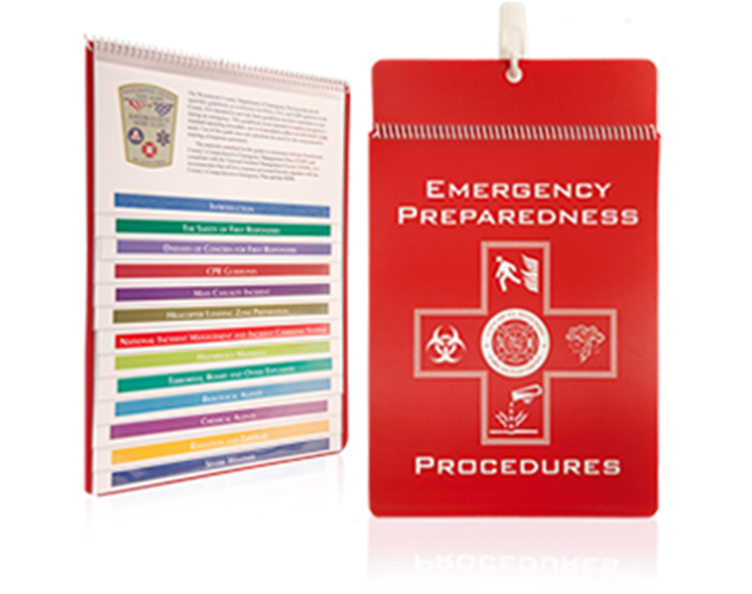
School Crisis Response Plan Resources
Developing Emergency Operations Plans
Classroom Quick Reference Flip Charts

Slide 33
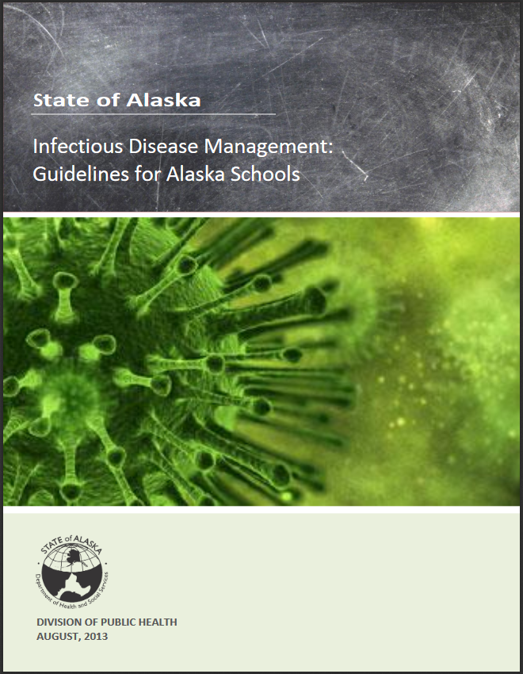

Slide 35
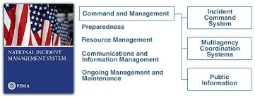
National Incident Management Systems course
All-Hazards courses
Earthquake courses
https://training.fema.gov/programs/emischool/emischool.aspx

Slide 36
Contact Information
Kami Moore, Program Coordinator II
kami.moore@alaska.gov
(907) 465-2939
Samantha Wilson, Program Coordinator I
Samantha.Wilson@Alaska.gov
(907)-465-2304

Slide 37
InDEED: Connect With Us
education.alaska.gov
Teacher Certification: (907) 465-2831
Main Line: (907) 465-2800
@AlaskaDEED on Twitter, Facebook, Instagram, Flickr, and Vimeo
eLearning: https://education.alaska.gov/ELearning
Notes:
Every DEED presentation should end with this slide.

