Slide 1
Family, Tribes and Community Outreach
Alaska Department of Education & Early Development
Paul Prussing, Director - Division of Student Learning
Sarah Emmal, Education Specialist II
April 26, 2018

Slide 2

Notes:
Sec. 14.03.015. State education policy.
It is the policy of this state that the purpose of education is to help ensure that all students will succeed in their education and work, shape worthwhile and satisfying lives for themselves, exemplify the best values of society, and be effective in improving the character and quality of the world about them.

Slide 3


Slide 4



Slide 5
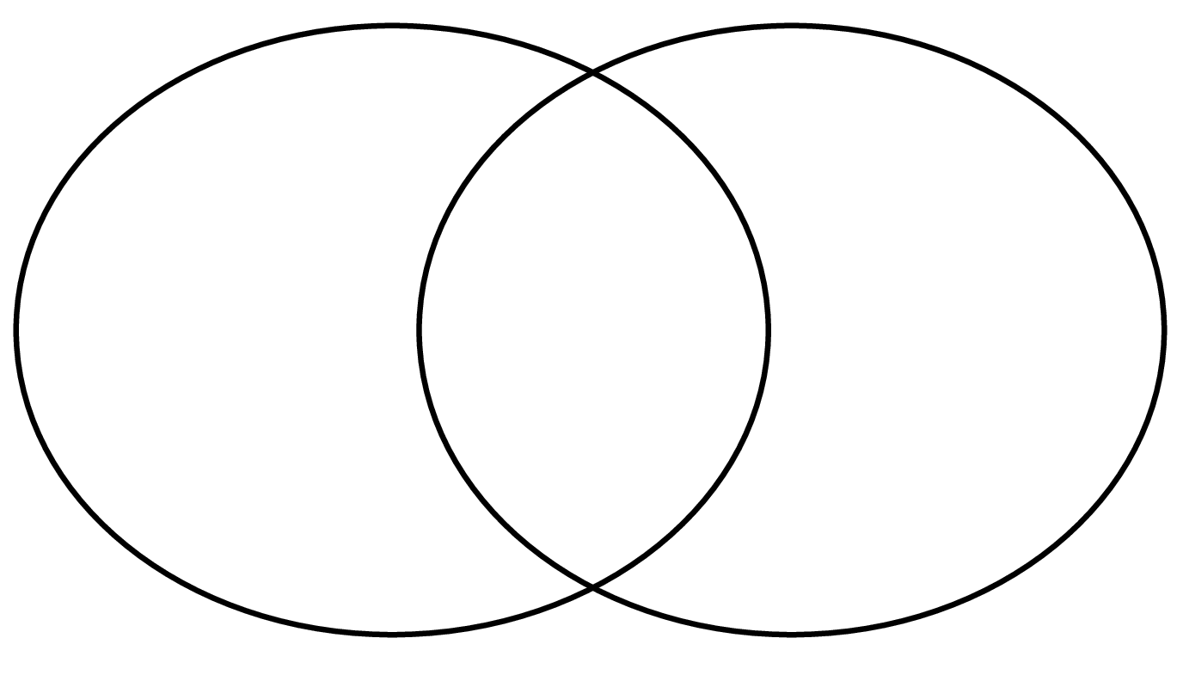


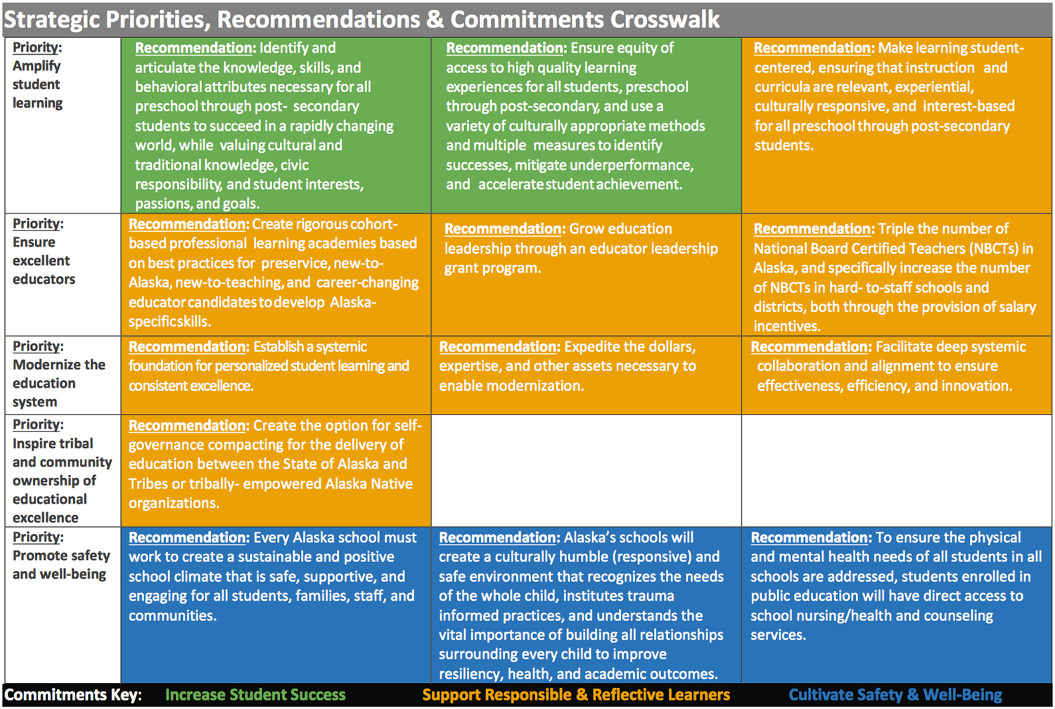
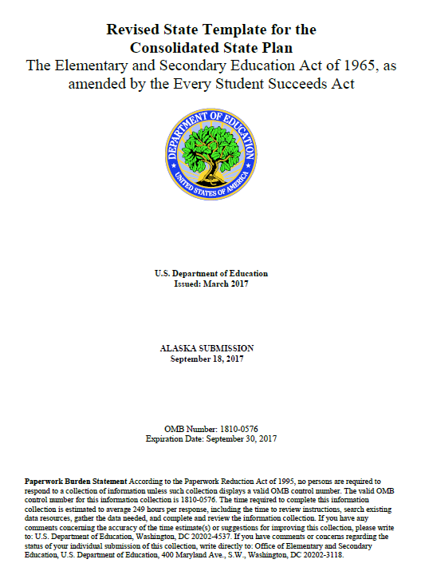
A Shared Vision

Slide 6
Agenda
Tribal Consultation in ESSA
Parent & Family Engagement in ESSA
Alaska Statutes & Regulations

Slide 7
Tribal Consultation in ESSA

Slide 8
Shift from NCLB to ESSA
SEA/LEA Tribal Consultation requirements didn’t exist under NCLB

Slide 9

Pause and Reflect
Why is it important to consult Tribes and Tribal Organizations?

Slide 10
Tribal Representatives
Districts and states must consult appropriate officials from Indian tribes or tribal organizations approved by the tribes located in the area served by the district.
The term ‘appropriate officials’ means—
tribal officials who are elected; or
appointed tribal leaders or officials designated in writing by an Indian tribe for the specific consultation purpose under this section.

Slide 11
Tribal Consultation at State Level
Section 1111
ESSA State Plan Development Requirements
Section 1111(a) requires that representatives of Indian tribes in the state be included in the formation of state plans.
States must engage in timely and meaningful stakeholder consultation.
State ESSA Assurances
States must notify various stakeholders, including Indian tribes and tribal organizations, of the challenging State academic standards, academic assessments, and State accountability system.

Slide 12
Tribal Consultation at District Level
Section 8538
Which school districts must consult with tribes and tribal organizations?
Districts that:
have an enrollment of over 50% American Indian or Alaska Native students
receive more than $40,000 for Title VI (Indian, Native Hawaiian, and Alaska Native Education), or

Slide 13
Tribal Consultation at District Level
Section 8538
What must districts consult on?
Title VI, Part A, Subpart 1 – Indian Education Formula Grants to LEAs
Title IV, Part A – Student Support and Academic Enrichment
Title III, Part A – English Language Acquisition
Title II, Part A – Supporting Effective Instruction
Title I, Part D – Prevention, Intervention Programs for Children and Youth Who are Neglected, Delinquent, or At-Risk
Title I, Part C – Education of Migratory Children
Title I, Part A – Improving Basic Programs
District applications and plans developed for:
Title V, Part B, Subpart 2 – Rural and Low-Income School Program (RLIS)

Slide 14
Tribal Consultation at District Level
Section 8538
What is the process/timing for consultation?
Consultation must be done in a manner and in such time that proves the opportunity for such appropriate officials from Indian tribes or tribal organizations to meaningfully and substantively contribute to such plan.
Deadline is the State’s submission deadline for ESEA Consolidated Application.

Slide 15
Tribal Consultation at District Level
Section 8538
What documentation is required for consultation?
Each district shall maintain in the district’s records and provide to the DEED a written affirmation signed by the appropriate officials of the participating tribes or tribal organizations approved by the tribes that the consultation has occurred.

Slide 16
Pause and Reflect
What are some good examples of districts working collaboratively with Tribes or Tribal Organizations to best support Alaska Native students?

Slide 17
Parent & Family Engagement in ESSA

Slide 18
Pause and Reflect
What is parent and family engagement?
What is the importance of parent and family engagement?

Slide 19
Shift from NCLB to ESSA
“Parent” to “Parent and Family”
Adding family is inclusive and respective of all adults who raise and care for children (i.e., biological parents, adoptive parent, foster parents, grandparents, legal and informal guardians, and adult siblings)
“Involvement” to “Engagement”
Involvement implies doing to
Engagement implies doing with

Slide 20
Parental Involvement Defined by ESSA
Section: 8101(39)
The participation of parents in regular, two-way, and meaningful communication involving student academic learning and other school activities, including ensuring that parents:
play an integral role in assisting their child’s learning;
are encouraged to be actively involved in their child’s education at school;
are full partners in their child’s education and are included, as appropriate, in
decision-making and on advisory committees to assist in the education of their child; and
the carrying out of other activities, such as those described in the parent & family engagement section of Title I-A.

Slide 21
Alaska Statute
Sec. 14.03.016. A parents right to direct the education of the parents child.
(a) A local school board shall, in consultation with parents, teachers, and school administrators, adopt policies to promote the involvement of parents in the school districts education program.

Slide 22
Importance of Parent and Family Engagement
When families and districts partner in meaningful ways, children:
have more positive attitudes toward school
stay in school longer
have better attendance
experience more school success
Source: ED/HHS Joint Policy Statement On Family Engagement From The Early Years To The Early Grades, 2016

Slide 23
Title I-A: Overview
Section 1116(a)(1)
Districts must:
Implement programs, activities, and procedures to involve parents and family members in Title I-A programs.
Plan and implement such programs, activities, and procedures with meaningful consultation with parents of participating children
Conduct outreach to all parents and family members

Slide 24
Title I-A: Parent & Family Engagement Policy
Section 1116(a) and (b)
Each district and school that receives Title I-A funds shall develop jointly with, agree on with, and distribute to, parents and family members of participating children, a written parent and family engagement policy.

Slide 25
Title I-A: Uses of Funds
Section 1116(a)(3)
Percentage of funds
Each district that receives more than $500,000 Title I-A funds shall reserve at least 1% of its Title I allocation to assist schools to carry out the parent and family engagement activities
Parent and family input
Parents and family members of children receiving Title I services shall be involved in the decisions regarding how these funds are used
Note: Districts that receive $500,000 or less may choose to use reserve funds

Slide 26
Title I-A: Parents Right-to-Know
Section 1112(e)
Title I-A provides parents the right to know:
the professional qualifications of their student’s classroom teachers and paraprofessionals
level of achievement and academic growth of their student(s)
any State or district policy regarding student participation in any State or local assessments
information on each required assessment
if applicable, information regarding their student being identified as an English Learner and their rights as parents
that their student(s) has been assigned, or has been taught for 4 consecutive weeks by, a teacher who does not meet applicable State certification or licensure requirements

Slide 27
Title I-A: Building Capacity
Section 1116(e)
To ensure effective involvement of parents and to support a partnership among the school, parents, and the community, each Title I school and district must —
assist parents in understanding the academic standards and assessments
provide materials and training to help parents to work with their children
educate staff in the value and utility of contributions of parents
provide info to parents in a format and language parents can understand
educate staff in how to reach out to, communicate with, and work with parents
coordinate parent involvement programs and activities with other programs
assist parents in how to monitor their child’s progress and work with educators
assist parents in understanding the requirements of Title I

Slide 28
Title I-C: Migrant Education
Section 1304(c)(3)
In the planning and operation of Migrant Education Programs there must be consultation with parents of migratory children that is:
in a manner that provides for the same parental and family engagement as is required for Title I-A, and
in a format and language understandable to the parents.

Slide 29
Title I-D: Neglected & Delinquent
Section 1414(c)(14), 1424(8), and 1425(8)
As appropriate, the program must involve parents and family members in efforts to:
improve the educational achievement of their children,
assist in dropout prevention activities, and
prevent the involvement of their children in delinquent activities

Slide 30
Title II-A: Supporting Effective Instruction
Section 2102(b)(3) and 2103(b)(3)(E)(iii)
In developing the district application, the district shall meaningfully consult with teachers, principals, other school leaders, paraprofessionals, specialized instructional support personnel, charter school leaders, parents, community partners, and other organizations or partners with relevant and demonstrated expertise and seek advice regarding how to best improve the State’s activities to meet the purpose of this title
Funds may be used to provide high-quality, personalized professional development that is evidence-based to train teachers, principals, or other school leaders to effectively engage parents, families, and community partners, and coordinate services between the school and community

Slide 31
Title III-A: English Language Acquisition
Section 3102(5), 3115(d)(6)
Districts must promote parent, family, and community engagement in the education of English learners.
Districts may use funds to provide parent and family outreach and training activities to English Learners and their families.

Slide 32
New ESSA Requirement
States must:
Identify language(s) other than English present “to a significant extent” among English learners.
Determine if academic assessments are needed in those languages.

Slide 33
Questions to Answer
TODAY:
What language(s) are present to a significant extent?
FUTURE:
Are academic assessments needed in those language(s)
  Stakeholder process will be used

Slide 34
Background
Academic assessments in ELA and math are given in grades 3-9
69,512 students in grades 3-9
12%, or 8346, were English learners
*Data from October 1, 2016

Slide 35
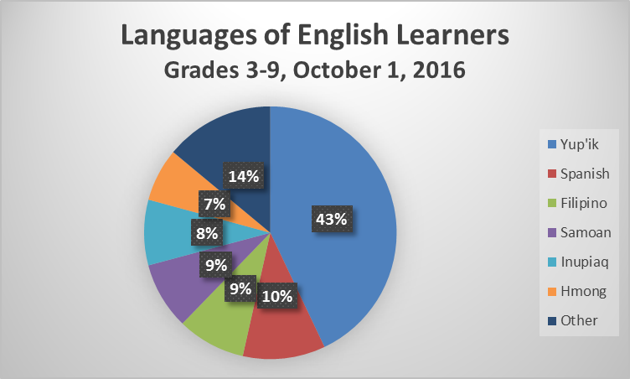

Slide 36
Top 5 Languages Statewide
Yup’ik consistently ranked #1
Other languages in the top five: Spanish, Filipino, Inupiaq, Hmong, and Samoan
Up to 100 languages present among English learners in any given year

Slide 37
Distribution of Languages
35 districts served English learners in grades 3-9
7 districts served 100+ ELs represented by Yup’ik
  In 5 districts, ~100% represented Yup’ik
Anchorage served 3,112 ELs in grades 3-9
  Yup’ik – 5.5% (171 students)
  Spanish – 21.6%
  Samoan – 21.6%
  Hmong – 17.9%
  Filipino – 13.1%

Slide 38
Alaska Statutes
Article 10. Bilingual-Bicultural Education.
Sec. 14.30.400. Bilingual-bicultural education

Slide 39
City or borough district school boards and regional educational attendance area boards shall provide a bilingual-bicultural education program for each school in a city or borough school district or regional educational attendance area that is attended by at least eight pupils of limited English-speaking ability and whose primary language is other than English. A bilingual-bicultural education program shall be provided under a plan of service that has been developed in accordance with regulations adopted by the department. Nothing in this section precludes a bilingual-bicultural education program from being provided for less than eight pupils in a school.

Slide 40
Sec. 14.30.420. Native language education.

Slide 41
a) A school board shall establish a local Native language curriculum advisory board for each school in the district in which a majority of the students are Alaska Natives and any school district with Alaska Native students may establish a local Native language curriculum advisory board for each school with Alaska Native students in their district. If the local Native language curriculum advisory board recommends the establishment of a Native language education curriculum for a school, the school board may initiate and conduct a Native language education curriculum within grades K through 12 at that school. The program, if established, must include Native languages traditionally spoken in the community in which the school is located. Each school board conducting a program of Native language education shall implement the program as a part of regular classroom studies and shall use
(1) instructors who are certified under AS 14.20.020 or 14.20.025; and
(2) to the maximum extent possible
(A) instructors and instructional materials available through the University of Alaska; and
(B) audio-visual, computer, and satellite technology.
(b) In this section,
(1) "district" has the meaning given in AS 14.17.990;
(2) "Native" means a person of one-fourth degree or more Alaskan Indian, Eskimo, or Aleut blood.

Slide 42
Title IV-A: Student Support and Academic Enrichment
Section 4106(c), 4108(3), 4108(5)(E)(ii)
Districts shall develop their application through consultation with parents, school staff, students, community-based organizations, local government representatives, charter schools, and others with relevant and demonstrated expertise.
Districts shall engage in continued consultation with the entities described above in order to improve the local program.
Districts shall promote the involvement of parents in activities and programs that support safe and healthy schools.

Slide 43
Title IV-B: 21st Century Community Learning Centers
Section 4201(3) and 4205(a)(10)
Offer families of students served by community learning centers opportunities for active and meaningful engagement in their children’s education, including opportunities for literacy and related educational development.
Program authorizes district who receives this grant to use funds to implement parenting skills programs that promote parental involvement and family, among other options.

Slide 44
Pause and Reflect
What can your school/district do to increase family engagement?
What are barriers to greater family engagement?
How does your school/district engage with families?

Slide 45
Opportunity for Parent and Family Engagement
In order to establish and foster sustained, trusting relationships it is important to:
Always provide information within the context of why family engagement is important for the child and how it will help him/her.
Identify and address needs of the school, the students, and the families.
Think of engagement as an opportunity to build relationships and partnerships, not an isolated event.
Listen to parents and families and incorporate feedback.

Slide 46

Contact Information
Paul Prussing
Director, Student Learning
  paul.prussing@alaska.gov
  (907) 465- 8721
Sarah Emmal
Education Specialist II
  sarah.emmal@alaska.gov
  (907) 465-3826

Slide 47
InDEED: Connect With Us
education.alaska.gov
Teacher Certification: (907) 465-2831
Main Line: (907) 465-2800
@AlaskaDEED on Twitter, Facebook, Instagram, Flickr, and Vimeo

