Slide 1
Ensuring Excellent Educators
Alaska Department of Education & Early Development
Sondra Meredith, Administrator
Educator Education & Certification
Cecilia Miller, Education Specialist
Title II-A Supporting Effective Instruction
April 27, 2018

Slide 2
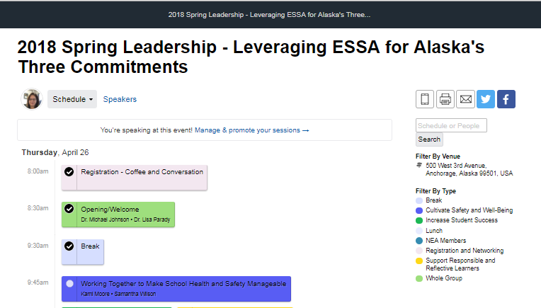
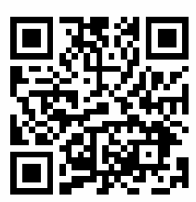
Presentation Materials
https://2018springlead.sched.com/

Slide 3

Notes:
Excellent education for every student every day.

Slide 4

Notes:
Ensuring excellent educators
Why is this important?

Slide 5
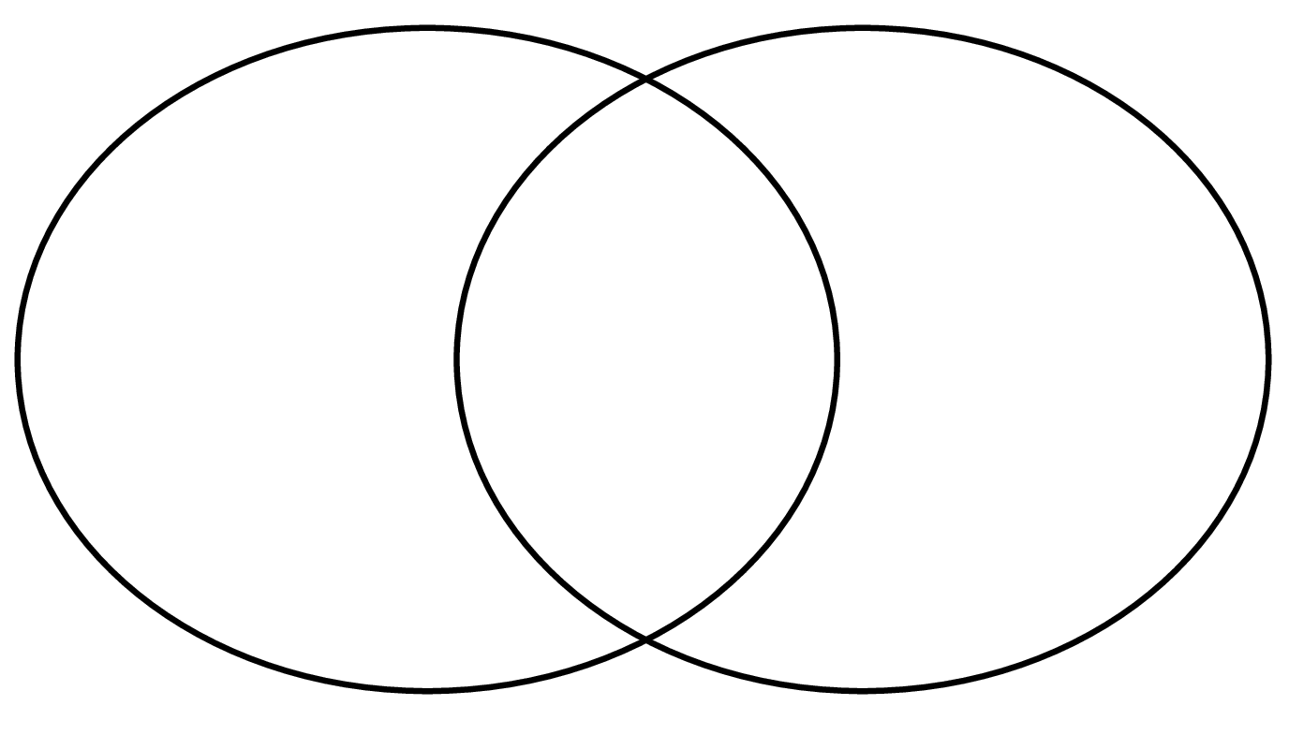


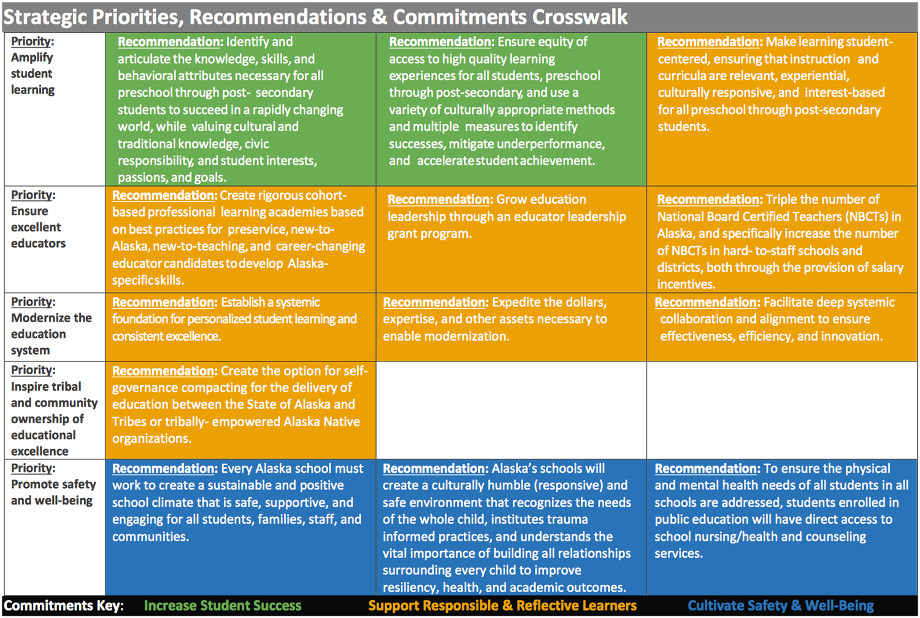
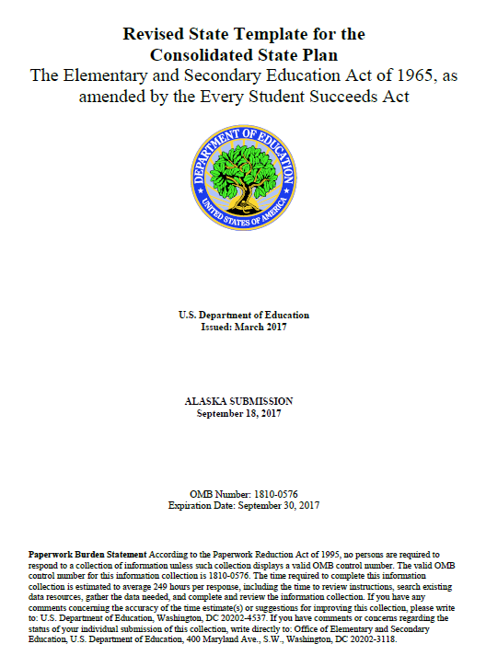
A Shared Vision

Slide 6


Notes:
Supporting Responsible and Reflective Learning
Families, tribes, educators and communities will provide relevant learning opportunities.

Slide 7

Ensuring Excellent Educators
AK Education Challenge Recommendations:
Professional Learning Academies
Education Leadership Program
National Board Certified Teachers

Slide 8
Who are our educators?
Paraprofessionals
Teachers
Special Service Providers
Administrators

Slide 9
Research tells us…
  the single most important factor in a student’s academic success is the quality of the teacher
  the second most important factor in a student’s academic success is the quality of the instructional leader (principal)
Notes:
Establish focus or purpose of our discussion…
Compelling reason for this work…

Slide 10
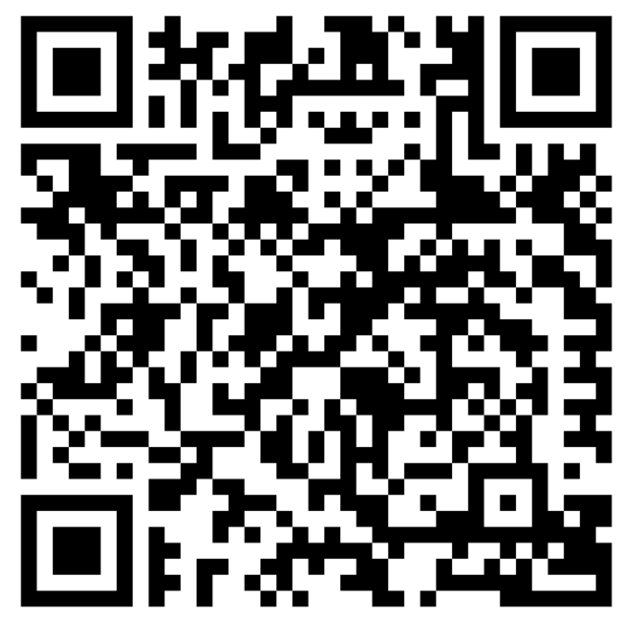
Three words to describe an excellent educator
Go to www.menti.com
Use the code
65 82 69

Slide 11
Key Questions
What does ESSA require?
How has Alaska responded?
How are Alaska’s responses to ESSA supportive of our three commitments?
Notes:
Now that we know a little about the Alaska Education Challenge, who we are referring to when we say educator, and little about the research, let’s dive into our key questions…

Slide 12
What does ESSA require?

Slide 13

What does ESSA require?
Educator Quality Definitions – E³
  Experienced (Inexperienced)
  Endorsed (Out-of-field)
  Effective (Ineffective)
Measures to identify equity gaps
Reporting
Strategies to increase equitable access
Notes:
ESSA Current Authorization of ESEA
NCLB replaced - “Highly Qualified” eliminated

Slide 14
How has Alaska responded?

Slide 15


Inexperienced
A teacher in the first year of practice….
Student teaching or
other similar preparation
does not count as experience.
Notes:
First, the definitions that will help Alaska measure and identify equity gaps.

Slide 16

Out-of-Field
Teaching in a subject area in which the
teacher does not hold an Alaska endorsement.
An endorsement can be added
with two years of experience and
a passing score on a content exam.
16

Slide 17

Ineffective
Any teacher on a plan of improvement under 4 AAC 19.010(g), or resigned based on plan of improvement,
Or
A tenured teacher receiving district support or
a plan of professional growth under 4 AAC 19.010(h).
Only as a result of the
evaluation system as
defined in state regulation.
17

Slide 18
Reporting to the public

Slide 19
District and School
Report Cards
Number and percentage of—
  inexperienced teachers, principals, and other school leaders;
  teachers teaching with emergency or provisional credentials; and
  teachers who are not teaching in the subject or field for which the teacher is certified.
  Aggregate and disaggregated by high-poverty compared to low-poverty schools

Slide 20
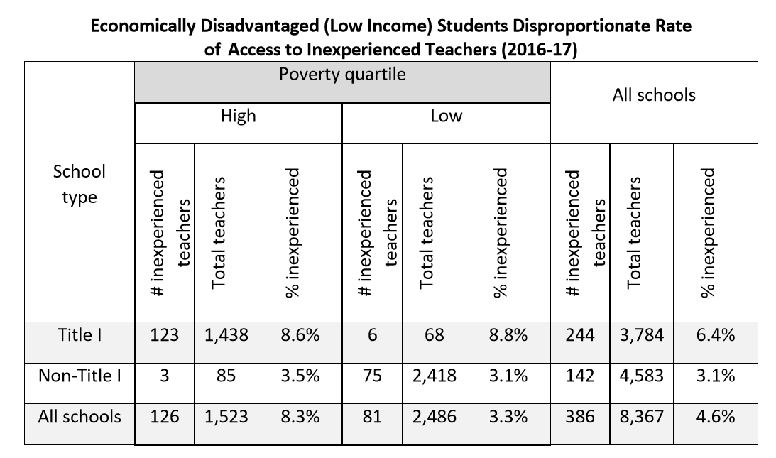
Economically Disadvantaged (Low-Income)
Equity Gap
  High and Low Poverty Quartiles
  Title I and Non-Title I schools

Slide 21
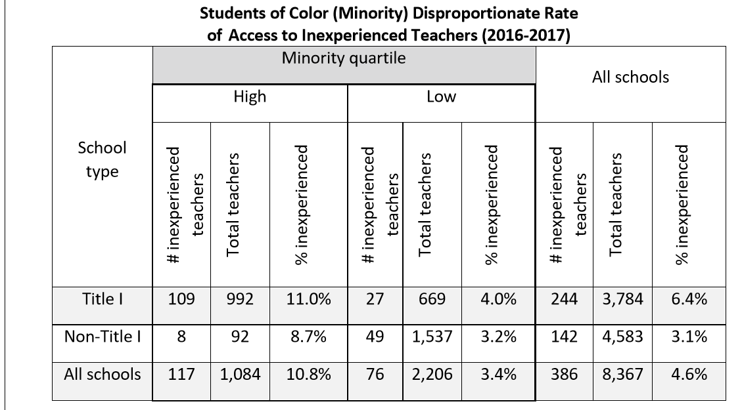
Students of Color (Minority)
Equity Gap
  High and Low Poverty Quartiles
  Title I and Non-Title I schools

Slide 22
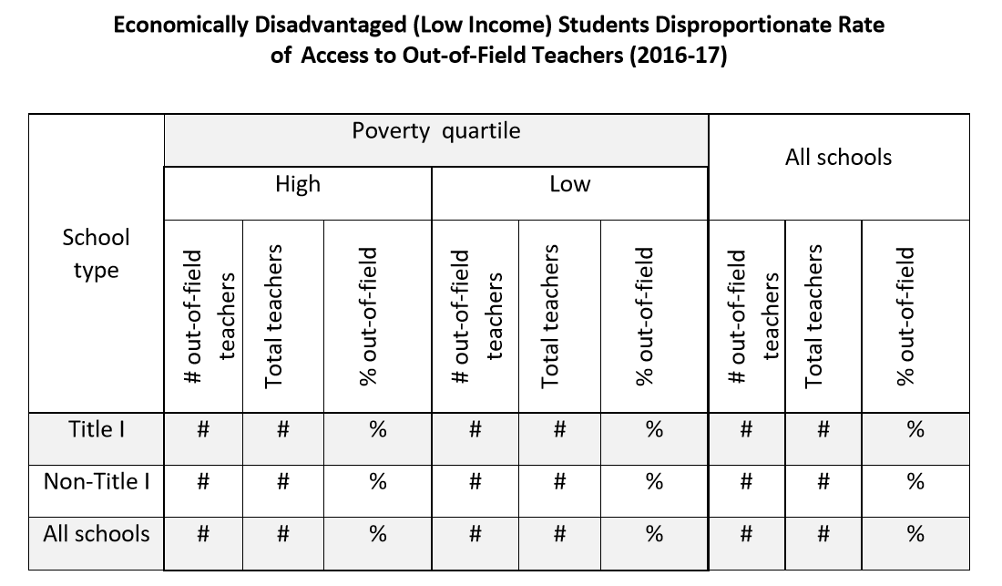
Out-of-Field due Nov 30th*
High and Low Poverty Quartiles
High and Low Minority Quartiles
Title I and Non-Title I schools

Slide 23
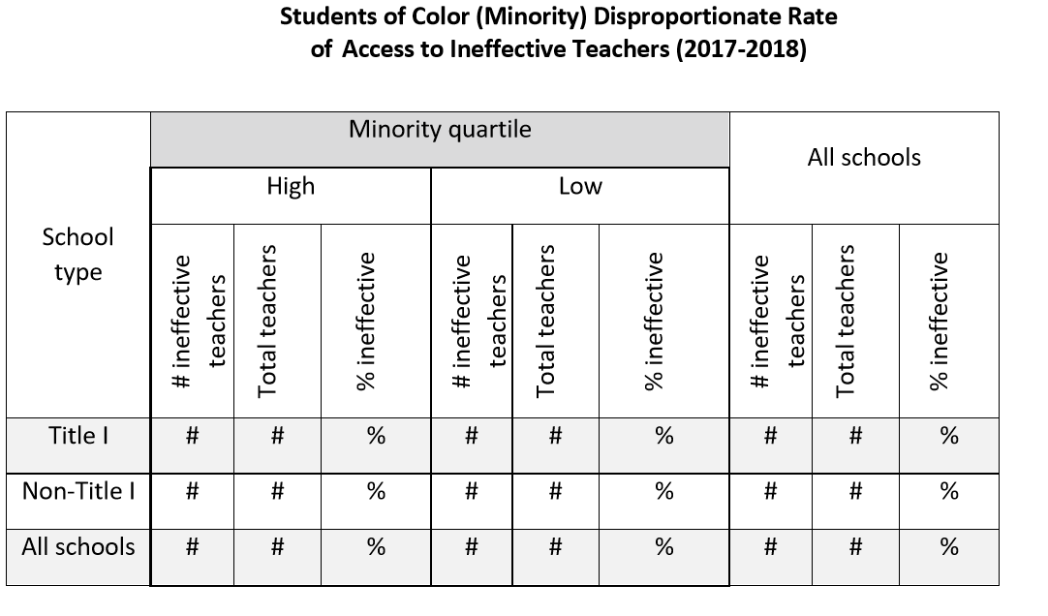
Ineffective due November 30th
High and Low Poverty Quartiles
High and Low Minority Quartiles
Title I and Non-Title I schools

Slide 24
State and District Strategies

Slide 25
State strategies to mitigate inexperienced
Revisit establishing additional routes to certification (e.g. former AKT2 program)
Considering Teacher/Leader Academies
Educator Preparation Programs

Slide 26
State strategies to mitigate inexperienced
Talent Management
Online Professional Development Network
Induction Initiative

Slide 27

District strategies to mitigate inexperience
Induction Programs
Professional Learning
????
Connections?
Notes:
Give participants 2 to 3 minutes to discuss district level strategies that mitigate inexperience.
Have participants call out strategies related to each of the three commitments
Record strategies on three large post it notes on the wall.

Slide 28
State strategies to mitigate out-of-field
Assignment and Endorsement Match
Content Area Exams
Financial Support
Content Academies and/or networks

Slide 29
District strategies to increase access to content experts
Innovative Practices to Deliver Content
Connections?
Notes:
Give participants 2 to 3 minutes to discuss district level strategies that increase student access to content experts
Have participants call out strategies and which of the commitment it supports
Record strategies on three large post it notes on the wall.

Slide 30
State strategies to increase access to effective educators
Talent Management Checklist: Retention
Educator Evaluation & Support (EES)
Professional Development
  Online network
  Blended Learning, Personalized learning

Slide 31
State strategies to increase access to effective educators
National Board Certification
Professional Learning Standards
Teacher Leader Standards
Teacher Recognition
Micro Credentials

Slide 32
District strategies to increase access to effective educators
Evaluation & Support
Evidenced-based professional learning
? ? ?
Connections?
Notes:
Give participants 2 to 3 minutes to discuss district-level strategies to increase access to effective educators.
Have participants call out strategies related to each of the three commitments
Record strategies on three large post it notes on the wall.

Slide 33
A Shared Vision

Slide 34
Questions?
Go to www.menti.com
Use the code
65 82 69

Slide 35
Contact Information
Sondra Meredith
Administrator, Educator Education & Certification
sondra.meredith@alaska.gov
(907) 465-8663
Cecilia Miller
Education Specialist, Title II-A
cecilia.miller@alaska.gov
(907) 465-8703
Notes:
The presenter’s contact information should be presented on this slide in this format. We encourage including a photo of the presenter to help personalize the presentation.

Slide 36
InDEED: Connect With Us
education.alaska.gov
Teacher Certification: (907) 465-2831
Main Line: (907) 465-2800
@AlaskaDEED on Twitter, Facebook, Instagram, Flickr, and Vimeo

