Slide 1
Integrating a Digital Learning Culture
Ms. Jessica Nitzberg
Mr. Ross Herbert

Slide 2
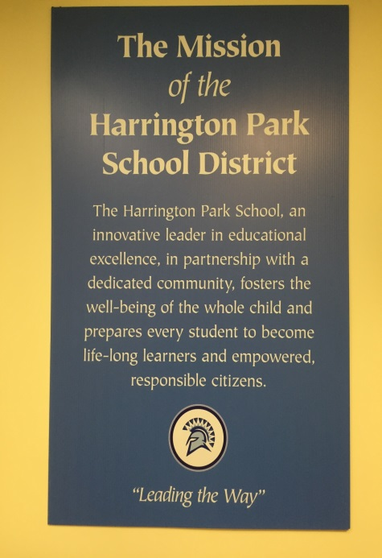
District Vision
  To become a world-class school system.
School Vision
  The Harrington Park School District has high expectations for its professional staff and is committed to providing all student with educational experiences of the highest standard.
School Mission
  The meaningful assessment of professional practice is essential to ensuring that established expectations are realized. The district shares in the belief that trust, risk taking and respect are the essential elements of a professional culture in which teachers, students, and administration engage in the continual process of growth and learning. These processes are optimized when supported by ongoing professional growth, timely and reflective practice, and evolving professional proficiency.

Slide 3
Our Vision
Technology integration in the classroom is the effective and efficient use of laptops, tablets, or other gadgets in a way that allows students to learn in a more meaningful way.
Technology should only be incorporated in a manner that enhances student learning.
The curriculum must drive technology usage and its incorporation must be based around sound instructional practices, and not the other way around, where technology drives the curriculum.

Slide 4
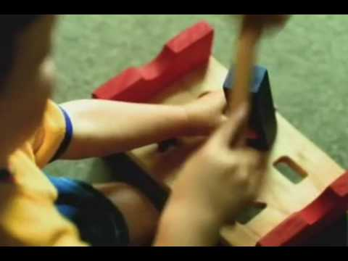
How does digital learning fit in your school?

Slide 5

Guiding Principles
Empower our teachers
Creating a meaningful learning environment for the staff
Develop/ Enhance Classroom Tools

Slide 6

Leverage pre-existing structures
Self Directed Growth Plan (SDGP)
Change the culture of Faculty Meetings
Developing partnerships with software developers

Slide 7
Is there something that you want to learn?
Has anything prevented you from starting the learning process?

Slide 8

Self Directed Growth Plan
Directed Personal & Professional Growth
You cannot have students as continuous learners and effective collaborators, without teachers having the same characteristics.
(Sarason, 1990)

Slide 9
Self Directed Growth Plan
2007-2008 - lead team began a self evaluation of the observation and evaluation practices
Danielson & Four Domains of Teaching
Framework provided a continuum and shared vocabulary around best practices
SDGP grew as an extension needed for a meaningful alternative
State Approved in 2013 to pilot and this year has it fully approved model
The implementation of SDGP in other districts has allowed for the development of a learning cohort

Slide 10

Structure
Self Assessment
Proposal process of Essential Question
Goal Setting
Improvement Planning
Plan Development
Status Reports/meetings
Final Defense/Share findings

Slide 11
 | 4 | 3 | 2 | 1
Essential Question | Question is compelling, open-ended, and provides the central focus on a theme/issue that provokes and sustains discussion to drive inquiry by raising other important questions. Must be arguable and discovered during the research and investigation. | Question is significant and open-ended enough to drive inquiry and clearly linked to the theme, issue, or question, with unpredictable student information related to the question. Must be able to be investigated and synthesized. | Question is limited by the clues pointing to a closed answer or predictable outcome. | Not stated as a question, but as guiding statement that points to closed answer or predictable outcome.

Slide 12
 | 4 | 3 | 2 | 1
Research | Research is valid and legitimate, as well as impacts your statement of purpose. Research is continued throughout the duration of the SDGP. In the final presentation, a reflection and summary of the research’s impact on the SDGP is included. | Research is valid and legitimate. Research is completed throughout the duration of the SDGP, but had no impact on the statement of purpose. In the final presentation, a reflection and summary of the research’s impact on the SDGP is included. | Research is valid and legitimate. Research is completed throughout the duration of the SDGP, but didn’t impact the statement of purpose. A summary or reflection was not included in the final presentation. | No seeking of outside resources and includes internal reflections only

Slide 13
Statement of Purpose
A Statement of Purpose states, in some detail, what you want to learn about in your SDGP. The statement guides you as you work so that you will read and do work only on what's needed for your project.
Essential Question: What is healthy eating?
Example: In this SDGP, I will study the impact of a low calorie diet in comparison to other diets including a gluten free diet or a paleo diet.
Statement of Purpose | Narrows focus of essential question by investigating multiple approaches/areas/techniques. Plan of action/proposal is detailed (Request Form). | Narrows focus of essential question to one approach/area/technique. Plan of action/proposal is detailed (Request Form). | Restates essential question. Plan of action/proposal is vague (Request Form). | Restates essential question. No plan of action/proposal.

Slide 14
Assessment and Data
Data | At least 2 sources of data are included with a reflection explaining the results | One source of data is included with reflection explaining the results | One source of data is included, but without reflection | Data found is not relevant

Slide 15
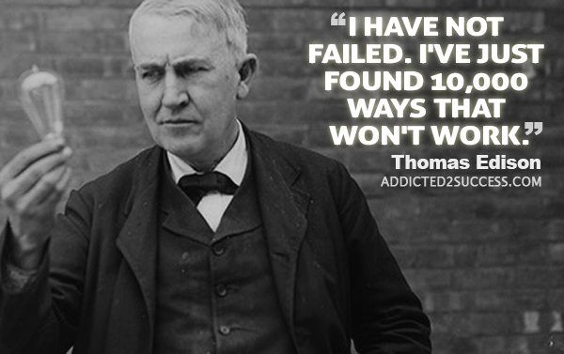
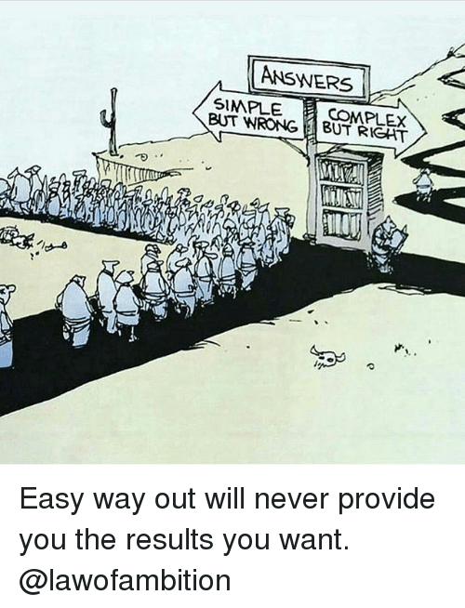
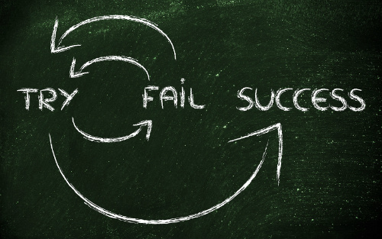
Power of the SDGP

Slide 16
Timeline
Dec 2016:
Introduced organizers as a method to improve writing in S.S.
Began using common language in both classes
Shared Assignment DBQ: researched in SS and organized/revised/wrote essay in LA.
Discussed results with SS teacher
Sept. 2016:
Gathered baseline data through writing sample
Met with SS teacher to discuss results, common concerns, and initial strategies.
Oct-Nov 2016:
Implemented and practiced grid organizer strategy with students in language arts
Worked with Applied Research teachers on shared assignment, which raised level of engagement

Slide 17
Timeline
March-April 2017:
Implemented flipped classroom procedures to free up time for conferring
Researched the use of Kaizena as an oral feedback tool to be used as a reference
Dec. 2016-February 2017:
Implemented use of Comment Tool on Google Drive to assist students in editing their writing
Implemented use of color coding on various assignments in language arts
Worked with SS teacher to create shared rubric
Met with teacher in Demarest to discuss DBQ procedures and created model.
Created plan for trimester 2.
Feb 2017:
Conducted second shared assignment with new procedures in place
Met with SS teacher to discuss results
May 2017
Shared DBQ Assignment
Met with SS teacher to discuss results

Slide 18
Other Benefits
Accerates Change
Collaboration and learning among staff

Slide 19
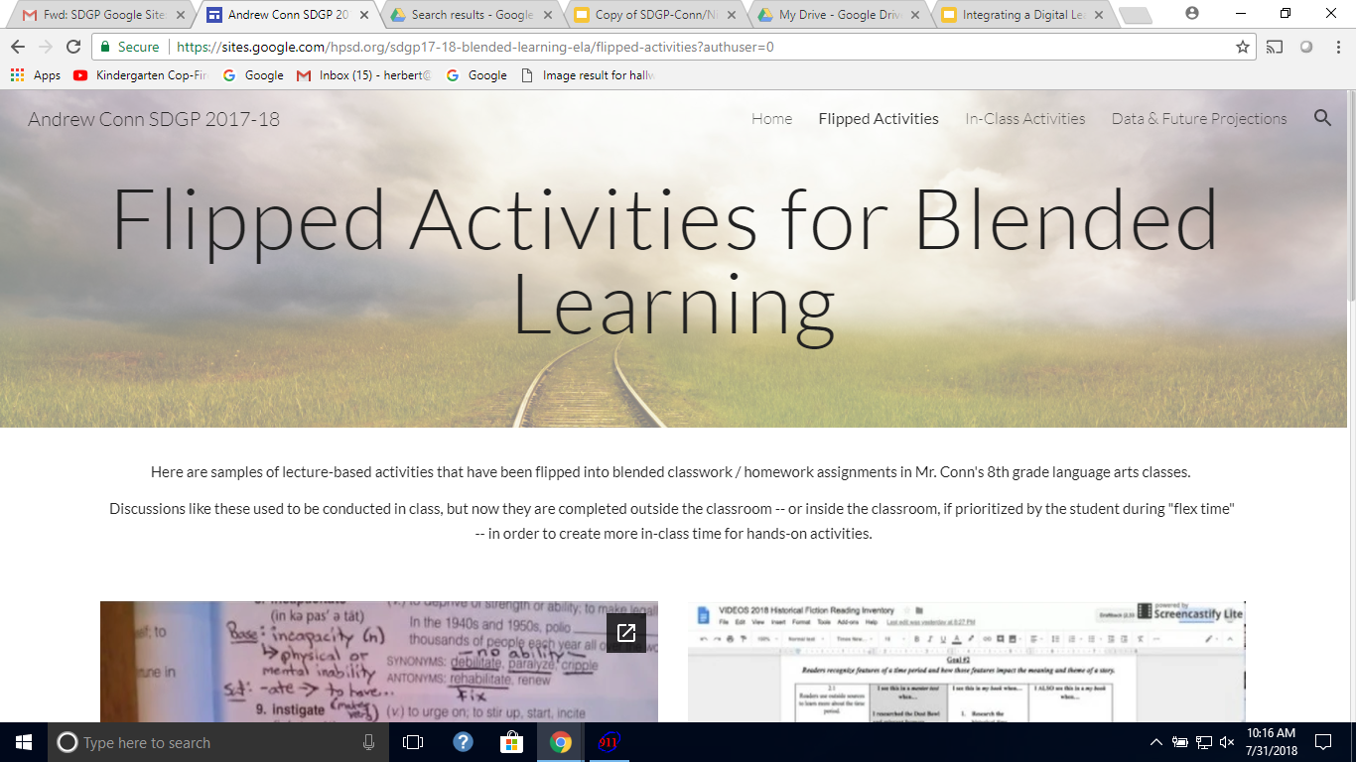
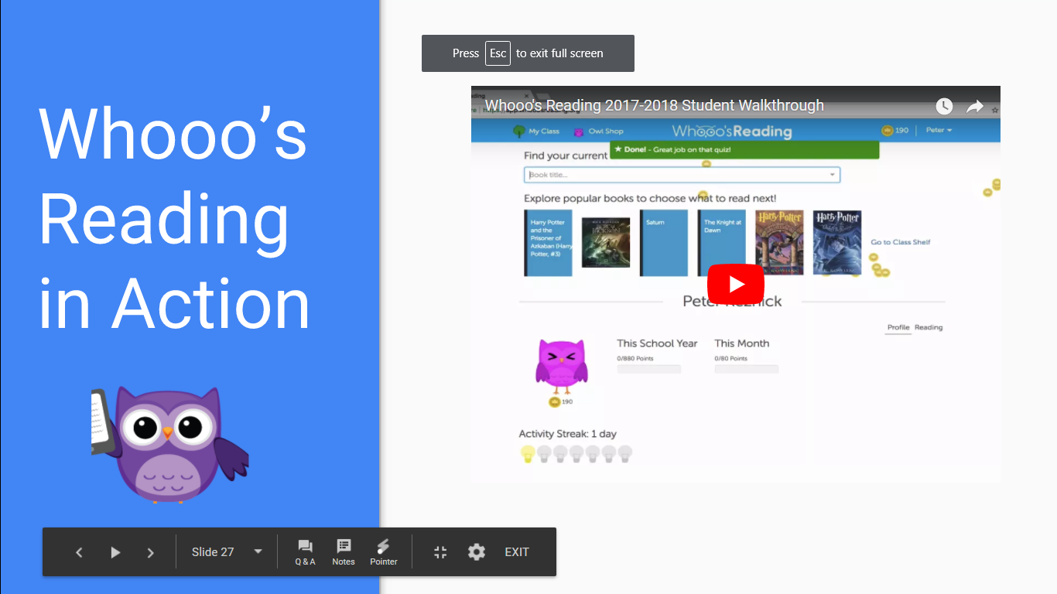
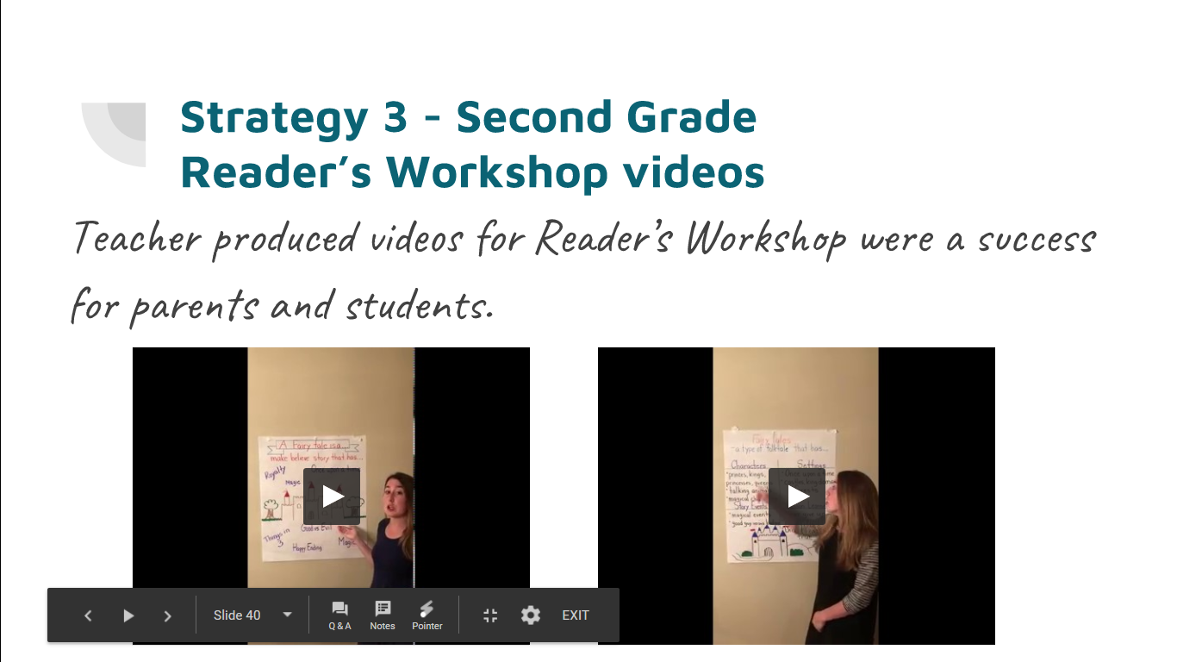
Examples

Slide 20
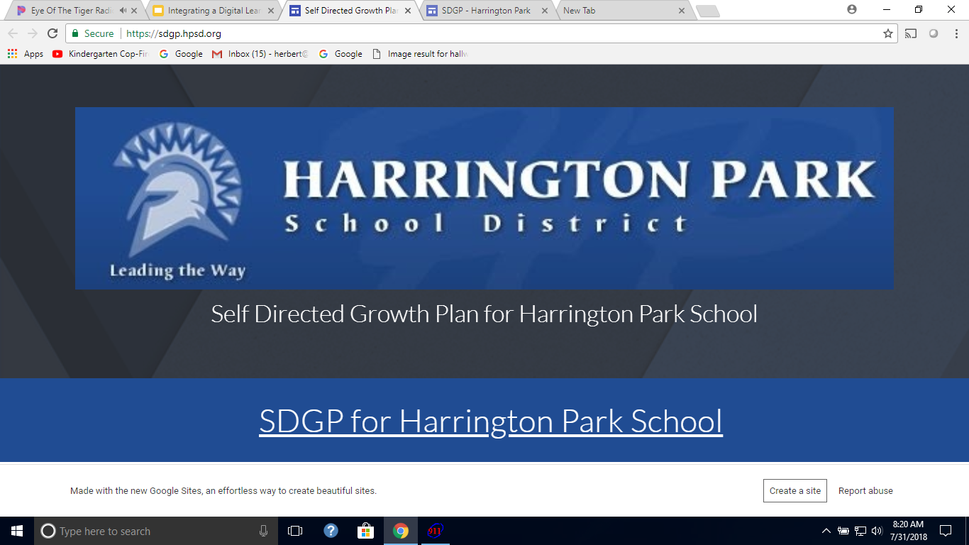
Actionable Research

Slide 21
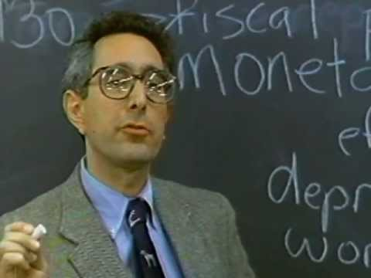
Faculty Meetings
Moved away from the “Sit and Get” model of faculty meetings
Made our time together meaningful

Slide 22
Learning Teams
In the beginning of the year, the administration identifies an area of focus
Teachers are grouped in Grade or Subject Level Teams
During the each month they are expected to discuss the topic
Each month, the teachers are asked to develop a lesson or complete a task within their Google Classroom related to the topic of the month
On a rotating basis, learning teams will be asked to present their work at the faculty meeting

Slide 23

Our Steps
13 - 14 School Year
Lead Team Examined Nimbus
14 - 15 School Year
School Level Goal was to Examine Nimbus
15-16 School Year
Google Exploration
16- 17 School Year
School Level Goal was to Examine Google Classroom

Slide 24
16-17 - Google Classroom
October Extending Learning Outside the School Day
November Supporting Parents/ Home Instruction
December Remedial Instruction/ Supports
January Assessments
February Differentiating Instruction - (Content)
March Differentiating Instruction - (Process)
April Student Collaboration
May Free Study

Slide 25
Additional Support
Morning teacher led technology sessions ( 1-2 offerings a week)
Columbus Day support
Walk Throughs which focus on device integration and blended learning model

Slide 26
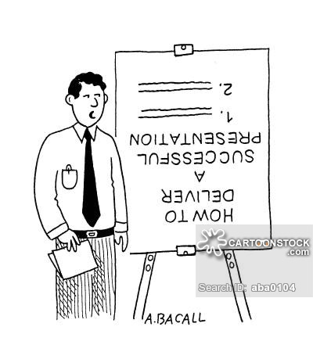
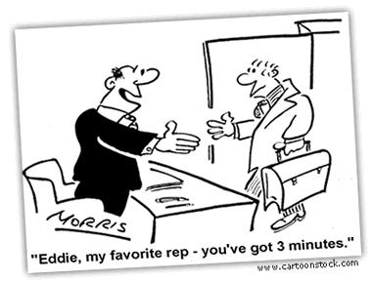

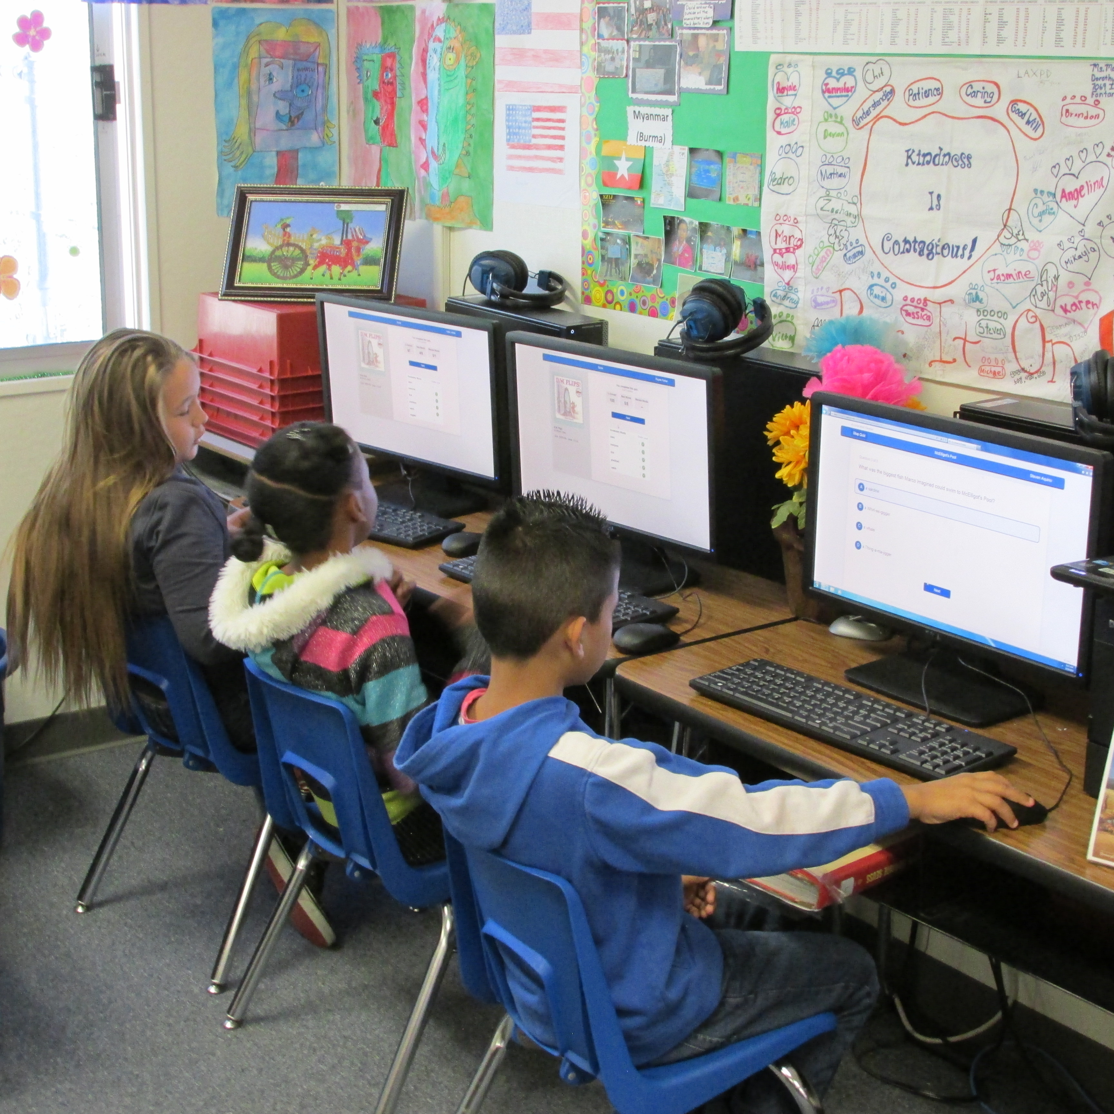
Changing the Digital Content Paradigm
Pre 2014

Slide 27

Micro-Cluster Work
Developers
Educators

Slide 28
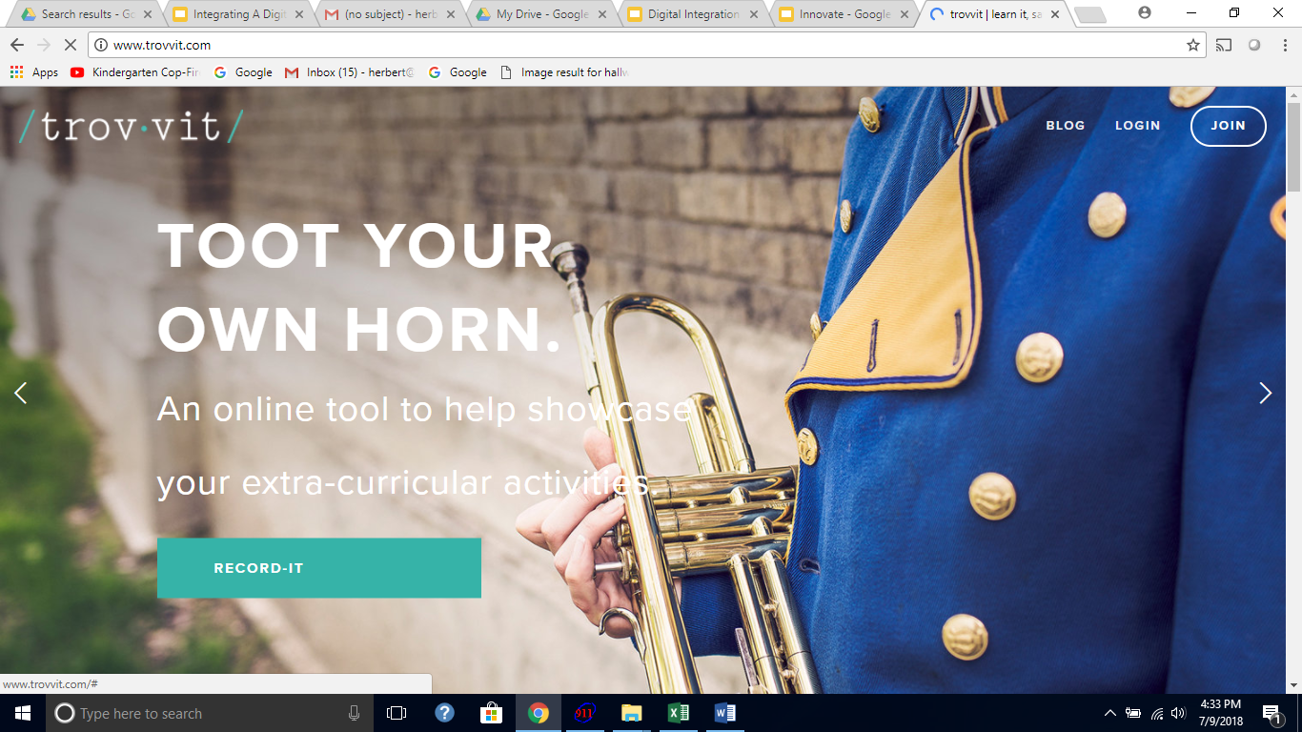

Micro Cluster in Action
6 Month Relationship
District uses the Application for Free/ Nominal Cost
District’s Feedback = Design Changes
Application meets the needs of the end user

Slide 29



Creating Symbiotic Relationships
Educators have a voice in the development of the application
Developers get data on how the application performs in the classroom

Slide 30
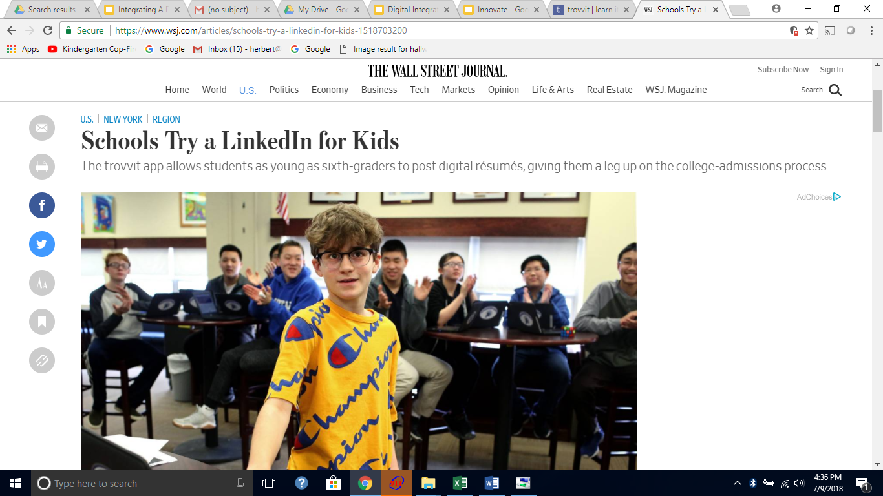
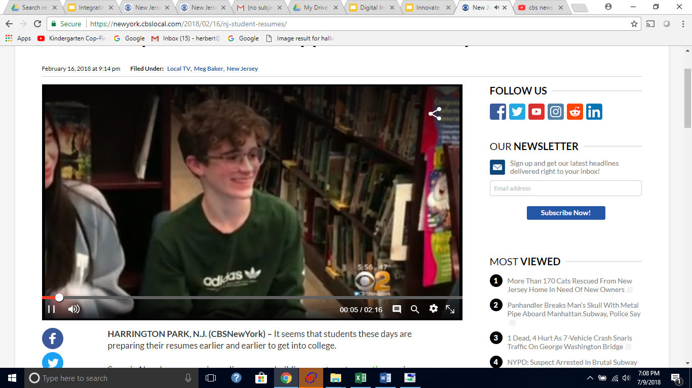
Trovvit

Slide 31
Questions

