Slide 1

Supporting and Encouraging Student Voice and Agency: Experiences and Resources
Webinar
January 20, 2022
Welcome! We will begin shortly.
If you can see the
slide and hear the
music, you are all set.
All attendees are muted upon entry.
Please use the chat feature for comments
and questions during the webinar.
www.learningforward.org
1
Notes:
This webinar will explore how to build capacity amongst educators as they seek to encourage more student voice and agency in their work. Panelists will share specific strategies/resources/tools so that schools and districts can access and use them.

Slide 2

Thank you for joining us
The webinar
will be recorded and available.
All webinar registrants will receive a follow-
up email that
will include the webinar slide deck, recording, and
other resources mentioned during the presentation.
Please introduce yourselves in the chat box
Your name
Your location
Your role in the educational sector
@learningforward

Slide 3

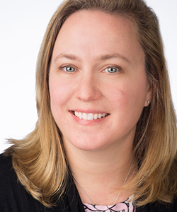
Let’s get started
Elizabeth Foster
Vice President Research & Standards
Learning Forward
Notes:
As the mom of a 16 year old who has some opinions about how school is going right now, I know personally that this topic is more important than ever. I am so proud of my daughter for the way she analyzes her own learning needs and the needs of others and I admire how brave she is when she shares her opinions about whether or not these needs are getting met. And I share her frustration when the outlets for her doing so are limited.
Professionally, I am also struck by the way students everywhere are speaking up and speaking out about their learning environments, racism, climate change, the economy and so much more.
Learning Forward recognizes that addressing student needs must be at the center of great teaching, and therefore authentic student voices must inform how we design professional learning. So we dedicated an entire issue to examining the ways to ensure that student voices are part of professional learning planning.

Slide 4

Students are speaking up
Notes:
Students are speaking up in, after, and about school in wonderful ways. They are driving and shaping their own independent study groups, and leading discussions in the classroom, starting from early ages through high school.
These are the most visible and publicized examples, but they remind us that students are prepared and eager to use their voices.
Students care so much about their world and their place in it
They know what they are talking about
We need to listen to them – not just in a performative way but in a way that will open us up, break our patterns, scare us a little maybe.
Today we will hear from experts why it is important to consider student voice and agency in your work and some ideas for how to facilitate and encourage
You might be wondering why we don’t have a student on the panel today. We discussed this and would like to do a follow up webinar to this one that would include students speaking for themselves. But for this webinar we are focusing on the professional learning and capacity building that is required for educators to embrace and support student voice and advocacy.

Slide 5
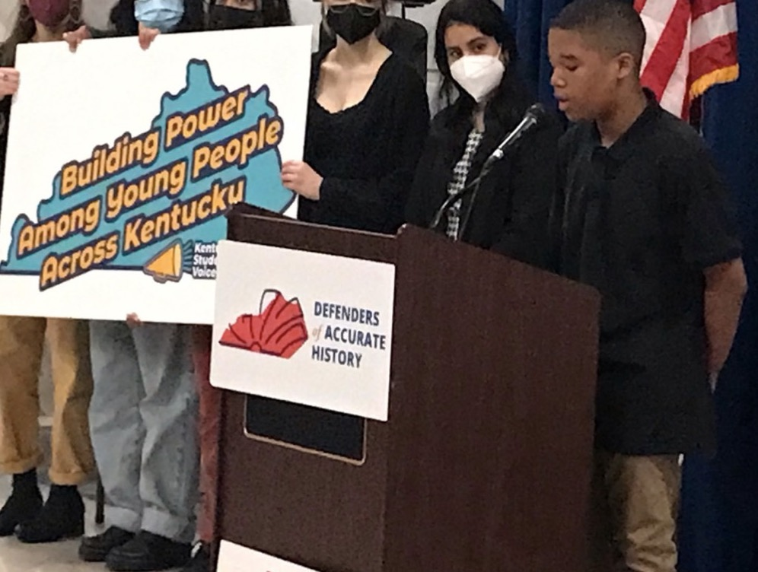
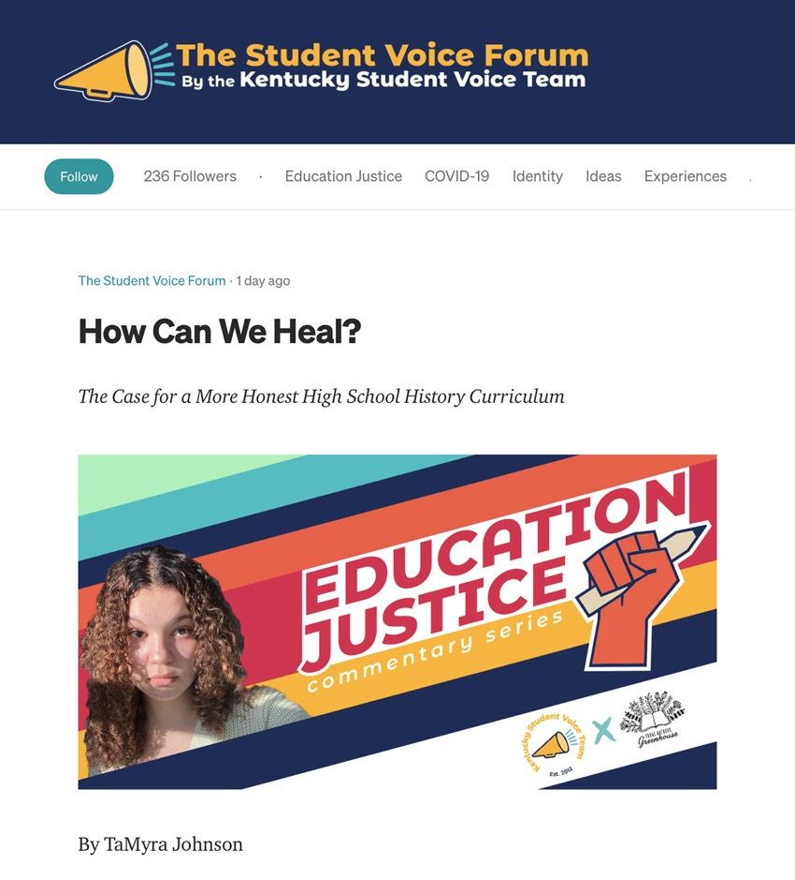
Students are influencing policy
Notes:
In addition, student advocacy groups are right now presenting to legislative sessions and writing blogs to influence policy.
(this link: https://studentvoiceforum.org/)

Slide 6
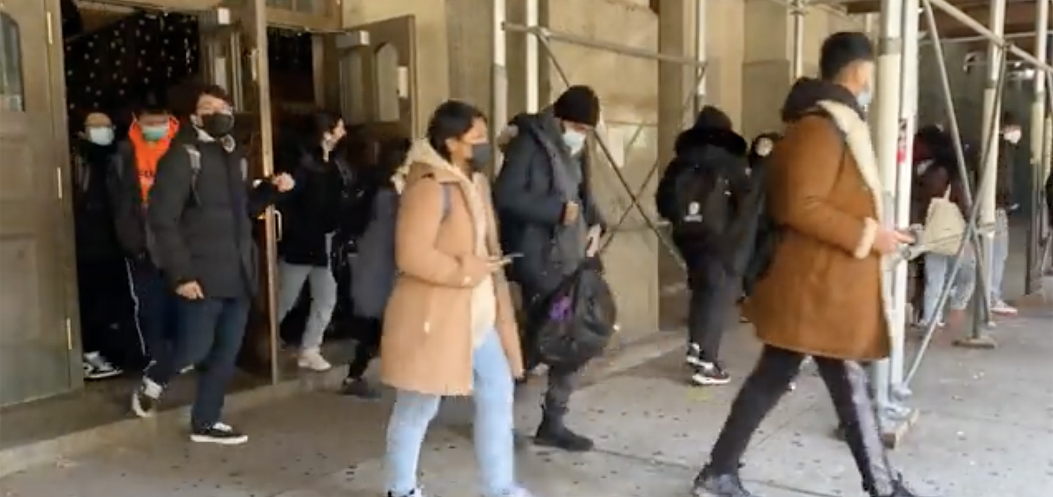
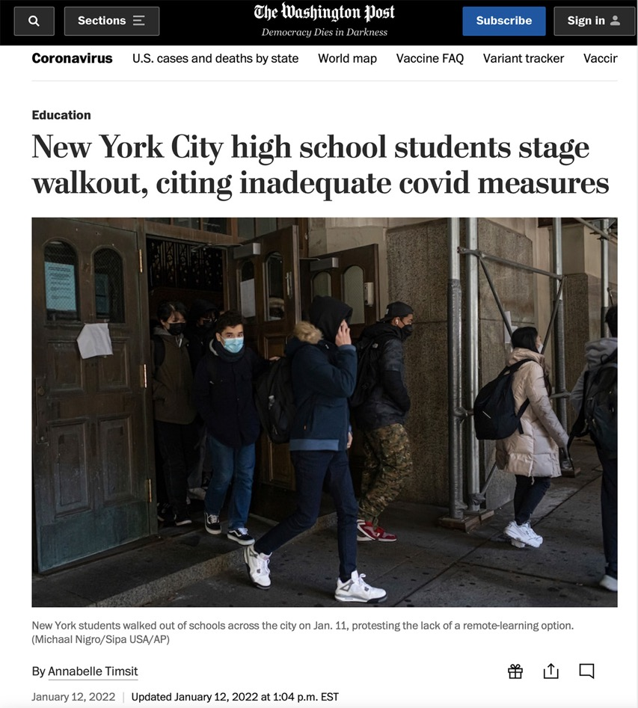
Students are advocating their own learning
Notes:
Students are shaking things up. In New York City, hundreds of students staged a walk out to advocate for remote learning for when students felt unsafe in school because of COVID.
https://www.washingtonpost.com/education/2022/01/12/new-york-high-schools-walkout-cororonavirus/

Slide 7
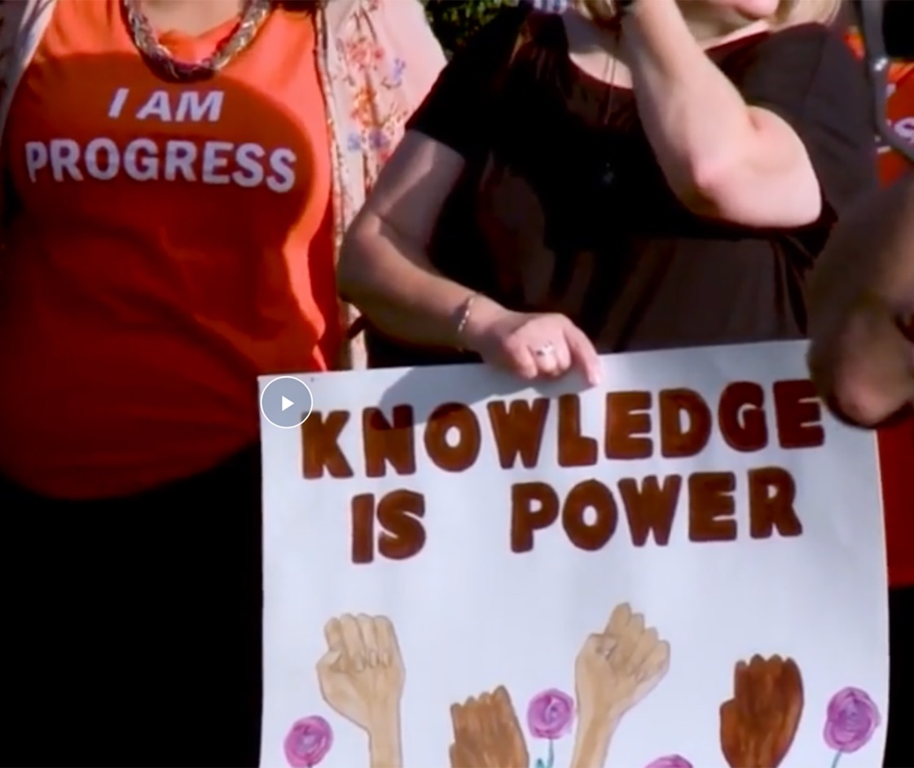
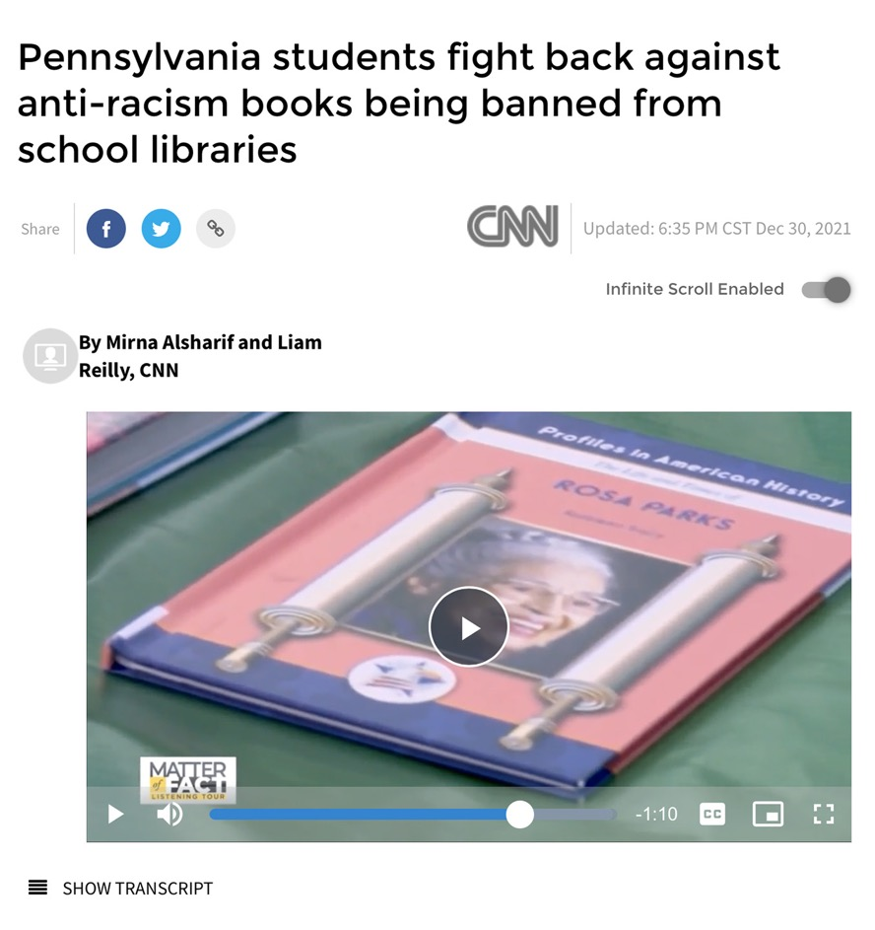
Students are eager to use their voices
Notes:
In Pennsylvania, students protested a book ban originally intended to expand the canon – they protested, wrote letters to the editor, and took to social media. The effort was led by five students.
(this link:
https://www.koco.com/article/students-fight-back-against-anti-racism-books-being-banned/38643129
These are the most visible and publicized examples, but they remind us that students are prepared and eager to use their voices.

Slide 8
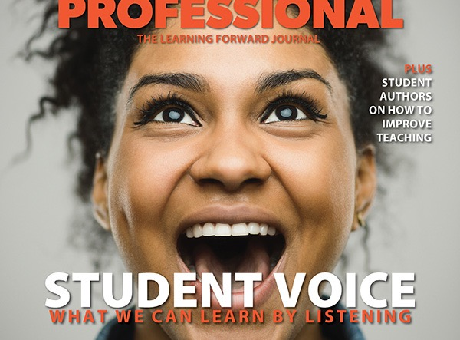
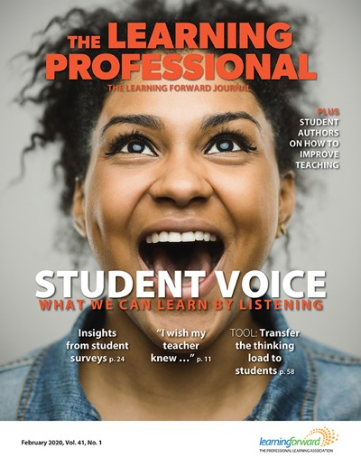
Read more about student voice
Notes:
Students care so much about their world and their place in it
They know what they are talking about
We need to listen to them – not just in a performative way but in a way that will open us up, break our patterns, scare us a little maybe.
Today we will hear from experts why it is important to consider student voice and agency in your work and some ideas for how to facilitate and encourage
You might be wondering why we don’t have a student on the panel today. We discussed this and would like to do a follow up webinar to this one that would include students speaking for themselves. But for this webinar we are focusing on the professional learning and capacity building that is required for educators to embrace and support student voice and advocacy.
Please check out our whole journal article about student voice – February 2020
If you are not already a member, you can use this code to sign up:
Get $10 off any new Learning Forward membership
Use coupon code LFWebinars*
Visit http://learningforward.org/membership
* Code valid for new members only

Slide 9
Poll — Student voice and agency
Do you intentionally encourage student voice in classes?
Is student voice and agency talked about in your teams
and PLCs?
Does your professional learning help you learn new strategies about student voice and agency?
Yes or No
How do YOU incorporate student voice?
Yes or No
Yes or No
Notes:
Updated EF

Slide 10
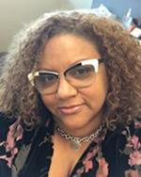

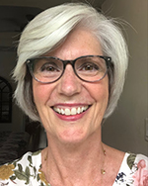
Panel discussion
Tammie Causey-Konaté
Senior Technical Assistance Consultant
American Institutes for Research (AIR)
Louisiana
Sharon Oldham
Consultant at Learning Forward and Hub Improvement facilitator
Texas Network for School Improvement (TXNSI)
Texas
Robyn Madison-Harris
Senior Technical Assistance Consultant
American Institutes for Research (AIR)
Louisiana
Notes:
We are so lucky today because we have an outstanding panel.
Robyn Madison-Harris
Senior Technical Assistance Consultant at American Institutes for Research (AIR) | + posts
Robyn Madison-Harris is a senior technical assistance consultant at American Institutes for Research (AIR). She supports state and local agencies in educator preparation, professional development, school approvement, and social-emotional learning. She designs and delivers technical assistance, conducts research, facilitates data-focused inquiry sessions to support school improvement and equitable access. Madison-Harris co-leads cultural and linguistic competence capacity building at AIR and engages in comprehensive action planning, resource development, and organization-wide training to support the integration of cultural and linguistic competence into all policies, practices, and projects.
Tammie Causey-Konaté
Senior Technical Assistance Consultant at American Institutes for Research (AIR) | + posts
Tammie Causey-Konaté is a senior technical assistance consultant at American Institutes for Research (AIR). She leads the implementation of equity-focused initiatives for impact in areas including workforce diversification, leadership, educator effectiveness, and cultural and linguistic competence. Her areas of expertise include equity, school improvement, social and emotional learning, cultural and collective trauma, and trauma-informed educational practices. Causey-Konaté co-leads cultural and linguistic competence capacity building at AIR and engages in comprehensive action planning, resource development, and organization-wide training to support the integration of cultural and linguistic competence into all policies, practices, and projects. Previously, Causey-Konaté served as deputy director of the Southeast Comprehensive Center at AIR.
Sharon Oldham
Consultant at Learning Forward | + posts
Sharon Oldham is a Learning Forward consultant with 32 years of public education experience specializing in math education and instructional coach development. She has served as a middle and high school teacher, a secondary coordinator, a director of secondary instruction, and a professional learning facilitator to guide others in the creation and delivery of standards-aligned instruction. Oldham is currently working as a Hub Improvement facilitator for Texas Network for School Improvement (TXNSI) where she coaches middle school principals and teacher teams as they implement continuous improvement processes and tools to design equitable instruction.

Slide 11
Supporting and Encouraging Student Voice and Agency: Experiences and Resources
Tammie M. Causey-Konaté, PHD, Senior Consultant | Robyn Madison, EdD, Senior Consultant
Learning Forward| December 2021

Slide 12
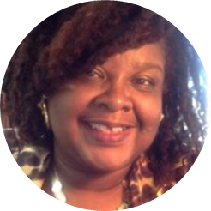
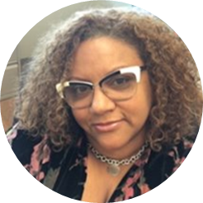
Meet the Presenters
Tammie Causey-Konaté, PhD
Robyn Madison, EdD
Senior Consultant,
Center on Great Teachers and Leaders at the American Institutes for Research (GTL Center)
tcausey@air.org
Senior Consultant,
Center on Great Teachers and Leaders at the American Institutes for Research
rmadison-harris@air.org

Slide 13
The Empirical Backdrop
Student Agency and Voice

Slide 14

Student Agency as a Personalized Learning Component
While there are many definitions and frameworks for personalized learning, they share the same central themes:
  Student-centered learning
  Student agency
  Demonstrated mastery of competencies
  Flexible learning, including remote/virtual and hybrid learning models
  Supporting the whole child
Source: https://www.air.org/developing-core-elements-personalized-learning
images.all4ed.org/ PHOTO CREDIT: Photo by Allison Shelley/The Verbatim Agency for EDUimages

Slide 15
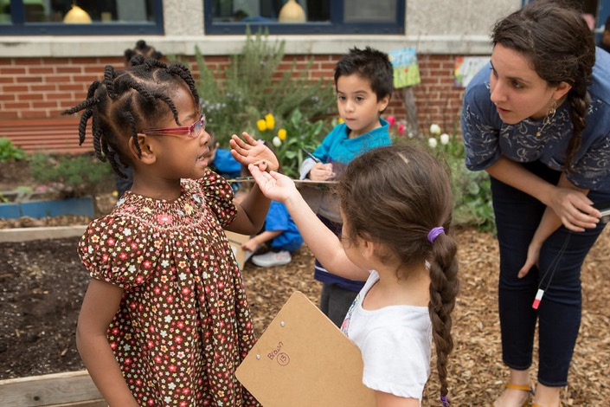
Student Agency as a Personalized Learning Component
Student-Centered Learning and Student Agency
When teachers embrace a student-centered approach, classroom content, instructional practices, and assessments are driven by student’s strengths, needs, and interests.
Student agency, or students' ability to manage their own learning, and instructional practices that foster student agency are inherent in student-centered learning.
Both students and teachers need easy access to student data, through a learner profile, to foster student agency and take a student-centered approach.
Source: https://www.air.org/developing-core-elements-personalized-learning

Slide 16


Regional Education Laboratory (REL) Southwest: Ask A REL
What is the relationship between student agency and student outcomes?
Student agency is defined as placing students in the role of active agents of
their own learning.
A recent synthesis of this concept noted that there are past, present, and future components to student agency:
  • Setting advantageous goals
  • Initiating action toward those goals
  • Reflecting on and regulating progress toward those goals.
https://ies.ed.gov/ncee/edlabs/regions/southwest/ask-a-rel/AAR-26-Student-Agency-508.pdf

Slide 17
REL SW: Ask A REL
Findings:
A. Self-directed learning (SDL) skills are the basis of lifelong learning, and SDL development across the curriculum is recommended.
B. The goals of Problem-Based Learning (PBL) include helping students develop flexible knowledge, effective problem-solving skills, SDL skills, effective collaboration skills, and intrinsic motivation, and lifelong learning skills.

Slide 18
REL SW: Ask A REL
Findings:
C. SDL includes giving students a broader role in the selection and evaluation of learning materials.
D. For elementary grades through college, it is more effective to explore quality measures of homework such as managing distractions, self-efficacy and perceived responsibility for learning, setting goals, self-refection, managing time, and setting a place for homework completion than only measuring the amount of time spent on homework.

Slide 19
REL SW: Ask A REL
Findings:
E. Positive relationships exist among classroom goal structure, achievement goal orientation, motivation, and self-regulated learning.
F. Self-Regulated Strategy Development (SRSD), involves teachers providing background knowledge, discussing strategy with student, modeling strategy, helping student memorize strategy, supporting strategy, and then watching as the student independently performs the strategy; and is especially appropriate for students with learning disabilities.

Slide 20
Research to Practice
Facilitating Student Agency and Elevating Student Voice

Slide 21

Framing Equity: Four Equity Dimensions
Access
Identity
Dominant
Critical
Achievement
Power
Source: Adapted from Gutierrez, R. (2009). Framing Equity: Helping Students “Play the Game and Change the Game. Retrieved from https://www.todos-math.org/assets/documents/TEEMv1n1excerpt.pdf

Slide 22

Agency and Voice
What Learners Feel and Are Enabled to Do
Feeling empowered to communicate learnings to others
Using agency to impact the broader community in which they learn and live
Feeling empowered to take ownership of their own skill-set as a learner and doer
Using agency to advocate for more information
Source: Adapted from Speranzo, Harris, Gulotta, & Castellano (2019). Agency and Voice: A Push for Greater Equity and What It Looks Like in Math. http://www.ifl-news.pitt.edu/2019/06/agency-and-voice-a-push-for-greater-equity-and-what-it-looks-like-in-math/

Slide 23
Advancing Student Agency and Voice Through Spoken Word
Cross Pollinating Culturally Sustaining Pedagogy and Universal Design for Learning
Attends to what (multiple means of representation), how (multiple means of action and expression), and why (multiple means of engagement)
Focuses on individual learner differences and the full range of student diversity expressed in all aspects of curricular design
Consciously enacts love to combat dehumanization of marginalized communities – preserving and nurturing linguistic, literate, and cultural pluralism
Advocates complex conceptualizations of culture – honoring the fluid and hybrid identities of students
Views their dynamic engagements through critical and additive lenses
Universal Design for Learning
Culturally Sustaining Pedagogy
Student Agency & Voice
Source: Coppola, Woodard, & Vaughan (2019). And the Students Shall Lead Us: Putting Culturally Sustaining Pedagogy in Conversation with Universal Design for Learning in a Middle-School Spoken Word Poetry Unit. https://journals.sagepub.com/doi/full/10.1177/2381336919870219

Slide 24

Hip-Hop Based Education: Student Agency and Voice
Application of Two Hip-Hop Pedagogical Practices
This Photo by Unknown Author is licensed under CC BY-SA
CO-TEACHING may support student agency and voice,
  Encouraging students to manage their own learning, find their voices, and hone communication skills
  Requiring students to set goals, pursue goals, and monitor progress toward achievement of goals
  Enabling students to tap shared realities and conditions to enhance learning
  Advancing high expectations and an asset focus
  Requiring them to take stock of their and other students’ strengths, needs, and interests
CALL-AND-RESPONSE functions as …
An expression of identity
A means of emphasizing key concepts and conveying cognitive information
A mechanism for tapping students’ culture and life outside school through rhythm
A form of active engagement and information exchange that generates
high energy
Source: Adjapong & Emdin (2015). Rethinking Pedagogy in Urban Spaces: Implementing Hip-Hop Pedagogy in the Urban Science Classroom. https://files.eric.ed.gov/fulltext/EJ1071416.pdf
Notes:
Co-Teaching – supporting ss agency and voice in science class; influence how and what ss learn; able to interact differentlywith peers; foster ss understanding of content; understanding shared realities and conditions to enhance learning; able to talk to lare numbers of others, trusted by teacher and peers; developing voice and public speaking skills
Call-and-Response (supporting ss understanding of science content
Call and response is considered integral to communicative behavior and functions as an expression of identity and as a means of conveying cognitive information among African Americans (Cazden, 1988).

Slide 25
Adjapong, E. S., & Emdin, C. (2015). Rethinking pedagogy in urban spaces: Implementing Hip-Hop pedagogy in the urban science classroom. Journal of Urban Learning Teaching and Research, 11: 66-77. https://files.eric.ed.gov/fulltext/EJ1071416.pdf
Coppola, R., Woodard, R., & Vaughan, A. (2019 August). And the students shall lead us: Putting Culturally Sustaining Pedagogy in conversation with Universal Design for Learning in a middle-school spoken word poetry unit. Literacy Research: Theory, Method, and Practice, 68(1): 226—249. https://journals.sagepub.com/doi/full/10.1177/2381336919870219
Gutierrez, R. (2009). Framing Equity: Helping Students “Play the Game and Change the Game. Teaching for Excellence and Equity in Mathematics, 1(1), 4-7. https://www.todos-math.org/assets/documents/TEEMv1n1excerpt.pdf
Speranzo, L., Harris, A., Gulotta, J., & Castellano, J. (2019 June). Agency and Voice: A Push for Greater Equity and What It Looks Like in Math. Bridges to learning: Research, Practice, Results. http://www.ifl-news.pitt.edu/2019/06/agency-and-voice-a-push-for-greater-equity-and-what-it-looks-like-in-math/
Dynan, L., Cate, T., & Rhee, K. (2008). The impact of learning structure on students’ readiness for self-directed learning. Journal of Education for Business, 84(2), 96–100. Retrieved from https://www.researchgate.net/publication/254344825

Slide 26
Hmelo-Silver, C. E. (2004). Problem-based learning: What and how do students learn? Educational Psychology Review, 16(3), 235–266. Retrieved from http://kanagawa.lti.cs.cmu.edu/olcts09/sites/default/files/Hmelo-Silver_2004.pdf
Loyens, S. M. M., Magda, J., & Rikers, R. M. J. P. (2008). Self-directed learning in problembased learning and its relationships with self-regulated learning. Educational Psychology Review, 20(4), 411–427. Retrieved from https://link.springer.com/article/10.1007/s10648-008-9082-7
Ramdass, D., & Zimmerman, B. (2011). Developing self-regulation skills: The important role of homework. Journal of Advanced Academics, 22(2), 194–218. Retrieved from https://www.davidsongifted.org/Search-Database/entry/A10702
Shannon, D., Salisbury-Glennon, J., & Shores, M. (2012). Examining the relationships among classroom goal structure, achievement goal orientation, motivation and self-regulated learning for ethnically diverse learners. Journal of Research in Education, 22(2), 136– 168. https://eric.ed.gov/?id=EJ1098427
What Works Clearinghouse. (2017). Self-regulated strategy development (What Works Clearinghouse Intervention Report). Washington, DC: Institute of Education Sciences, U.S. Department of Education. https://eric.ed.gov/?id=ED577336

Slide 27
TAMMIE CAUSEY-KONATÉ, PHD
ROBYN MADISON, EDD
Senior Consultant
+1.504.481.6680
tcausey@air.org
Senior Consultant
+1.202.403.5949
rmadison@air.org

Slide 28


Using Student Voice to Spur
Continuous Improvement
Sharon Oldham

Slide 29
Empathy means listening with humility and trying to more deeply understand the experiences and feelings of other people.
Empathy
Notes:
EMPATHY itself is a mindset. It’s a way to do the work.
To do the work, there are also empathy tools. Important to remember that it isn’t just about a tool - it’s about the big picture/mindset.
Its a muscle that is not well-developed in our work spaces and we need to practice it.
Empathic Listening is listening to hear, not to respond (Stephen Covey)
Empathy – Brene Brown – Feeling what someone else if feeling
Type 1 Understanding: I’ve been there, I’ve walked that & experienced it
Type 2 Understanding: I can see what that feels like, but I’ve never experienced it
Key words here:
HUMILITY -
TRYING -
EXPERIENCES + FEELINGS -

Slide 30

Tell me about a time you learned something new.
What was easy about it?
What was hard?
Probes - Use ONLY probes that start with:
“Why…”
“How did you feel?”
“Tell me more about ____”
Notes:
Breakout rooms
3 min each (6 min total)
Rules of engagement:
practice listening
practice storytelling
No “conversations”
When they return
Share - Without using a Name or part of their story – Share One need you learned that your partner has. (Give an example)
If lots of participants, have a couple share out, while the others put in the chat

Slide 31
Why Empathy Interviews
Research
See the System
Data
Diverse
Lived Experience
Notes:
Goal: Understand the Purpose of Empathy Interviews
1 min
Pause: What resonates with you. Chat how it might impact your future work.
Why are we even here today? Why empathy interviews? Let’s ground in the why before we talk about the what.
Be Human-centered – Our improvement processes prioritize the perspectives and lived experiences of the people we are designing for.
With all of your focus on improvement networks, we’re sure you are all very familiar with the principle of SEE THE SYSTEM.
Organizations are getting better at collecting data about their users
Research using data tells us about why something is happening
But this info may not translate to lived experience and need to gather those stories especially the lived experienced of BIPOC
One way to ensure that your “seeing the system tools” support a deep understanding of systemic barriers to transformation aren’t left unexamined is to prioritize and VALUE qualitative data of the lived experiences of those within your system. Specifically the experiences of Black, Indigenous, and People of Color.
(If time permits, and it feels appropriate, bring in…)
White dominant culture traits to bring awareness to at this point:
There is one right way: The path to power lies here and there is only one way to get there so everyone needs to learn the same things, in the same way, at the same time, and come up with the same answer in order to be like us.
Valuing quantity over quality: Uniformity allows for mass production and standardized grading practices. Checking off whether you got the answer right rather than deepening your perspective and skill level.
Belief in objectivity: The western white male lens on the world is defined as the objective view. This world is linear, siloed, based on control, and limited to what can be observed with the eye.
Worship of the written word: If it’s not in writing (by a white male author), it is neither valuable nor true. Writing skills are more highly valued than other information

Slide 32

Why Empathy Interviews
Identify or narrow down a systemic problem your team will work on
Uncover hidden needs that aren’t being met within the current system
Understand a problem and its root causes more deeply
Understand differences among users
Get inspiration for a change idea
Get feedback on a change idea
Notes:
Think about all the ways that these stories we just heard inform the “Why”
- Facilitator share an example, and then open it up to the participants to share

Slide 33
Open-ended questions to elicit stories
Semi-structured protocol with lots of probing from just a few questions
One-on-one live (or virtual) conversations
Empathy Interviews

Slide 34
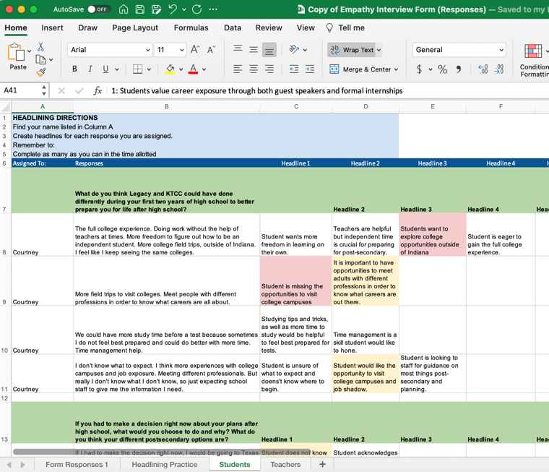
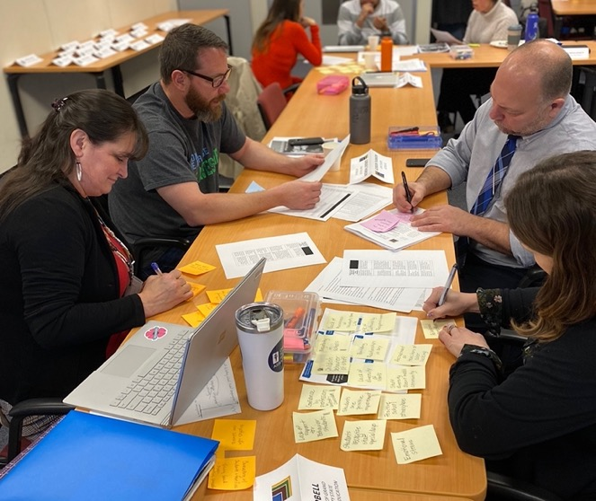
Create Headlines & Themes
Remain descriptive
Stick to the data
One idea per headline
Not too long, not too short
Categorize
Create Themes
Notes:
Give teams a “where are we going with this headlining…”
Julie :
Inclusive experience- diverse identities, diverse lived experience, diverse views on the system.
Ultimately we want to find themes that cut across story, because those are systemic issues.
But first we need to pull headlines from individual stories

Slide 35
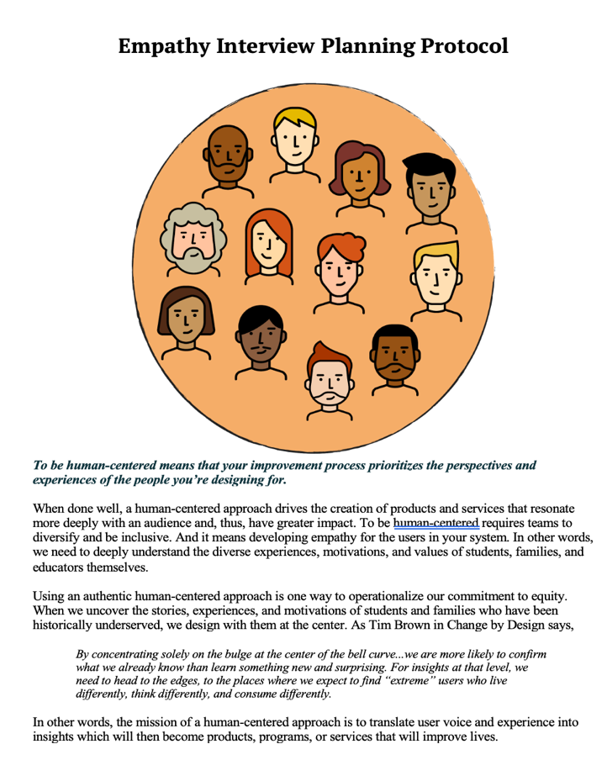


Resources:
Empathy Interview Planning Protocol
Empathy Interview Article
Notes:
So how do we get started?

Slide 36

Discussion and
Questions
36

Slide 37
Let us hear from you
Please fill out our
post-webinar
survey
https://www.surveymonkey.de/r/NBZ6229

Slide 38

Learning Forward is pleased to announce
Use the Powered
by Title II
website to
raise awareness
in your own community
and to develop your personal advocacy plan.
A website designed to provide:
Background facts and data on Title II
Tools to support your advocacy
The latest news on Title II
Research on the effectiveness of professional learning
poweredbytitleii.com

Slide 39
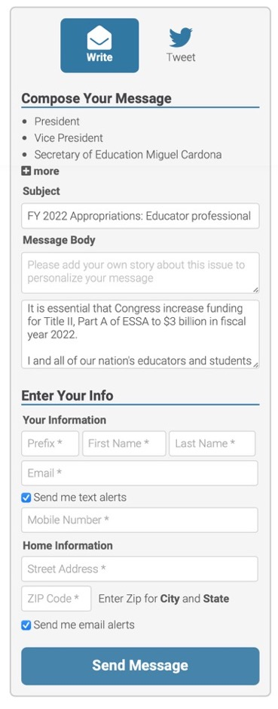
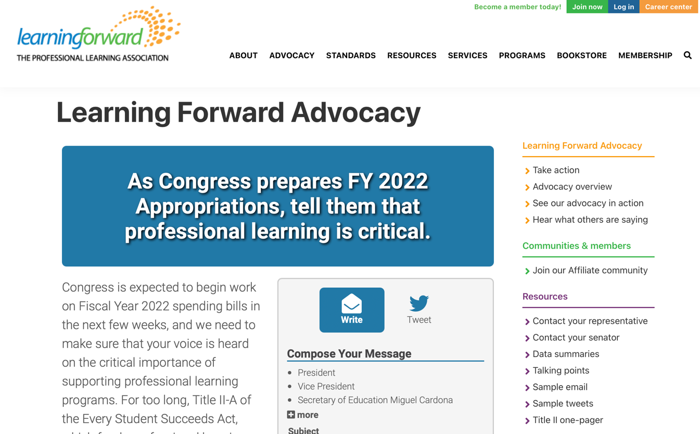
Be an Advocate
Notes:
THIS IS AN OPTIONAL PROMO SLIDE.

Slide 40

Mark your calendars
TUESDAY January 25 3 pm ET | Thursday February 10 3 pm ET | Thursday February 24 3 pm ET
Coaching with Impact: Enacting Partnership Principles through the Jim Knight Coaching Model | Retaining Educators Through Transition | Communication and Collaboration in a Divided World

Slide 41
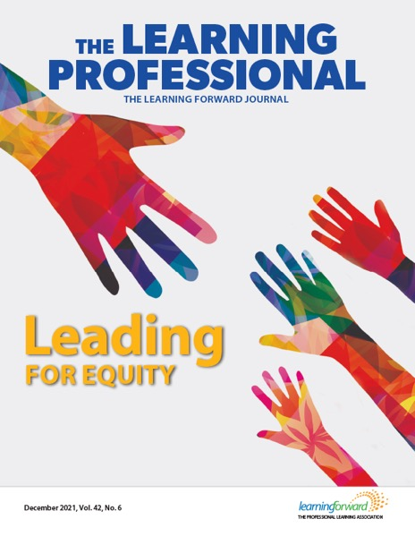
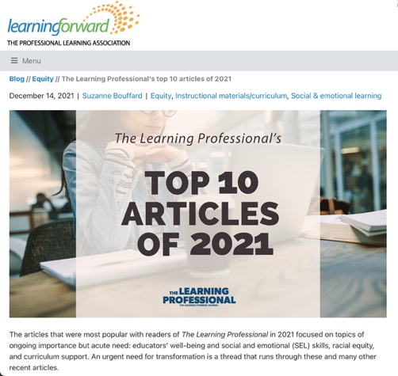
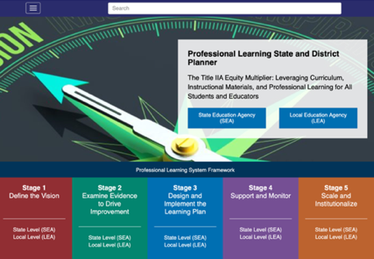
Online resources
Look for follow-up resources, including a recording of this
webinar and slides
Read latest issue of
The Learning Professional
Check out the
Learning Forward blog
Use the planner at
Professional Learning State
and District Planner
Notes:
THIS IS AN OPTIONAL PROMO SLIDE.

Slide 42

Thank you!

