Slide 1

Elementary and Secondary School Emergency Relief
ESSER Funds:
Creating District Impact
Webinar
January 13, 2022
Welcome! We will begin shortly.
If you can see the
slide and hear the
music, you are all set.
All attendees are muted upon entry.
Please use the chat feature for comments
and questions during the webinar.
www.learningforward.org
1

Slide 2

Thank you for joining us
The webinar
will be recorded and available.
All webinar registrants will receive a follow-
up email that
will include the webinar slide deck, recording, and
other resources mentioned during the presentation.
Please introduce yourselves in the chat box
Your name
Your location
Your role in the educational sector
@learningforward
Notes:
Good afternoon. Want to welcome all of you to this webinar.
As we are gathering, please take a moment to include in the chat box your name and role (as so many of you are already doing).
My name is Melinda George and I am the Chief Policy Officer for Learning Forward. It is my honor to welcome all of you today. I also want to introduce my colleagues who are working on this webinar with me. Ariel Durham is handling all of the technical aspects and Suzanne Bouffard is our chat box moderator. Suzanne will make sure to capture your questions for the discussion with our panelists.
A few reminders as we get started:
These webinars are off the record. While they are public and even recorded, we want to give our panelists the grace and space to share their journey with us. We are about building community so please honor this request to be here to learn together.
As I just mentioned, our panelists have agreed to share their own experiences along this journey. They do not have all the answers but they are willing to share some of their great learnings in the hopes that there are strategies, resources or ideas that you as attendees can use in your own educational contexts.
Every registered attendee will get a copy of the slides, a link to a recording of the webinar and a list of the resources shared in the chat box shortly after the webinar.
Please change the default “to” link in your chat box. The current default is to panelists only but we want to be sure that your comments, ideas and questions go to panelists AND attendees.

Slide 3
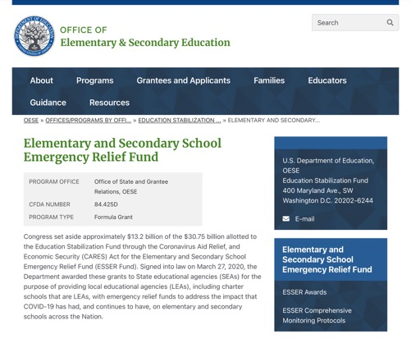
COVID relief funds abound
Elementary and Secondary School
Emergency Relief (ESSER) Fund:
3/27/20 | Coronavirus Aid Relief, and Economic Security (CARES) Act | $13.2 billion in ESSER funds
12/27/20 | Coronavirus Response and Relief Supplemental Appropriations Act (CRRSA) | $54.3 billion in ESSER II funds
3/11/21 | American Rescue Plan (ARP) Act | $122 billion in ARP ESSER funds
https://oese.ed.gov/offices/education-stabilization-fund/elementary-secondary-school-emergency-relief-fund/
Notes:
https://oese.ed.gov/offices/education-stabilization-fund/elementary-secondary-school-emergency-relief-fund/
Since the pandemic hit in mid-March 2020, there have been significant funds (through three legislative actions) allocated to states, districts and schools to address the immediate and future needs of students and educators as a result of the pandemic. These funds total almost $190 billion that have gone to schools and districts.
Elementary and Secondary School Emergency Relief (ESSER) Fund:
3/27/20 - Coronavirus Aid Relief, and Economic Security (CARES) Act: $13.2 billion in ESSER funds
12/27/20 - Coronavirus Response and Relief Supplemental Appropriations Act (CRRSA): $54.3 billion in ESSER II funds
3/11/21 - American Rescue Plan (ARP) Act: $122 billion in ARP ESSER funds
Today we are going to focus on the American Rescue Plan funds but it is important to put this into the context of other COVID-relief funding as well as ongoing allocations that districts receive.

Slide 4
The American Rescue Plan (ARP)
Professional learning is an allowable and critical use of the ARP funds
States are required to send 90% of the funds to school districts
20% of funds must be used to address learning loss
80% of funds for any authorized activity in current education law
Notes:
For the American Rescue Plan, funds were allocated to states (and states to districts) based on the formula used for Title I but the allowable uses for the funds are very broad.
States are required to send 90% of the funds to school districts. For those funds:
20% of funds must be used to address learning loss – summer learning, tutoring, extended school year programs – reach the most disadvantaged students
80% - any authorized activity in current education law;
For the Learning Forward community, in particular, know that professional learning is an allowable and critical use of the funds. Professional learning should be at the top of the list of investments you make to address your most urgent challenges. You will hear today how districts have been doing just this - targeting these funds to support the educator workforce.

Slide 5

Data, data, data
Six steps to measuring impact
1 | Identify the desired outcomes of your professional learning efforts.
2 | Identify the indicators that will demonstrate the effectiveness of professional learning.
3 | Identify the measurement instruments you will use to track progress.
4 | Identify your baseline data.
5 | Measure, measure, measure.
6 | Share your findings.
https://learningforward.org/2021/04/02/want-your-arp-funds-to-have-long-term-impact-collect-data/
Notes:
As districts plan for spending this funding, there is a critical component that I want to underscore. In three years, policy makers and community members are going to say, we gave the education community an enormous amount of money. What do they have to show for it? For you all, as district leaders, I want you to think about how you are going to answer that question.
Data has to be a part of your planning and implementation. Last spring, I wrote a Learning Forward blog focused on measuring the impact of ARF funds. Here are some of the steps that I included.
Six Steps to Measuring Impact
Identify the desired outcomes of your professional learning efforts.
Identify the indicators that will demonstrate the effectiveness of professional learning.
Identify the measurement instruments you will use to track progress.
Identify your baseline data.
Measure, measure, measure.
Share your findings.
https://learningforward.org/2021/04/02/want-your-arp-funds-to-have-long-term-impact-collect-data/

Slide 6
Let’s check in
Do you know (in round numbers) how much funding your district has received in COVID-relief funding?
Has your district published
a plan for the use of those funds?
Is professional learning and/or other educator supports part of that plan?
Yes or No
What is your district doing with its COVID relief funding?
Yes or No
Yes or No

Slide 7
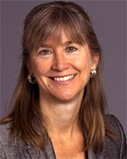
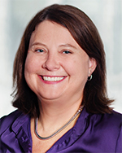
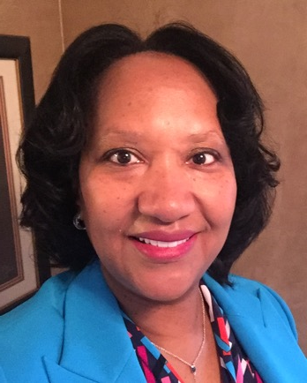
Panel discussion
Karolyn Belcher
Chief Academic Officer
Charleston County School District
Charleston, SC
Jennifer Colley
Professional Development Specialist
Jefferson County Public School System
Louisville, KY
Karen Hawley Miles
President and CEO
Education Resource Strategies, Inc.
Elmhurst, IL
Notes:
We are so lucky today because we have an outstanding panel.
We are going to kick our panel off with Karen Hawley Miles, president and CEO of Education Resource Strategies, Inc. I have known Karen for a long time and have always been impressed that she and her colleagues at ERS do great work in helping school districts to maximize their funding systems, school-level resource use, and human capital and professional development systems. When I saw her new report, “MOVING FROM PLAN TO ACTION: AN ANALYSIS OF DISTRICTS' ESSER PLANS” come out at the end of November, I knew she was a must have for this panel.
Karolyn Belcher is the chief academic officer of the Charleston County School District (CSSD). In that role, she is responsible for leading the academic improvement strategy for South Carolina’s second-largest school district. This includes CCSD’s curriculum adoption, professional learning, and COVID recovery planning. Again – the right person for this webinar. I also knew of Karolyn when she was the president of TNTP. She has also been a teacher and a principal. Welcome!
We will complete our panel with Jennifer Colley. Jennifer is a retired administrator in the Jefferson County Public School system, serving recently in the role of Director of Professional Development and Learning. And a special shout out to Jennifer because she is a Learning Forward Academy graduate so we know she has been doing great things. Jefferson County has done a lot of work with Learning Forward and they have a great track record for thinking about supporting their educator workforce through professional learning and systems development. Jennifer, we are so glad that you are here.
Welcome to all of you.
Karen, I am going to start with you.

Slide 8
ESSER Funds: Creating District Impact
Learning Forward Webinar Series
January 13, 2022

Slide 9
It’s a big moment…and it’s been hard.
Putting out Fires
For the third straight school year, systems have had to pivot from fire to fire, pulling leaders away from key priorities and driving feelings of burnout. Some carefully planned COVID-recovery strategies have started to feel out of reach.
Underspending Relative to Initial ESSER Plans
Many districts haven’t been able to spend all the money they planned on due to hiring shortages, procurement timelines, and bandwidth challenges.
It’s a little tricky. The actual ESSER dollars are going out the door, but I’m building up reserves and not spending as much as I anticipated.
-District CFO
We’re so overwhelmed with decisions. How do I cut through to the most important changes we need to make?
-District Leader
Meanwhile, Academic Recovery and Social Emotional Needs Continue to Rise
Source: ERS
Notes:
Links for Chat
Tending Gardens & Putting Out Fires
District Budget Development Process: Six Key Changes for FY23
Getting Real About Tutoring
A lot of districts have bet big on tutoring, but grappling with burnout and putting out fires has made implementing effective tutoring programs difficult. This brief explores common barriers districts are facing and proposes strategies for navigating those obstacles.

Slide 10



Do Now, Build Toward:
7 Principles for Investing Federal Stimulus Dollars
Understand and quantify students’ needs.
Invest in proven, high-impact strategies.
Define Vision & Strategy for Recovery & Redesign
Design new staffing and scheduling models.
Design for equity.
Plan spending for long-term sustainability.
Create system conditions.
Define success, measure, and adjust.
Source: ERS
Notes:
We’ve created a host of materials to support district leaders in planning out their spending.
What to invest in related to improving instruction and how to do it sustainably. First let me quickly share what we know about how the spending is going.

Slide 11
Investing ESSER in Power Strategies can support sustainable academic recovery and social-emotional support
Grounded in years of research
Address students’ critical academic and social-emotional needs that have emerged or been exacerbated as a result of the pandemic
Tackle underlying cost structures in ways that make them sustainable to implement over time
Help leaders create a stronger and more effective system of schools that benefits all students
Source: ERS

Slide 12
Power Strategies for accelerating equity-focused recovery and redesign
1 | Empowering, Adaptable Instruction | Ensure teaching teams have high-quality curriculum, time and support to collaboratively assess and accelerate learning and provide just-in-time support.
2 | Time and Attention | Expand and target individual attention and learning time inside and outside of traditional school hours, especially for students with the greatest learning needs.
3 | Improving the Teaching Job | Restructure teaching jobs and roles to be more rewarding, collaborative, and sustainable while enabling excellent instruction from a diverse teaching force
4 | Relationships & Social Emotional Support | Organize to cultivate positive student-adult relationships and ensure support for wellness and social emotional needs
5 | Community & Family Partnerships | Engage families, community partners, and other out-of-school resources to increase academic, health, social, and emotional support for students.
Source: ERS

Slide 13
ERS Analysis of District Spending Plans
24 districts collectively educating 1.3 million students
Median size: 21,000 students | Median $pp: $12,700
Median ESSER $: 26% of annual budget
Source: ERS

Slide 14
Half of ESSER II/III funds are allocated toward research-backed “Power Strategies”
Staff, Subs, & Monitors 1.4%
“Power
Strategies”
Indirect Costs 3.1%
Other 2.9%
Nearly 40 percent of funds are being targeted toward facilities upgrades or investments related to technology, health, and safety
Districts have allocated the most funds to strategies that aim to expand and target learning time and individual attention
Passthroughs to schools, CMOs, & 3rd parties
5.0%
Infrastructure & Recovery
Other Strategies
Health & Safety
6.4%
Improving the Teaching Job
3.5%
Family & Community Partnerships
3.5%
Source: ERS analysis of district ESSER plans​
Notes:
ESSER Plan Analysis (November)
Trends and key considerations for to help district teams move from plan to action. Based on a deep-dive of 24 predominantly low-income systems across the country.
First Look (July)
A behind-the-scenes look at how five sample districts plan to leverage ESSE

Slide 15
Districts vary widely in how much spending targets improved instruction and how much they have already allocated
Percent of Planned ESSER Dollars by Investment Area
Source: ERS analysis of district ESSER plans​

Slide 16




Federal stimulus funds provide an opportunity to address students’ current needs and build toward lasting improvement.
To plan ESSER investments with long-term sustainability in mind…
Size the full cost of implementing strategies over time.
Consider all the cost components associated with implementing the strategy well, including those that address intensified needs and those that build long-term capacity. Understand which costs will need to be sustained over time.
Plan out how spending and organization will shift to sustain critical investments over time.
To avoid fiscal cliffs, have an exit strategy where possible. Carefully monitor and plan for what needs to be sustained.
Invest in building bridges to new ways of organizing.
Pilot and evaluate new approaches that lower future costs or redirect resources to sustain this strategy.
Define success, measure, and adjust.
Investing in a continuous improvement system is critical for ensuring that strategies evolve and improve over time. For more on this, see Uncharted Waters.
Source: ERS

Slide 17




Size the full cost of implementing strategies over time.
To invest sustainably, districts and schools will need to size the full cost of key components of their approach to professional learning and collaboration.
Content-Expert Roles What new and/or existing roles are best for supporting professional learning and collaboration?
Dedicated Time for Professional Learning and Collaboration How will we find sufficient time for professional learning and collaboration while protecting individual planning time? How will we minimize tradeoffs?
High-Quality, Aligned Materials High-quality instructional materials and assessments are the basis of any strong, curriculum-connected professional learning. Depending on the current state of your district’s materials, what investment is needed?
Program Development and Management What investments must be made in developing, managing, and monitoring the program?
Source: ERS
Notes:
See our Cost calculator https://www.erstrategies.org/tap/ESSER_School_District_Strategy_and_Funding_Calculator

Slide 18

Plan out how spending and organization will shift to sustain critical investments over time.
ESSER investments should balance investing in immediate student needs with building lasting capacity.
Address intensified needs
Build system capacity
Content-Expert Roles
Dedicated Time for Professional Learning and Collaboration
High-Quality, Aligned Materials
Program Development and Management
ESSER investments in this area are highly strategic as they both build system capacity for the long-term to deliver improved teaching and learning and increase teachers' capacity to respond immediately to intensified student needs.
Source: ERS

Slide 19
Do now build toward by Investing to building bridges to new ways of organizing.
Districts and schools can pilot ways to sustain better professional learning and opportunities for collaboration than were provided pre-COVID.
…while piloting and evaluating ways to provide more and better professional learning and collaboration, even without stimulus dollars.
Pilot other ways to embed more staff collaboration time into the school day.
Build partnerships with community organizations who can provide programming while teachers engage in professional learning and collaboration.
Restructure compensation systems to pay for teacher-leader responsibilities instead of, for example, lanes.
Shift more resources to roles focused on professional learning. For example, reduce administrative staff to instead allocate teacher-leaders or instructional coaches based on students’ needs.
Explore shifts to funding systems that will increase resources at higher-need schools. For example, schools with more novice teachers are allocated an instructional coach.
For now, schools might…
Provide stipends to staff to meet after school and during additional professional learning days.
Provide stipends to teacher-leaders or hire instructional coaches to facilitate professional learning and collaboration.
Add staff to increase teacher release time.
Source: ERS

Slide 20
Define success, measure, and adjust.
Districts and schools will need to monitor progress and learn from experience to plan and improve on future investments.
Districts and schools should invest in rapid cycles of continuous improvement to answer questions, such as:
Where is professional learning and collaboration being implemented with fidelity? Where it isn’t, what are the barriers? How can we address them?
Which schools are bright spots where professional learning and collaboration are improving teacher practice? What effective practices can we try?
What challenges are arising? How can we address them?
As more students are reaching grade-level achievement, how should we adjust our structures for professional learning and collaboration?
ERS, Uncharted Waters
Source: ERS

Slide 21
1 | Empowering & Adaptable Instruction | Ensure teaching teams have high-quality curriculum, time and support to collaboratively assess and accelerate learning and provide just-in-time support.
Build Towards...
All students have access to engaging, culturally relevant, and standard-aligned instructional materials that embed culturally responsive instruction and SEAD
Students engage in regular formal and informal assessments that are standards-aligned and used to inform future instruction and student groupings.
Teachers have state-of-the-art technology & tools that help them save time & problem-solve instructional challenges
Sufficient teacher time for content-focused and curriculum-connected professional learning and instructional planning, led by instructional experts built into the regular teacher work-day
Do Now...
Adopt new curricula and/or to adapt existing curricula to embed cultural relevancy, SEL, and just-in-time support
Evolve assessment systems and invest in capacity to unpack data and plan supports
Invest in job-embedded instructional experts supporting school-based PL, through new school-based content coaches and/or by deepening investment in teacher leadership (more release time and coaching, stipended master-teacher roles)
Partner with 3rd parties to provide training and support to staff in instructional expert roles during team meetings and coaching cycles
Expand professional learning time, both through added days (e.g. for literacy training) and expanded job-embedded professional learning time
Partner with 3rd party or pay teacher stipends to evolve and improve tools supporting teacher professional learning like observation protocols and PLC meeting agendas and artifacts
Source: ERS

Slide 22
Helpful ERS Resources
District Trends
First Look (July)
ESSER Plan Analysis (November)
The Planning Process
Strategy Planner & Spending Calculator
Equity
Resource Equity Diagnostic
Resource Equity Full Toolkit
Investing ESSER Funds Equitably
Sustainability
Overview Brief
Getting Real About Sustainability
Continuous Improvement
Uncharted Waters
Getting Real About Continuous Improvement: Spotlight on Dallas ISD -- Coming Soon!
States
5 Actions for States
Enabling Conditions Examples
States Start Here
PL & Collaboration
Connected Professional Learning & Guidebook
Alliance for Resource Equity Teaching Guidebook
Tutoring
Getting Real About Tutoring
Schools Start Here: Tutoring (ES & HS)
Targeting Instruction
Power Strategies
Schools Start Here: Small Group Instruction (ES)
Schools Start Here: Targeted Academic Supports (HS)
Relationships & SEL
Power Strategies
Schools Start Here: Relationships & Social-Emotional Supports (ES)
Schools Start Here: Building Strong Relationships (HS)

Slide 23

“Do Now, Build Toward”
Learning Forward Webinar
January 13, 2022
Karolyn Belcher, Chief Academic Officer
23

Slide 24
Understand and Quantify Needs
CCSD Context
  We opened for in-person instruction beginning in Fall of 2020
  Our buildings on average are new with high-quality HVAC; highly effective nursing team; and we invested early in safety equipment from reserve
  80+ schools in countywide system that include schools that are best in state and those that have struggled historically
We do NOT have a systemwide COVID achievement gap. Instead, we have bigger learning gaps in areas that existed pre-COVID [See Board Student Achievement Data presentation from July 2021]
Students and adults in the system are struggling with Mental Wellness because of the pandemic and its accompanying trauma [See Board Mental Wellness presentation from December 2021]
24
Notes:
.Board Student Achievement Date presentation for July 2021
Board Mental Wellness presentation from December 2022

Slide 25
Now: Invest in Proven Strategies
Launch additional supports to close specific COVID gaps:
  Partner with Saga Education for high-dosage tutoring approach to help high school students NOT on track to pass Algebra
  Schools could apply for up to $100,000 to fund a plan to close their particular COVID gap, e.g., adding teaching assistant to work with small groups, pay teachers to tutor subset of kids, etc. Project can only extend beyond this year if effective
  Summer program for approximately four weeks focused on ELA/Math and enrichment (through outside partners) for bottom 15% of students K–8 on MAP— 1-2% achievement gain on MAP (no learning loss)
All hands-on-deck to meet mental health needs: Free up social workers, school psychologists, etc. to support students directly
25

Slide 26
Build Toward: Invest in Proven Strategies
Prioritized Acceleration Schools
  Acceleration team focused on supporting rapid turnaround: 90 plans; Regular principal and assistant principal coaching cycles; Principal/Assistant principal network meetings; and Instructional Learning Walks
  Key Partnerships to build district leader, school leader and teacher capacity
    University of Virginia - Partnership for Leaders in Education on capacity building on school turnaround strategies;
    Leading Educators to support 1) continuous improvement in math instruction through professional learning communities (PLCs) and
    2) piloting of new ELA curriculum aligned to science of reading
26

Slide 27
Build Toward: Invest in Proven Strategies
Prioritized Acceleration Schools (cont’d)
  Focus on improving core instruction first
    Rigorous, research-based curricula: EL and Bridges/Illustrative
    Professional learning: Pay for an extra hour a week for teachers
  Exploring compensation to attract and retain talented teachers and leaders
  in these schools
Building toward rigorous, grade-level instruction systemwide
  Early childhood: Adopting Creative Curriculum, early Bridges, and Heggerty’s phonemic awareness with necessary professional learning
  New ELA curriculum in place by 2024 with professional learning
  Launch systemwide benchmark assessments in ELA/Math
Provide access to early childhood instruction for every family that needs it
Expand mental health care and wraparound services to remove obstacles and support student well-being
27

Slide 28
Long-term Considerations
Engage high-need school communities in deciding what enrichment, intervention, engagement, extension programs will differentiate their school and meet community needs
Review all funding sources: Titles, State funds, grant options to plan for sustainability of effective ESSER strategies
Think about new school calendar possibilities: We do NOT have a lot of teacher PD time built into our schedule. Would a modified academic calendar help?
Domain 4
Climate & Culture
28

Slide 29


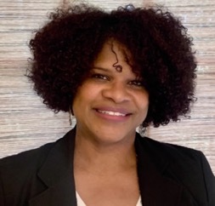
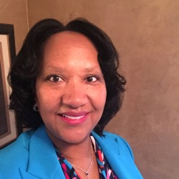
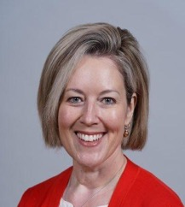
Jefferson County Public Schools
Louisville, Kentucky
Shifting Adult Practice to Improve Student Learning
January 13, 2022
Ms. Sheryl Bibby
Supervisor
Ms. Jennifer Colley
Specialist
Dr. Tara Isaacs
Director
29

Slide 30
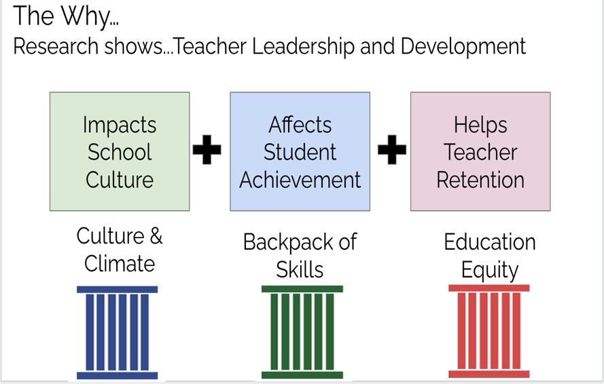
Problem of Practice
How can we shift educator practice to improve student learning?
30
Notes:
JCPS invested in sending three leaders from three departments to the Learning Forward Academy to explore a problem of practice.

Slide 31


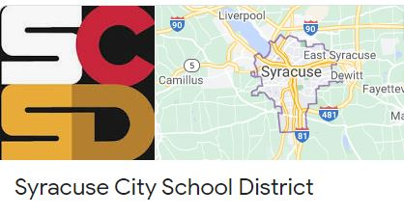
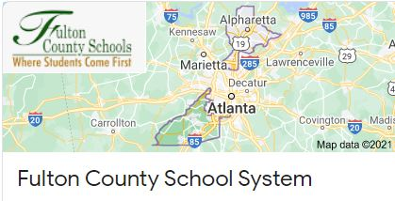
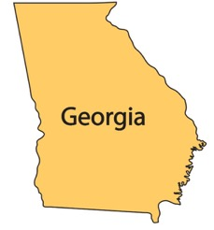
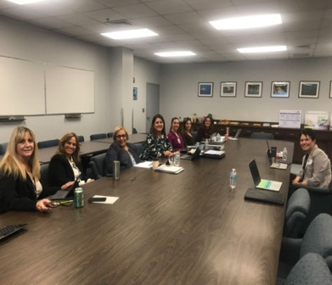
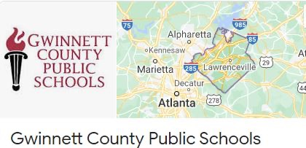
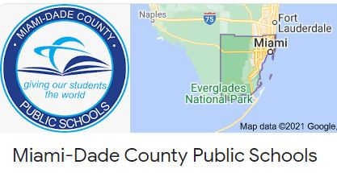

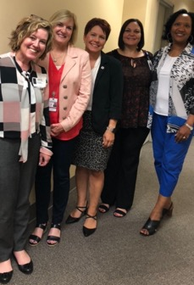

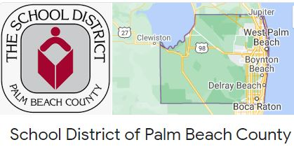

Travel Grant Site Visits
Moved from 87%–96% in 2 years!
31
Notes:
Focused Areas of Support for Teachers: Were able to show district that investment in new and mentor teachers was where to focus.
Jennifer-New teacher support through New Teacher Induction
Sheryl - Coaching
Tara - Retention

Slide 32
ESSR Funds Focus
District Professional Development Plan
Mentoring Academic Instructional Coaches
Teacher Leadership Mentoring Program Expansion
32
Notes:
Explain our focus and plans to move support forward
District is infusing support to teachers at different levels of the profession (i.e. new, coaching, mentoring)

Slide 33
Investment in Future State
33
Notes:
With a focus on Teacher Support, we hope to see in 3 years the following…
Acceleration of work with emphasis on data
Expansion of Tiered support
Improving the teaching profession

Slide 34
Resources
Retaining & Supporting New Teachers
New Teacher Onboarding
New Teacher Induction
New Teacher Survey
New Teacher Networking
School-Based Induction Plan
New Teacher Support Model
District Support Teams Handbook
34

Slide 35

Discussion and
Questions
35

Slide 36
Let us hear from you
Please fill out our
post-webinar
survey
https://www.surveymonkey.de/r/NBZ6229

Slide 37

P R O F E S S I O N A L
S E R V I C E S
Ensure your ARP funds have a long-term impact on teaching and learning
Visit services.learningforward.org/arp/
Systemwide Planning
Set a vision
for equity and excellence
School
Leadership
Support school leaders to meet needs of students and families
Coaching & Mentoring
Ensure
high-quality,
job-embedded teacher support
Learning
Teams
Implement a learning team cycle for continuous improvement
Learning
Networks
Work collaboratively
to build capacity and leadership

Slide 38

Mark your calendars
Thursday, January 20 3 pm ET | Thursday February 10 3 pm ET | Thursday February 24 3 pm ET
Student Voice and Agency | Retaining Educators Through Transition | Communication and Collaboration in a Divided World

Slide 39

Thank you!

