Slide 1

Assessing student
work online
Webinar
February 25, 2021
Welcome! We will begin shortly.
If you can see the
slide and hear the
music, you are all set.
All attendees are muted upon entry.
Please use the chat feature for comments
and the Q&A feature for questions during the webinar.
www.learningforward.org
1

Slide 2

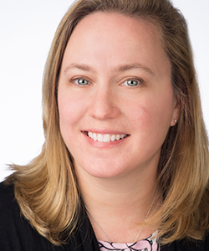
Thank you for joining us
Elizabeth Foster
Vice President Research & Standards
Learning Forward
2
Notes:
PLACEHOLDER

Slide 3

Thank you for joining us
The webinar
will be recorded and available.
All webinar registrants will receive a follow-
up email that
will include the webinar slide deck, recording, and
other resources mentioned during the presentation.
Please introduce yourselves in the chat box
Your name
Your location
Your role in the educational sector
@learningforward

Slide 4
Participants will …
Learn about effective practices for formative assessment in the online environment.
Hear about how practitioners have adapted their student assessments to virtual and hybrid learning.
Discuss the purposes and benefits of assessing student learning during these unprecedented times.

Slide 5
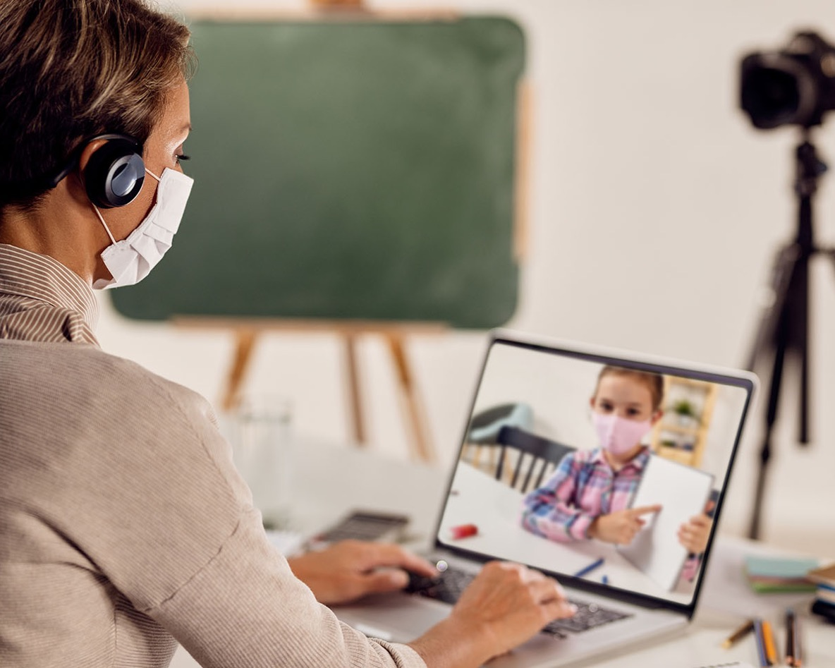


Assessing student work online

Slide 6
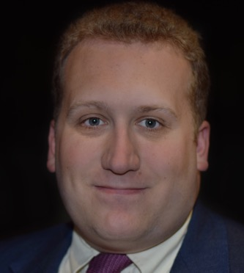
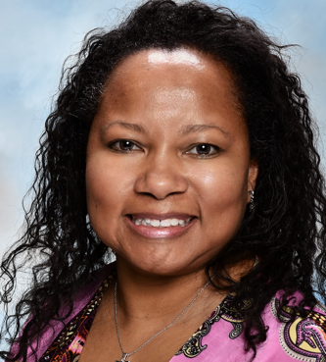
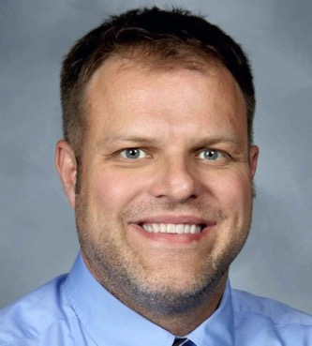
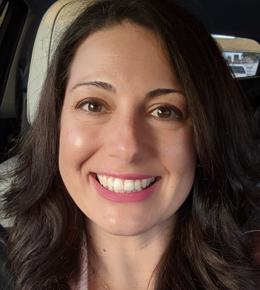
Panel discussion
Chase Nordengren
Senior Research Scientist
NWEA
Portland, OR
Tracey Giardina
Director and Instructor
Justin F. Kimball High School Academy of Engineering
Dallas, TX
Derrick Swistak
Educator and Administrator
Maine Township
High School District 207
Cook County, IL
Melissa Spadin
Director, Systems of Support, Learning and Leadership Division
San Diego County Office of Education
San Diego, CA

Slide 7

Assessment in a Virtual World
Move to project-based instead of traditional assessment
Use of a presentation as evidence of student knowledge
Request Industry Partners’ help with lessons & project
Extremely detailed rubric for each project
Recorded lessons for absent/ESL/SPED students
Add reflection questions as conclusion:
  Soft & technical skills used
  Transferrable aspects of project
  Takeaways

Slide 8
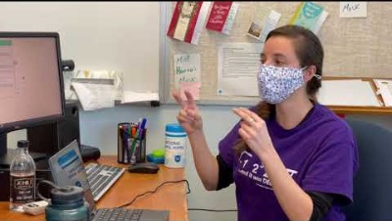
Statement of problem

Slide 9
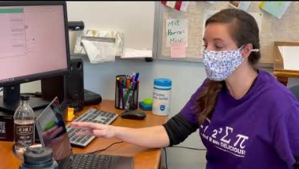
Google Meet

Slide 10
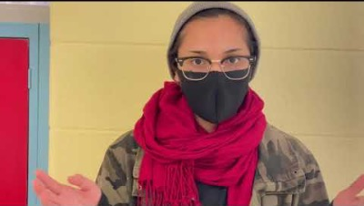
Student Reaction

Slide 11
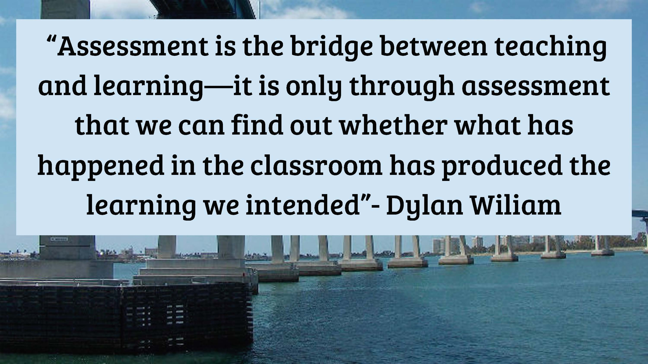

Slide 12
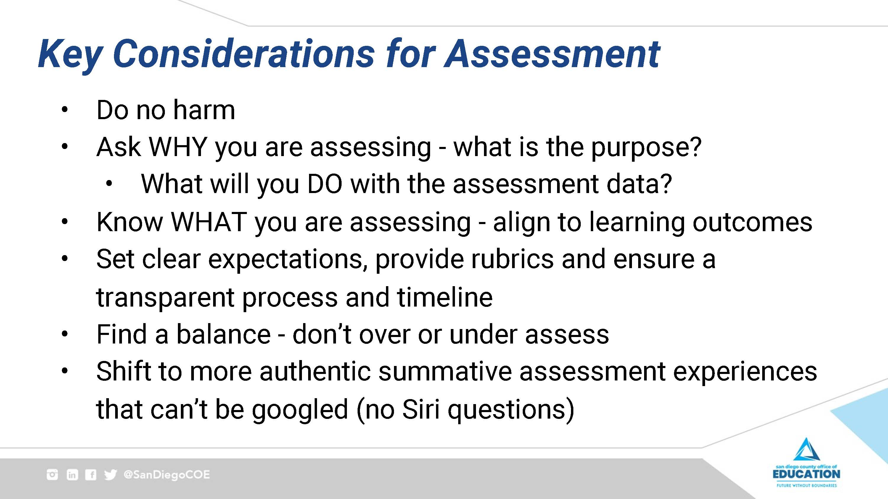

Slide 13
When thinking like an assessor, we ask - | When thinking like an activity designer (only) we ask -
What would be sufficient and revealing evidence of understanding? | What would be fun and interesting activities on this topic?
Given the goals, what performance tasks must anchor the unit and focus the instructional work? | What projects might students do with this topic?
What are the different types of evidence required by the desired results? | What tests should I give, based on the content that I taught?
Against what criteria will we appropriately consider work and assess levels of quality? | How will I give students a grade (and justify it to their parents?)
Did the assessments reveal and distinguish those who really understood from those who only seemed to? Am I clear on the reasons behind learner mistakes? | How well did the activities work? How did students do on the test?
Source: Understanding by Design Chapter 7, Thinking like an Assessor

Slide 14
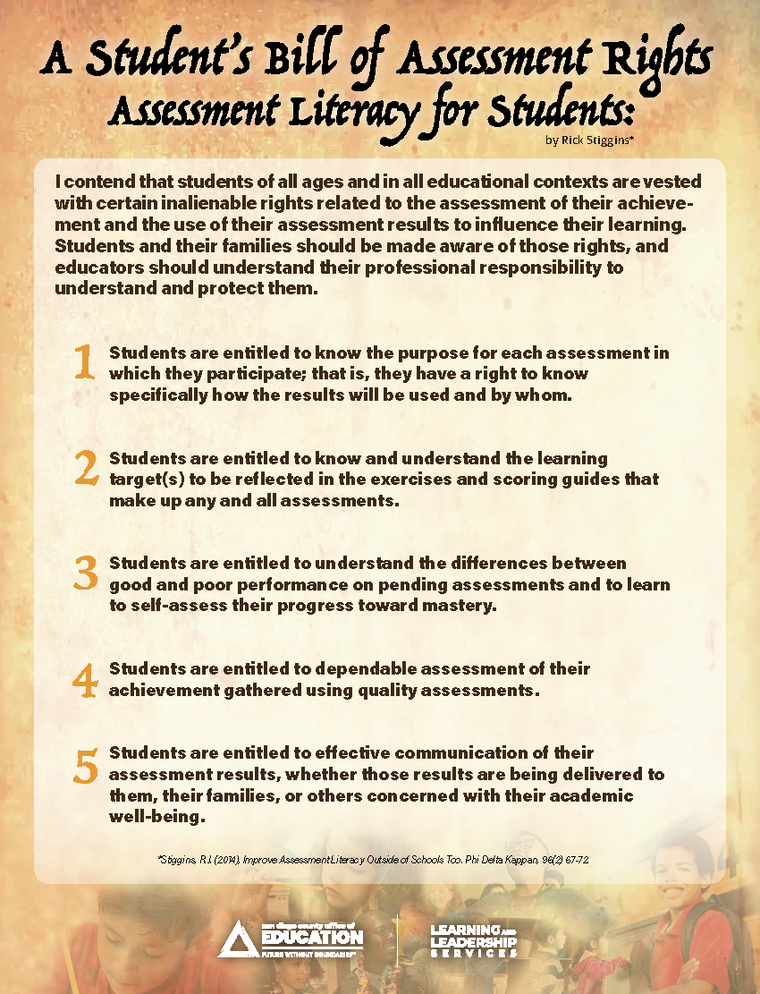
Notes:
Culturally Responsive-Sustaining Assessment Practices

Slide 15
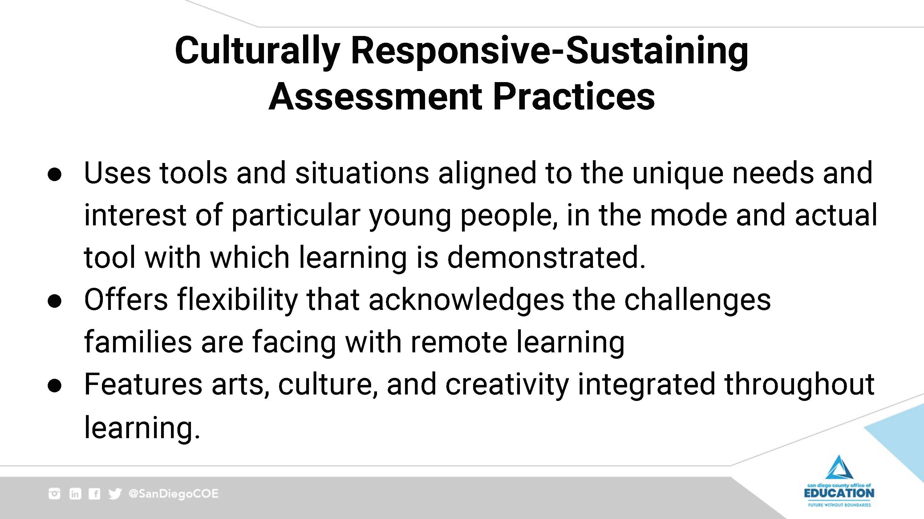

Slide 16
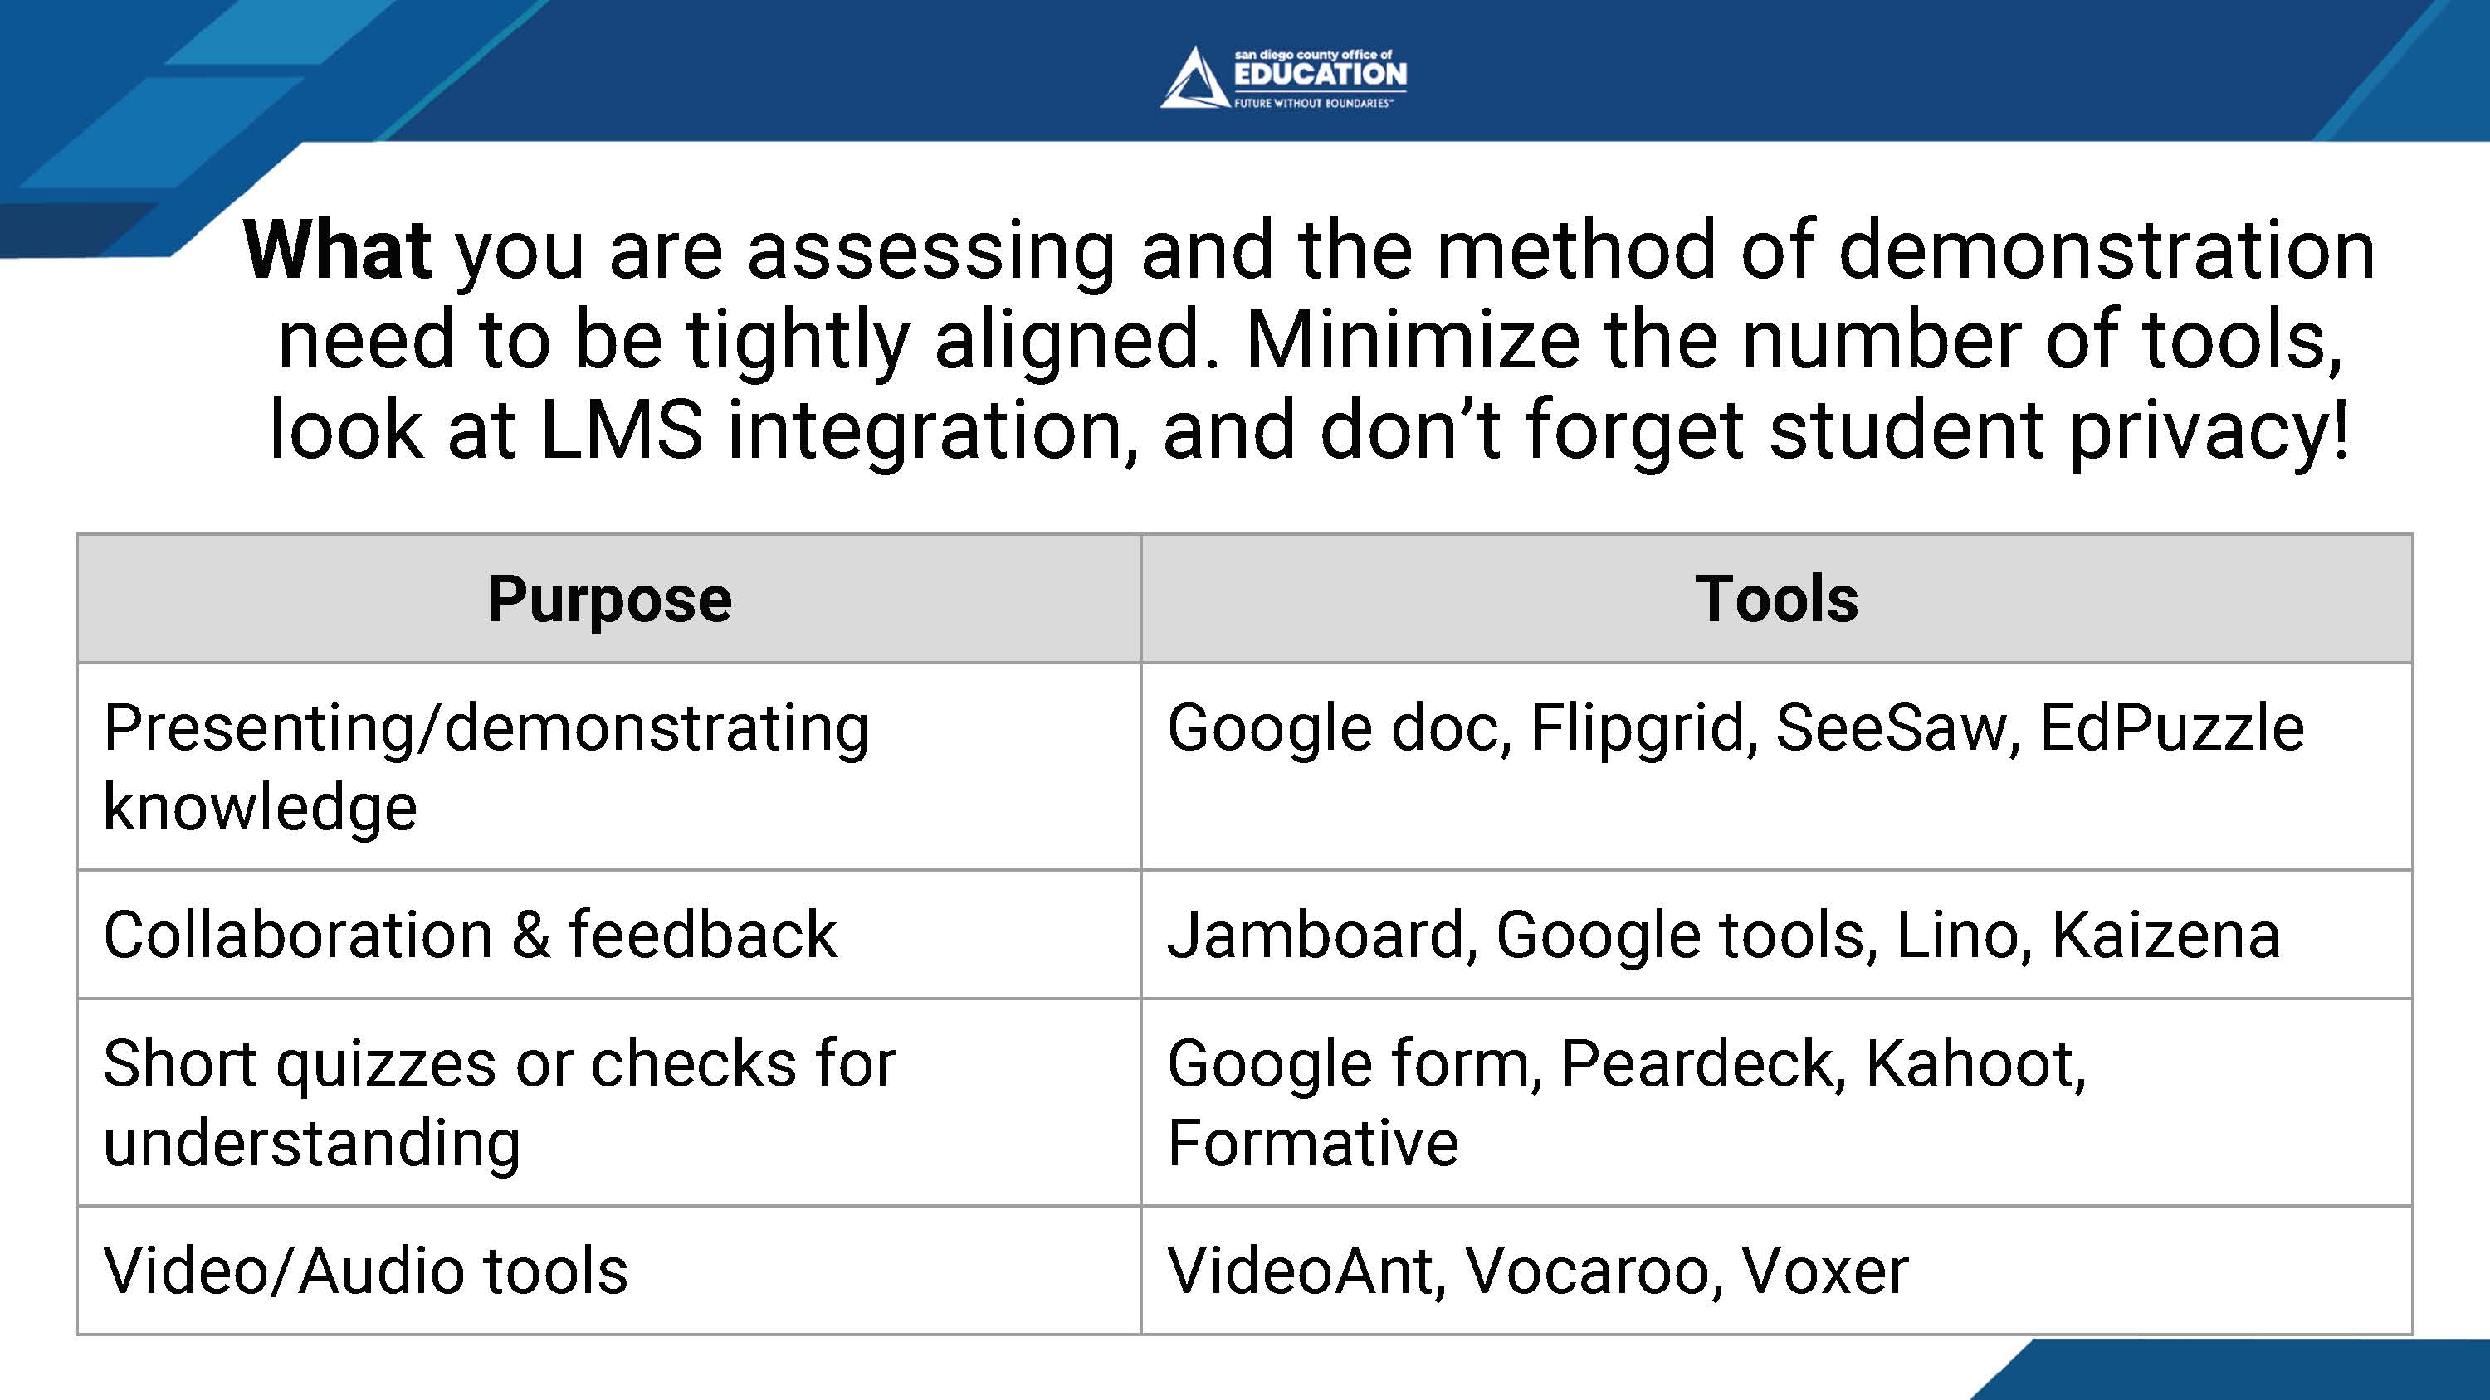

Slide 17
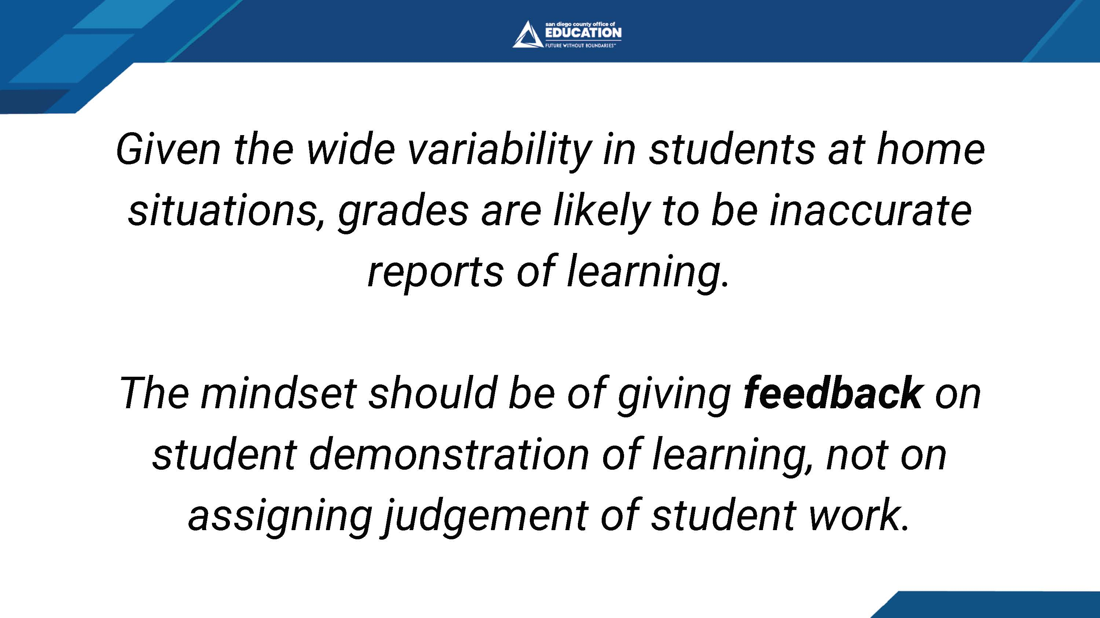

Slide 18
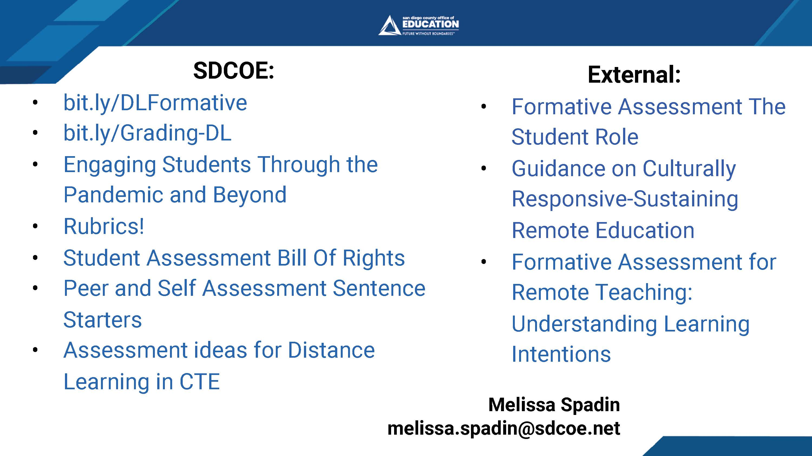

Slide 19

Discussion and
Questions
19

Slide 20

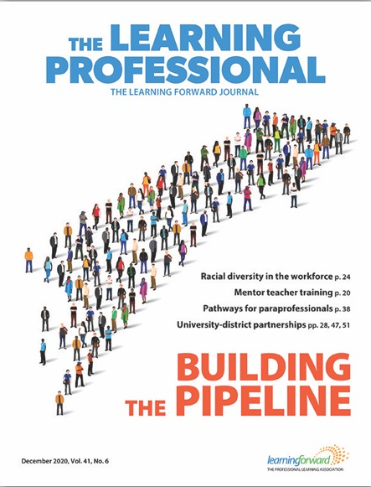

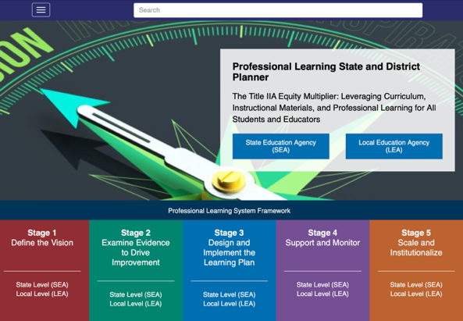
Online resources
Look for follow-up resources, including a recording of this
webinar and slides
Read latest issue of
The Learning Professional
Check out the
Learning Forward blog
Use the planner at
Professional Learning State
and District Planner

Slide 21

Mark your calendars
Thursday March 11 3pm ET
Virtual Leading and Learning in Unique Contexts

Slide 22
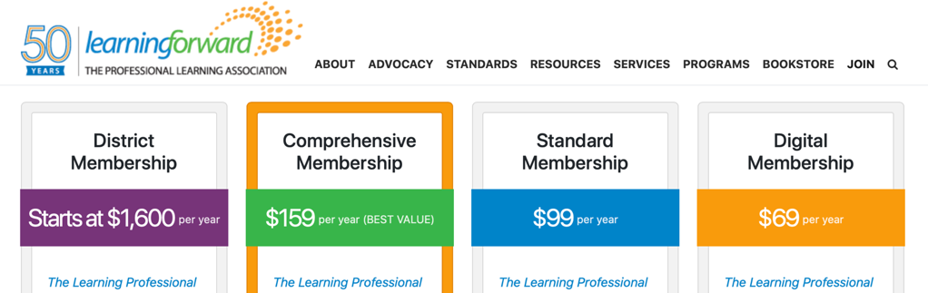
Learning Forward memberships
Get $10 off any new Learning Forward membership
Use coupon code LFWebinars*
Visit http://learningforward.org/membership
* Code valid for new members only

Slide 23

Thank you!

