Slide 1

Introduction to the
Standards for Professional
Learning

Slide 2
Learning objectives
Learners will be able to …
Explain the purpose of the Standards for Professional Learning.
Identify the implications of the prerequisite for professional learning.
Understand the purpose and key components of the Standards for Professional Learning.
Identify the alignment between the cycle of continuous improvement and the professional learning standards.
Identify actions to take to improve professional learning within the school or district.
2

Slide 3
Agenda
3

Slide 4
Agreements
Be open to defining professional learning in new ways.
Participate actively.
Take responsibility for your own learning.
Honor your colleagues’ learning needs.
4

Slide 5
vs.
Professional
learning
Professional development
5

Slide 6

All professional learning is not created equal.
6

Slide 7
Why do we need standards for professional learning?
Silently read Handout 2.1.
As a table team, chart the similarities and differences between the two scenarios.
At your table, predict which professional learning scenario will result in a higher level of implementation. Explain why.
7

Slide 8
Relationship between professional learning and student results
In teams of four, review Handout 2.2.
2. Discuss how might you explain these ideas to others.
3. Use a metaphor describe the relationship.
8

Slide 9
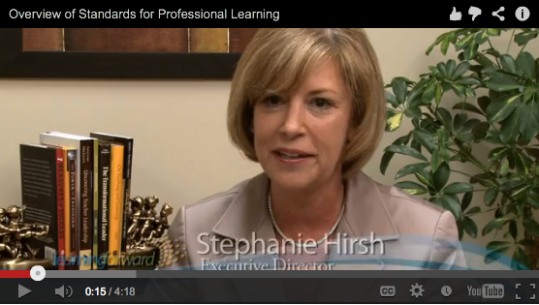
Introduction to the standards
Watch the video.
Use Handout 2.3 as you watch.
At your table, discuss your responses to the questions on the viewing guide.
http://learningforward.org/video-test#.USfvYoU25mN
9

Slide 10
Standards card sort
Use the task directions and materials at your table to complete the card sort.
Make observations about the results of your card sort.
Check your work and discuss variations.
10

Slide 11
Standard for
Professional Learning
Read the standard your table group has been given.
Highlight key elements of the rationale.
Create a windowpane chart using Handout 4.2 as a guide.
Designate a spokesperson to give a 3-minute presentation on the standard to the whole group.
Use Handout 4.3 to take notes on others’ presentations.
11

Slide 12
Reflection
Use Handout 4.4 to reflect on what you learned about the standards for professional learning.
Find a partner and exchange responses from one box.
Rotate to a new partner and exchange responses to a different box.
Meet with two additional partners to share responses from each of the remaining boxes.
12

Slide 13
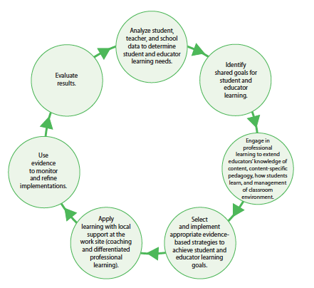
Cycle of continuous improvement
13

Slide 14
Self-assessment and next steps
Complete Handout 6.1 on your own.
Work with a partner to generate possible next steps to improve professional learning so that
it increases educator effectiveness and student learning.
Record your next steps in Handout 6.2.
14

Slide 15
Final reflection
Use Handout 7.1 to stop and reflect.
At your table, share one thing you wrote.
15

