Slide 1

Learning
Designs

Slide 2
Learning objectives
Learners will be able to …
Provide a rationale for using multiple learning designs.
Identify at least five to seven learning designs appropriate for one of their professional learning goals.
Draft a professional learning plan using a variety of learning designs.
2

Slide 3
Agenda
3

Slide 4
Agreements
Be open to learning new strategies.
Participate actively.
Take responsibility for your own learning.
Honor your colleagues’ learning needs.
Think about how you might use these resources to develop professional learning.
4

Slide 5
Self-assessment
Complete the self-assessment independently.
Pair off at your table.
Discuss your results with your partner.
Formulate a summary statement about your collaborative professional learning in your school or district based on your results.
5

Slide 6
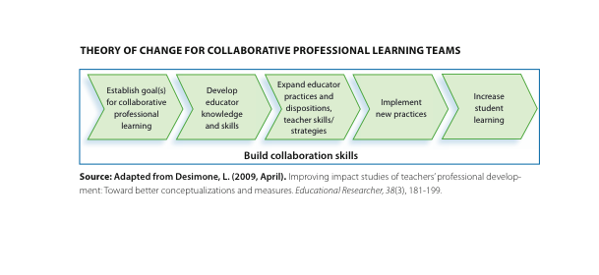
Multiple designs
What learning designs have you found effective
for:
Building knowledge?
Developing skills?
Supporting implementation?
6

Slide 7
Jigsaw on learning designs
Purpose: To learn different learning designs and
their purposes, including several processes or
protocols that could be used in a learning team.
Form groups of four to five people.
2. Divide the cards among team members.
3. Read your card and prepare to explain the
learning design to others in your group.
4. Use the handout to take notes.
7

Slide 8
Learning designs scenarios
Read the scenarios on Handout 4.1.
Highlight the professional learning designs in each scenario.
Record the professional learning designs on the note-taking guide.
Use the theory of change to identify which learning designs might be appropriate for each stage of the theory.
8

Slide 9
Types of learning designs
Form triads.
Read your assigned scenario.
Generate possible learning designs appropriate for your scenario and explain your rationale for proposing these designs.
Be prepared to share your learning design and rationale.
9

Slide 10
Reflection on scenarios
What did you learn about using multiple learning designs to support educator learning and implementation?
What activities surprised you?
What activities intrigued you?
What would your school need to learn, do, or change in order to use these professional learning strategies?
10

Slide 11
Culminating activity
11

Slide 12
Culminating activity
12

Slide 13
Gallery walk
Designate one person in your group to stay with the group’s chart and answer any questions.
In your gallery walk, look for designs you did not use in your own plan.
Consider whether plans attend to each stage of the theory of change (building knowledge, developing skills, supporting implementation).
13

Slide 14
What did you learn?
3 Write 3 big ideas that you learned about learning designs.
2 Write 2 points to ponder about how to
apply this information to your setting.
1 Write 1 point you don’t want to forget
about learning designs.
14

