Slide 1

Sample professional learning pie charts from

Slide 2
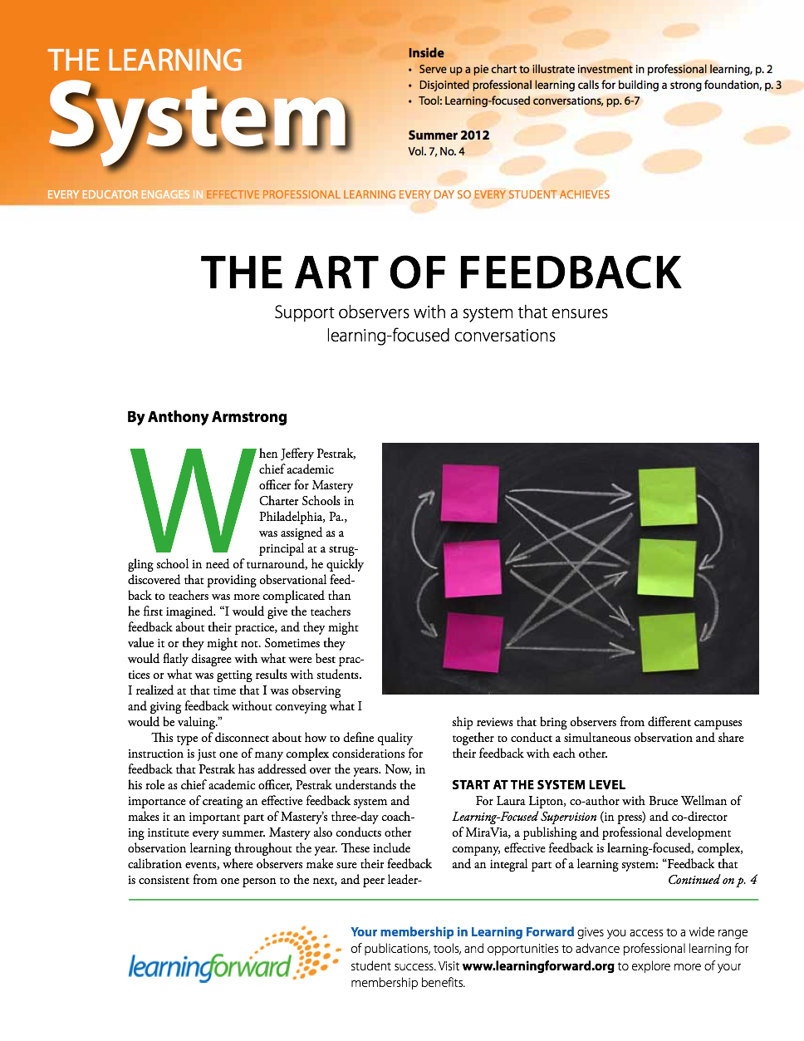
Download the original article
This digital tool is based on Serve up a pie chart to illustrate investment in professional learning by Hayes Mizell.
Read the full article, published in
The Learning System (Summer, 2012).
Available at www.learningforward.org

Slide 3
Instructions
Use these sample pie charts to enable non-experts (whether educators, policymakers, taxpayers, or other stakeholders) to quickly understand the different proportions that constitute the whole of your professional learning.
To edit the data for each chart, simply right-click the chart and select “Edit data.”
You can then copy and paste each chart into your own documents or presentation slides.

Slide 4
Funding Sources
Use these charts to help understand the sources of funding and how those funds are allocated.

Slide 5
Funding Sources
Notes:
Identify major sources of funding for all school system-sponsored professional learning, and the total amount derived from each source.
*To edit the data for each chart, simply right-click the chart and select “Edit data."

Slide 6
Funding Expenditures
Notes:
Based on the school system’s total expenditures for all professional learning during the past year, what was the aggregate allocation for each major type of learning experience?
*To edit the data for each chart, simply right-click the chart and select “Edit data.”

Slide 7
Time and Venues
Professional learning time and venues are important variables in the effectiveness of professional learning. Use this information to monitor the adequacy of time for professional learning and make informed judgments about how time is used.

Slide 8
Type of venue
Notes:
Among all school system-sponsored professional learning during the past year, what proportion occurred at each type of venue (school, central office, professional development center, regional service center, out-of-district, out-of-state, etc.)?
Data produced by posing these or related questions could yield helpful information that helps improve the quality and effectiveness of professional learning.
*To edit the data for each chart, simply right-click the chart and select “Edit data.”

Slide 9
Time of Day
Notes:
What portion of professional learning occurred during the school day or contract year and what occurred outside those parameters?
*To edit the data for each chart, simply right-click the chart and select “Edit data.”

Slide 10
Length of Focus
Notes:
Professional learning in extended blocks of time, focused on a single area is associated with increases in student achievement.
Among those participating in school system-sponsored professional learning during the past year, what proportion participated in professional learning focused on a specific area of development for up to eight hours, nine to 20 hours, 21 to 40 hours, 41 to 60 hours, and more than 60 hours?
*To edit the data for each chart, simply right-click the chart and select “Edit data.”

Slide 11
Identify who participates
Participation data provides valuable insights about the equitable allocation of professional learning resources, alignment of those resources with school and school system priorities, access to professional learning, and relevance of content.

Slide 12
School participation
Do the schools with the biggest expenditures reflect the places of greatest student achievement challenges and needs?
Notes:
*To edit the data for each chart, simply right-click the chart and select “Edit data.”

Slide 13
Attendees by grade
What degree does this participation reflect the district’s areas of need and align with the district’s priorities for improvement?
Notes:
*To edit the data for each chart, simply right-click the chart and select “Edit data.”

Slide 14
Attendees by School
What degree does this participation reflect the district’s areas of need and align with the district’s priorities for improvement?
Notes:
*To edit the data for each chart, simply right-click the chart and select “Edit data.”

Slide 15
Attendees by Subject
What degree does this participation reflect the district’s areas of need and align with the district’s priorities for improvement?
Notes:
*To edit the data for each chart, simply right-click the chart and select “Edit data.”

Slide 16
Attendees by level of experience
What degree does this participation reflect the district’s areas of need and align with the district’s priorities for improvement?
Notes:
*To edit the data for each chart, simply right-click the chart and select “Edit data.”

Slide 17
Designs for professional learning
Understanding how learning occurs and using that information in combination with what results occur will allow leaders of professional learning to adjust designs to increase engagement and results.

Slide 18
Design options
Notes:
What percentage of professional learning occurs in workshops, online courses, coaching, peer collaboration, lesson study, etc.?
*To edit the data for each chart, simply right-click the chart and select “Edit data.”

Slide 19
Results by Design
Notes:
What percentage of participants report that each design is highly effective in changing their practice?
*To edit the data for each chart, simply right-click the chart and select “Edit data.”

Slide 20
Download the original article
This digital tool is based on Serve up a pie chart to illustrate investment in professional learning by Hayes Mizell.
Read the full article, published in
The Learning System (Summer, 2012).
Available at www.learningforward.org

Slide 21
Learn more with
Learning Forward
To learn more about professional learning at all levels of education, visit Learning Forward, an international membership association of learning educators: www.learningforward.org
Membership in Learning Forward gives you access to a wide range of publications, tools, and opportunities to advance professional learning for student success.

